Slide 1
Virginia State University
Urban Agriculture Certification Program
Module 13a
Backyard Rabbit
Dahlia O’Brien, PhD.
Some information adapted from Niki Whitley, Fort Valley State University, Cooperative Extension
© 2022 All material and content is intellectual property of VSU
College of Agriculture. Do not duplicate or otherwise utilize without
written permission from VSU Urban Agriculture Certification Program.

Slide 2
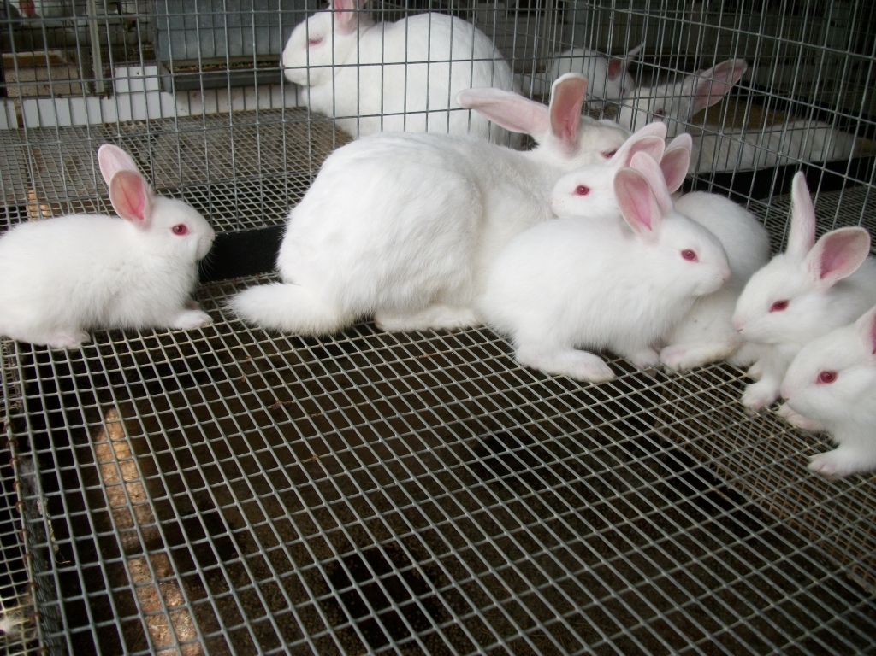
Todays Topics
13a.1 U.S. Rabbit production
13a.2 Terminology
13a.3 Determining zoning codes for keeping animals in urban areas
13a.4 Benefits of backyard rabbit production
13a.5 Rabbit breed selection
13a.6 Housing
13a.7 Rabbit reproduction
13a.8 Feed and nutritional requirements
13a.9 Health
13a.10 Marketing
13a.11 Management and budget

Slide 3
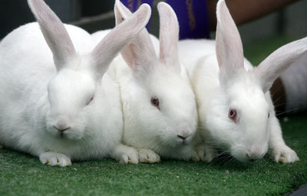
13a.1 US rabbit production
Lagamorphs (two pair long, constantly growing teeth) – includes rabbits, hares and pikas
Hares and wild rabbits cannot interbreed with domestic rabbits
USDA NASS Census (2017);
  Number of farms with rabbits – 4,186
  Inventory – 495,707
2.5 million households with rabbits in 2012
(www.rabbits.org)

Slide 4
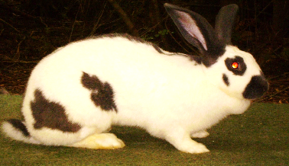
13a.1 US rabbit production
ARBA - American Rabbit Breeders Association (www.arba.net)
  Started in 1910
  23,000 members
  Authority on rabbit industry
  Recognizes 49 breeds
Slide from presentation by Dr. Niki Whitley

Slide 5
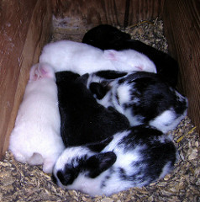
13a.2 Terminology
Buck - a male rabbit
Doe - a female rabbit
Kit - a baby rabbit
Kindle - the act of giving birth
Litter - young rabbits (kits) being raised by one doe
Fryers/young rabbit
  Rabbit carcass weighing 1 ½ - 3 ½ lbs.
  Less than 12 weeks of age
Stewer/roaster
  Mature rabbit of any weight (usually > 4 lbs.)
  6 months of age or older
Slide from presentation by Dr. Niki Whitley

Slide 6
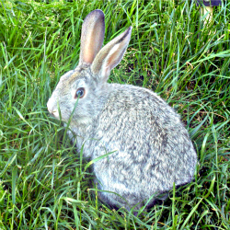
13a.3 Determining zoning codes for keeping animals in urban areas
https://www.municode.com/library/va
Check all local ordinances, and property association laws.

Slide 7
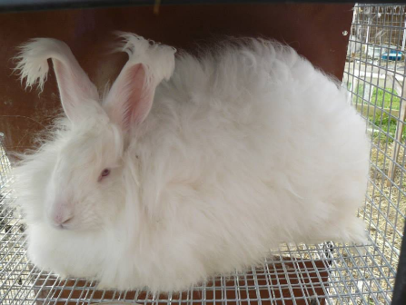
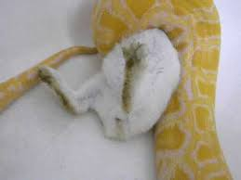
13a.4 Benefits of backyard rabbit production
Meat
Fur (pelts)
Laboratory
Hobby
Pets
Pet food
Show
Manure
Photos from internet sources
Slide from presentation by Dr. Niki Whitley

Slide 8
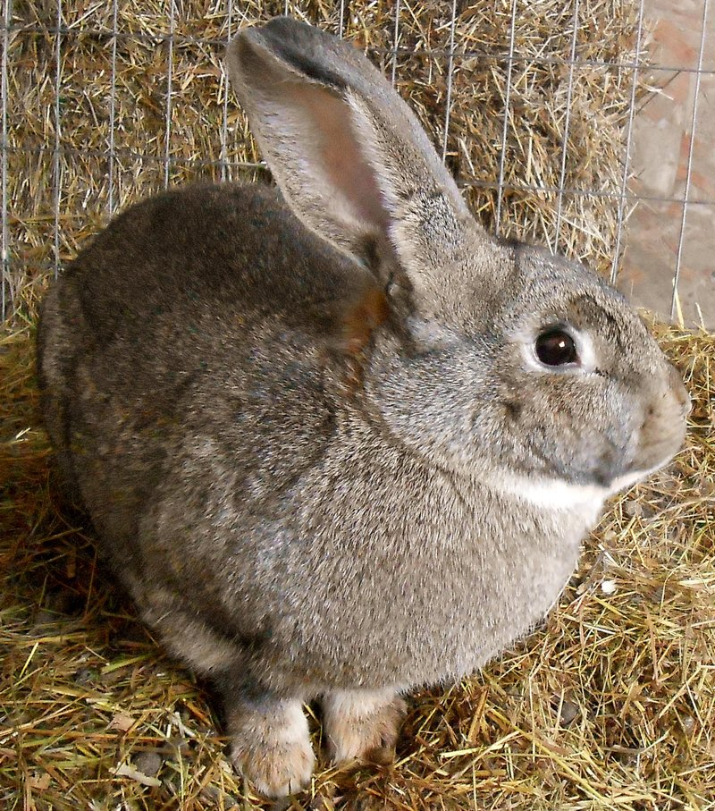
13a.4 Benefits of backyard rabbit production
Rabbits are quiet and small
Do not require large equipment and lots of land
Litters are large with short generation intervals
They are efficient at extracting protein from forage
Educational experiences for youth
Fun

Slide 9
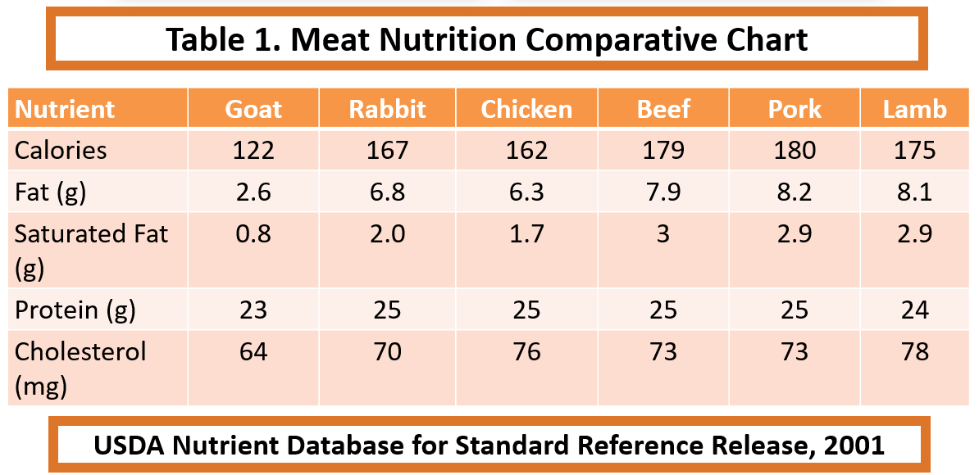
13a.4 Benefits of backyard rabbit production
Nutritious meat (low fat, calorie, cholesterol and high protein)
Potential income
  Demand for healthy, low-fat, novel and locally produced food has led to resurgence in rabbit meat
  Organic market is untapped
Manure for gardening or flower beds

Slide 10
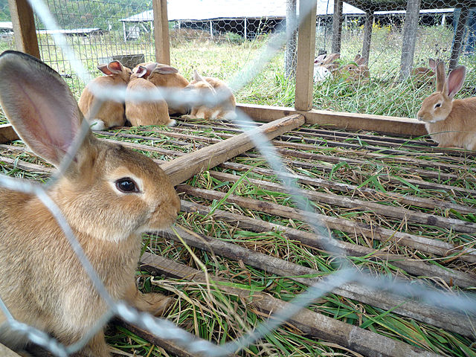
13a.4 Benefits of backyard rabbit production
Raising rabbits is a labor-intensive endeavor
  Very small industry (mostly pets/hobby)
  Few approved drugs
  Not widely consumed meat

Slide 11
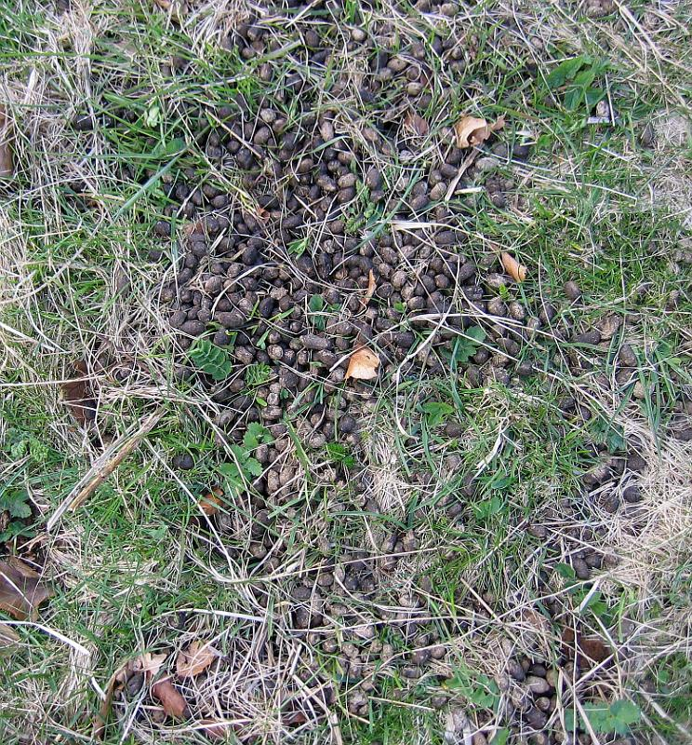
13a.4 Benefits of backyard rabbit production
“Bunny berries” or “Bunny honey”
Production (10 lb. doe)
  0.31 lbs./day (feces and urine)
  0.056 ton/year
Four times more nutrients than cow or horse manure
Higher in nitrogen and phosphorus
Twice as rich as chicken manure
Doesn’t need composting
Not as smelly
Worms can be raised in the rabbit manure to produce fishing bait and worm castings

Slide 12
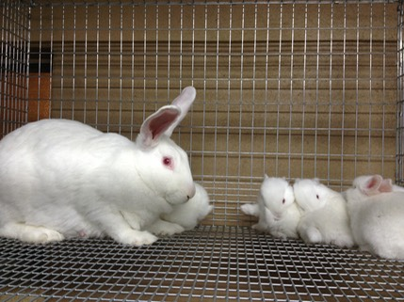
13a.5 Rabbit breed selection
  Rabbits are generally classified according to:
  Size
  Weight
  Type of pelt
  Small rabbits weigh 2 to 5 pounds at maturity
  Medium breeds weigh 5 to 8 pounds
  Large breeds weigh an average of 8 to 12 pounds

Slide 13
13a.5 Rabbit breed selection
Breeds | Size | Use | Mature Weight (lbs)
Angora | medium | wool; meat | 9-12
American Chinchilla | medium | fur | 9-12
Californian | medium | meat | 8-11
Champagne d'Argent | medium | meat | 9-12
Checkered Giants | large | fur | 11+
Dutch | small | lab | 3-6
English Spot | medium | meat; lab | 9-13
Flemish Giants | large | meat | 13+
Himalayan | small | lab | 2-6
New Zealand | medium | meat | 9-12
Polish | small | lab | 3-4
Rex | medium | fur | 8-11
Silver Martens | medium | fur | 6-10
Heritage/rare breeds - https://livestockconservancy.org/index.php/heritage/internal/conservation-priority-list#Rabbits

Slide 14
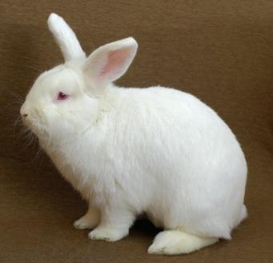
13a.5 Rabbit breed selection - meat
The most popular breeds for meat production include New Zealand and Californian rabbits (cross = smut)
They have a higher meat-to-bone ratio but low feed efficiency
Also very popular because their fur is mostly white
  Processors prefer as dark hair shows up on light-colored meat
The New Zealand White is considered the best breed
  Good mothering ability and carcass characteristics
Californian
(Himalayan x Chinchilla x New Zealand)
Medium size, 9-11 lbs.
New Zealand
(white, red, black and broken)
Medium size, 10-12 lbs.

Slide 15
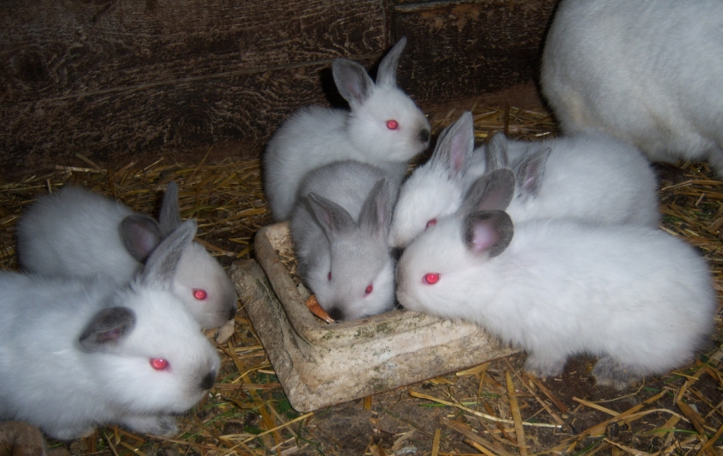
13a.5 Rabbit breed selection- meat
Cross-breeding will result in hybrid vigor
  Increase in desired characteristics in crossbred/hybrid offspring over parents
Breed male Californians to female New Zealand White
  Breeding the female from this cross back to male Californians
  Results in larger litter sizes and heavier carcasses

Slide 16
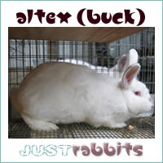
13a.5 Rabbit breed selection - meat
Altex (hybrid breed developed from crosses of Flemish Giant, Champagne d’Argent, and Californian)
Breed was developed by Alabama and Texas A&M for commercial viability
  More heat-tolerant
  Gains weight quicker than other breeds—reaching up to 10 to 20 lbs.
  For more information, visit http://users.tamuk.edu/kfsdl00/rabb.html

Slide 17
13a.5 Rabbit breed selection - wool
Types of Angora rabbits (four ARBA):
  English (5–7.5 lbs.); French (7.5–10.5 lbs.); Satin (6.5-9.5 lbs.); Giant (10 lbs. and up); German (7-11.5 lbs.; produces up to 2.5 lbs. wool/year)
Harvesting the fiber
  Pluck during molt (not Giants/Germans) or every 10-11 weeks; shear (with scissors) every 10-11 weeks
  Average of 15 ounces/year ($8.50-$15/ounce on Etsy)
More at: www.thespruce.com/angora-rabbit-breed-profiles-1835793
Slide from presentation by Dr. Niki Whitley

Slide 18
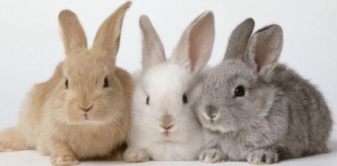
13a.5 Rabbit breed selection - other
Any breed for show, pets, hobby; 49 ARBA
Dwarf breeds – popular as pets; 25% may inherit lethal gene
  Netherland Dwarf (many colors) 1.75–2.5 lbs., very popular; Dwarf Hotot (White with black around its eyes) 2-3 lbs.; Jersey Wooley (many colors; wool) 2–3.5 lbs.; Polish (many colors) 2–3.5 lbs.; Britannia Petite (multiple colors) 1.5–2.5 lbs.;
Info: www.debmark.com/rabbits/basics.htm
Pic: People.com; Peoplepets
Slide from presentation by Dr. Niki Whitley

Slide 19
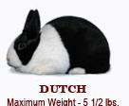
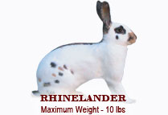
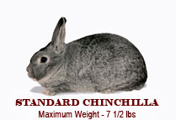
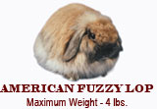
13a.5 Rabbit breed selection - other
Small breeds - American Fuzzy Lop; Dutch; Himalayan; Holland Lop; Mini Rex
Medium breeds –American Sable, Belgian Hare, Standard Chinchilla, English Spot, Florida White, Harlequin, Havana, Lilac, Mini Lop, Rhinelander, Silver/Marten, Tan
Info: www.debmark.com/rabbits/basics.htm
Pics: www.arba.net
Slide from presentation by Dr. Niki Whitley

Slide 20
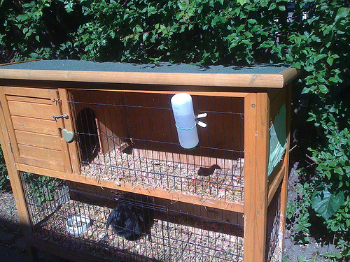
13a.6 Housing
Housing should provide the following:
  Comfort
  Protection from predators
  Prevention from escape
  Protection from extreme weather
  Easy access
  Easy to clean
  Affordable to build and maintain

Slide 21
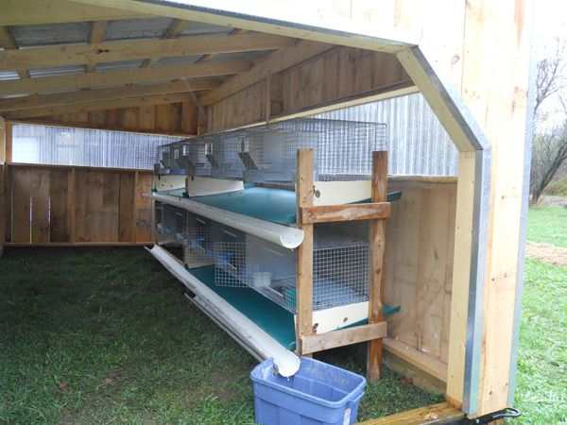
13a.6 Housing
Outdoors
Shed or outbuilding in your backyard as long as they are in a dry and draft free environment
Simple pole barn with drop down sides
Ventilation is important in reducing ammonia buildup and the incidence of disease and other health-related problems
Rabbit Housing: Hutches, Cages, Wires by James McNitt
  http://www.suagcenter.com/Images/Interior/sustainableag/animals/rabbit%20production/rabbit%20housing%20manual.pdf

Slide 22

13a.6 Housing
Polyface Farm (Joel Salatin) developed a mixed rabbitry and chicken coop
Rabbits are suspended above the chickens
  Manure is processed by the chickens
  Hens get whatever nutrients are left over
  Prevents ammonia build up
Mobile hutch that acts similar to a chicken tractor
www.polyfacefarms.com

Slide 23
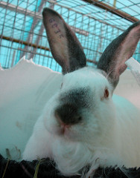
13a.6 Housing - equipment
Feeders
Watering
Nest boxes
Resting mats
Animal identification
Record keeping
Carrying cages
Slide from presentation by Dr. Niki Whitley

Slide 24
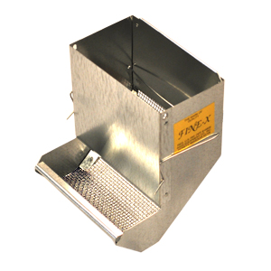
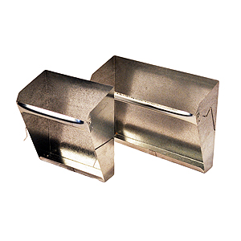
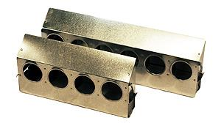
13a.6 Housing - equipment
Pellets: Self feeders (hoppers; screen), creep feeders, unbreakable vinyl bowls, ceramic crocks, pans, dishes, cups
Hay: Hanging feeders, hoppers, on top/side of pen
Other: Storage container for feed, feed scoop
Fine-X©
Hay
Creep
Pics: www.bassequipment.com
Slide from presentation by Dr. Niki Whitley

Slide 25
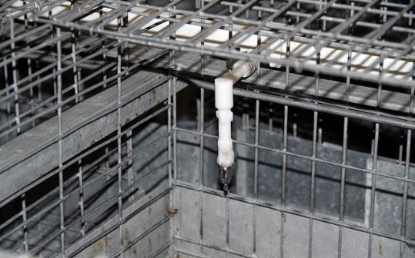
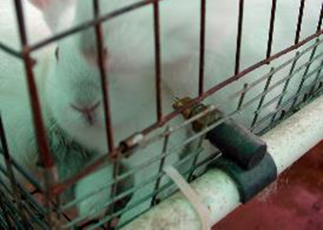
13a.6 Housing - equipment
Automatic waterers
    Gravity fed
    Tubes (rigid or flexible); can use heat tape
Manual waterers
    Unbreakable bowls, dishes, crocks (not recommended)
    Water Bottle
Slide from presentation by Dr. Niki Whitley

Slide 26
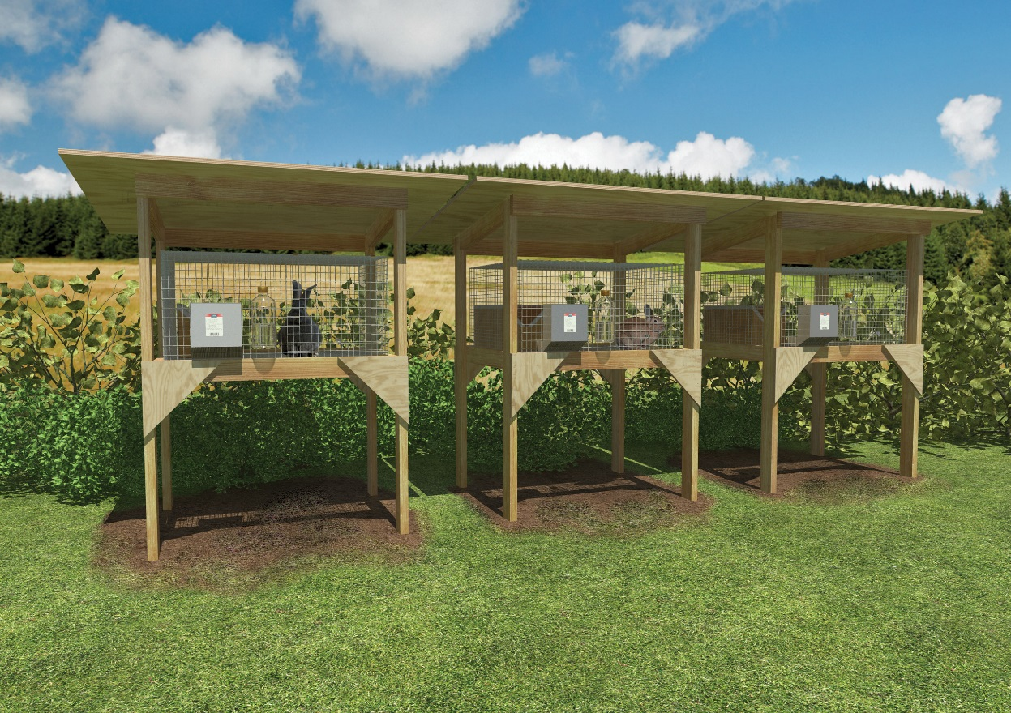
13a.6 Housing - cages
Cages are a necessity
Rabbits are territorial
  Crowded conditions may cause aggression
  Each rabbit must be kept in a separate cage
Cages can be purchased individually or in sets (3 to 6 cages)
Kept off the ground
  Easy access to clean under cages
.

Slide 27
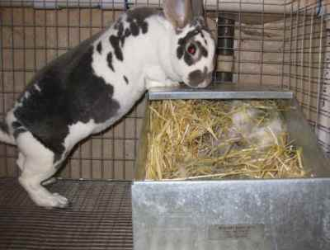
13a.6 Housing - cages
Sizes vary depending on size of the rabbits
Cage size for medium sized meat breeds are 24″W x 36″L x 18″H
Cages for bucks or young replacement breeding stock should be - 24″W x 24″L x 18″H or a 24″W x 30″L x 18″H
Larger size allows for a nesting box
  30″W x 36″L x 18″H
  Need enough space for a doe and her litter
  Allows doe to kindle (give birth) and houses young rabbits until they are weaned
  ½ x 2 in. wire on sides (baby saver wire, urine guards)
  ½ x 1 in. wire on floors
  NO solid floors
  (adapted from Dr. Whitley)

Slide 28
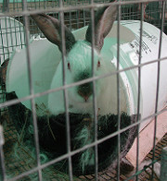
13a.6 Housing - equipment
Nest Box
  Size depends upon size of rabbit, e.g. 16 x 10 x 8 in.
  Made from metal, wire, wood, plastic (chewed)
  Purchased or homemade
  With or without lid
  Inside or outside cage
  On cage floor or below
  Bed with hay or straw
  Insulate in winter

Slide 29
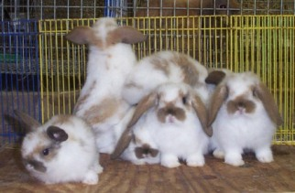
13a.7 Rabbit Reproduction
Most meat size rabbits are ready to breed between 5 to 8 months of age
  Young bucks attempt to breed as early as 3 months
  Not advisable to breed does too young or too old
    Litter will be small and could stunt the doe’s growth
    Harder to breed the first time if too old

Slide 30
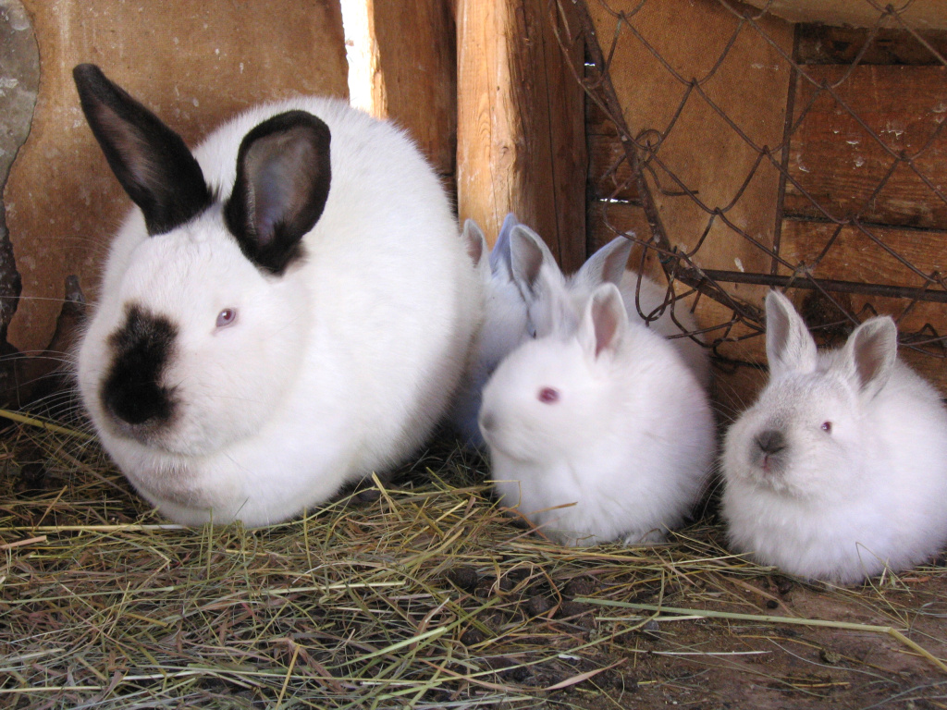
13a.7 Rabbit Reproduction
A female is ready to breed when her vulva is moist and bright pink to a reddish color
Rabbits are induced ovulators
  Meaning ovulation does not occur until the actual mating by the buck
When mating, take the doe to the bucks cage
  Bucks are very territorial and might get aggressive towards the doe
  Should mate after 1 minute
  Don’t leave in too long
A ratio of one buck for every 10 – 15 does is recommended

Slide 31
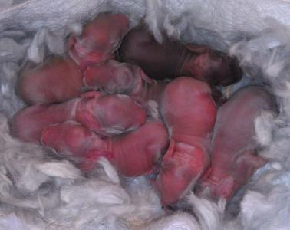
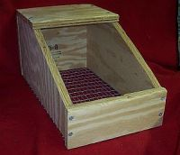
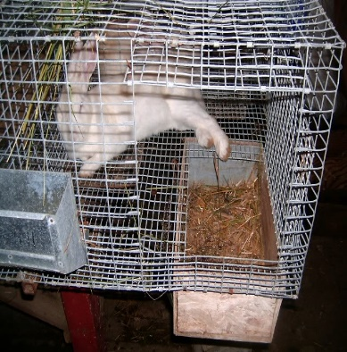
13a.7 Rabbit Reproduction
Palpating the doe’s abdomen 10 to 14 days after breeding can determine pregnancy (YouTube videos)
  The embryos are round and feel like grapes
Gestation period - 31 to 32 days
The nest box should be put in the does cage on day 27 from breeding
  Wood shavings or bedding and the doe’s fur
  Nest boxes should be cleaned and disinfected after use
Rebreeding can be done within 14-45 days
  4 – 8 litters/year
  1 – 14 kits (average 8)

Slide 32
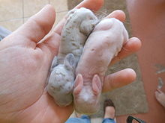
13a.7 Rabbit Reproduction
Accelerated systems rebreed one to seven days after kindling for maximum production
  11 litters per year
  Requires top nutrition and management
  Rest after 3/4 consecutive
Young are born naked and blind
  Eyes open in 2 weeks
  Start to leave nest box in 3 weeks
  Weaning usually 4 – 8 weeks

Slide 33
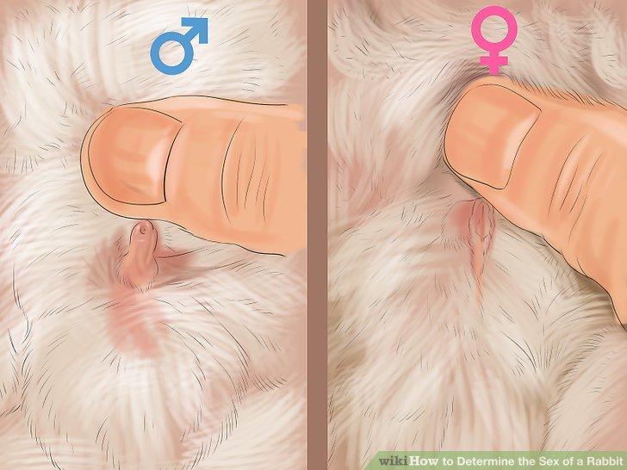
13a.7 Rabbit Reproduction
Determine sex
  Use thumb to depressing the external genitalia
    Slit-like vulva in females
    Penis in males
Adapted from online
https://www.youtube.com/watch?v=SyHoi5PJcIQ

Slide 34
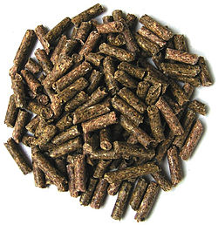
13a.8 Feeding and nutritional requirements of rabbits
Rabbits eat only plants and are classified as non-ruminant herbivores
Hind-gut fermenters
  Use cellulose and other fermentable plant material
  They only have a single stomach compartment
  Fermentation and digestion of cellulose primarily occurs in the large intestine and cecum

Slide 35
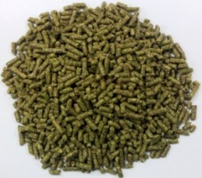
13a.8 Feeding and nutritional requirements of rabbits
All animals require six nutrient types: water, proteins, fats, carbohydrates, vitamins, and minerals
Protein requirements increase during times of growth, pregnancy, or lactation (milk production)
Protein needs are lowest for adults at maintenance
  Excess protein can cause a rabbit's kidneys to overwork

Slide 36
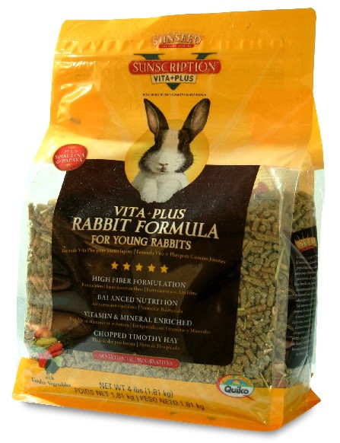
13a.8 Feeding and nutritional requirements of rabbits
Rabbit feed can be found at most feed stores
  Use feed specially formulated for rabbits is recommended
Can also be supplemented with hay, steam-rolled oats and barley, and black oil sunflower seed
Fresh greens and succulents
  Fresh legumes (alfalfa, clover), grasses, vegetables (lettuce, celery), roots and tubers (carrots, potatoes), weeds (dandelions), and comfrey
Since fresh greens are about 80% to 90% water, it is difficult to raise rabbits solely on them
  Not nutrient-dense
  May cause indigestion
Feed by weight (oz.), not volume (cups)

Slide 37
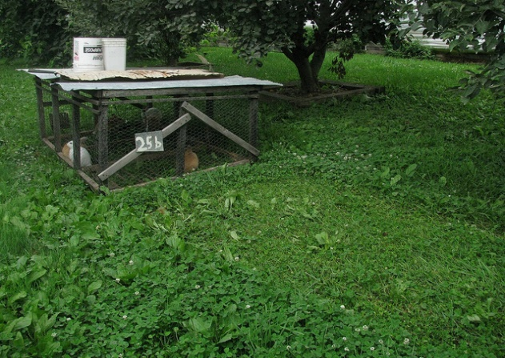
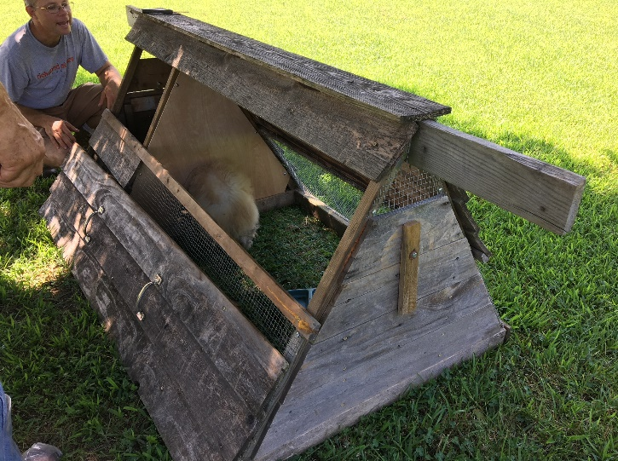
13a.8 Feeding and nutritional requirements of rabbits
Can be pastured in outdoor pens placed on the ground
  To harvest their own fresh forage
Can be kept in outdoor pens with slats or chicken wire on the floor
  To prevent the rabbits from digging out of the pen
Rabbits are fed concentrate feed and pens are moved daily to fresh pasture
  To prevent the spread of coccidiosis, rabbits should not be allowed to graze the same area of pasture again for at least 6 months

Slide 38
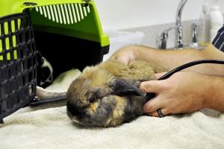
13a.9 Health
It is important to provide routine health care for rabbits
You can do preventative health care yourself, including proper grooming, good nutrition, and suitable housing
Generally, rabbits do not need vaccinations in the U.S., however, a veterinarian can tell you if there are vaccinations recommended for your location
  Limited veterinarian expertise and approved drugs

Slide 39

13a.9 Health - diseases
Wry neck (head tilt) – caused commonly by ear canker (ear mites) that lead to inner ear infection
  Can be treated with ear mite drops, mineral oil and Ivermectin (Rx)
Respiratory diseases
  Snuffles
    Treat with antibiotics (caused by bacteria such as Pasturella)
    Prevent with good sanitation, biosecurity and antibiotics in feed
Sore hocks
  Treat - antiseptics and antibiotics
  Prevent – good hygiene, board or mat to rest on

Slide 40
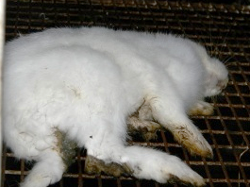
13a.9 Health - diseases
Coccidiosis (Eimeria)
  Intestinal and hepatic (liver)
  Treat with antibiotics (Rx)
  Prevent with good hygiene and anti-coccidial medications
Enteritis (complex)
  Inflammation of intestinal tract
  Various causes: e. coli, clostridium, salmonella
  Diarrhea common symptom
  Treat with antibiotics and supportive care
  Prevent: good hygiene, gradual changes in diet, adequate fiber
Photo: www.vetbook.org
Slide from presentation by Dr. Niki Whitley

Slide 41
13a.9 Health - diseases
Dental issues
G.I. statis
Hairballs
Obesity
Urinary tract diseases
Mastitis
Heat stroke

Slide 42

13a.9 Health
Normal body temperature is 103.3°–104°F (39.6°–40°C)
Heat stroke - hot weather is more of a concern than cold weather
Adult rabbits overheat at temperatures above 90°F
Ideal temperature is 62°F

Slide 43
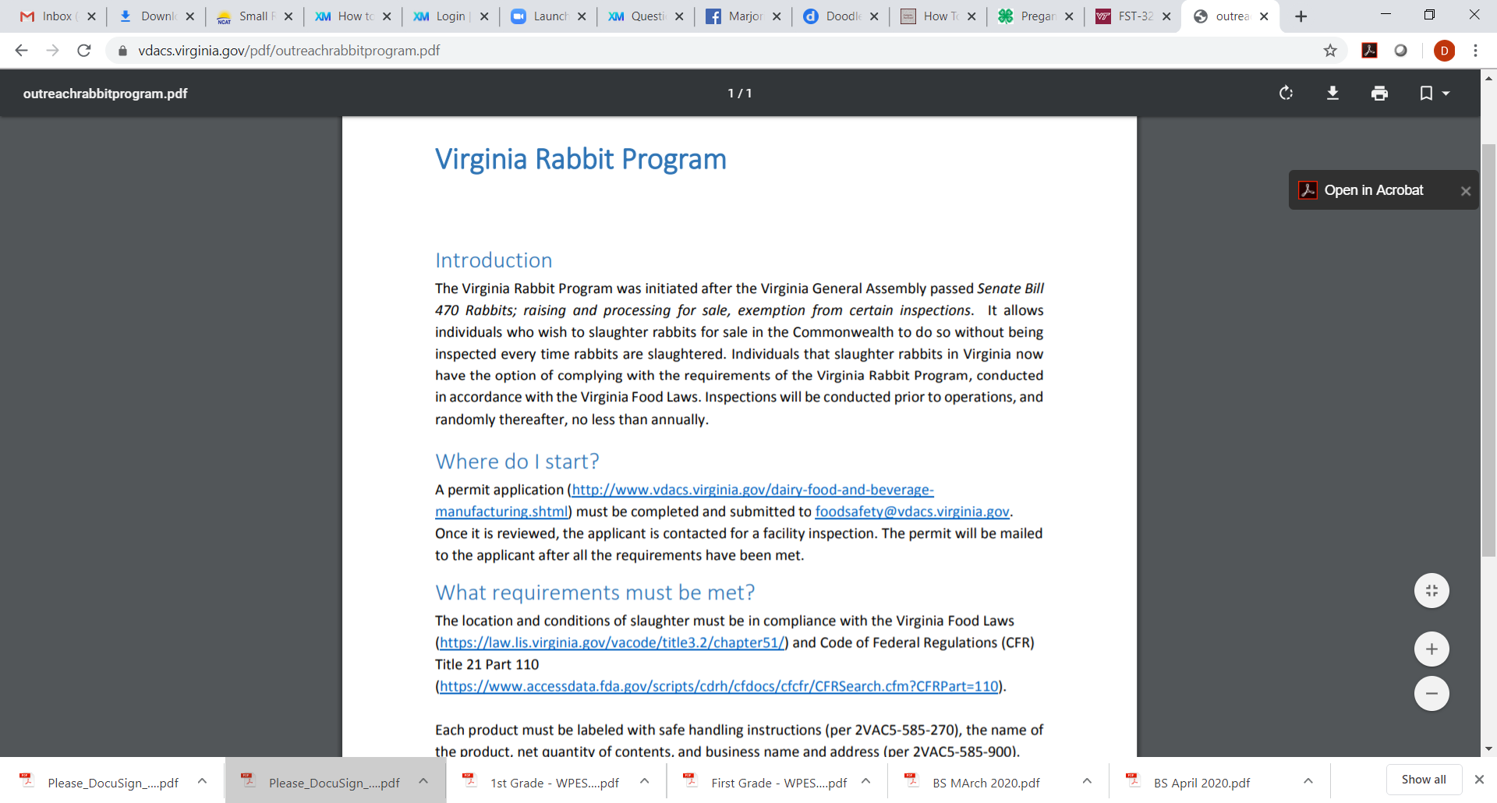
13a.10 Rabbit marketing - meat
Virginia Rabbit Program
https://www.vdacs.virginia.gov/pdf/outreachrabbitprogram.pdf
Allows slaughter of rabbits and sale without inspection at each slaughter
  Permit required – renewed annually
  Inspection (no-cost) prior to operating and random/period afterwards
  Correctly labelled and stored (refrigerated temps)
  Only domesticated breeds
  Comply with VA Food Laws and GMPs
Across state lines require inspection by FDA or voluntary inspection from VDACS-OMPS/USDA-FSIS

Slide 44
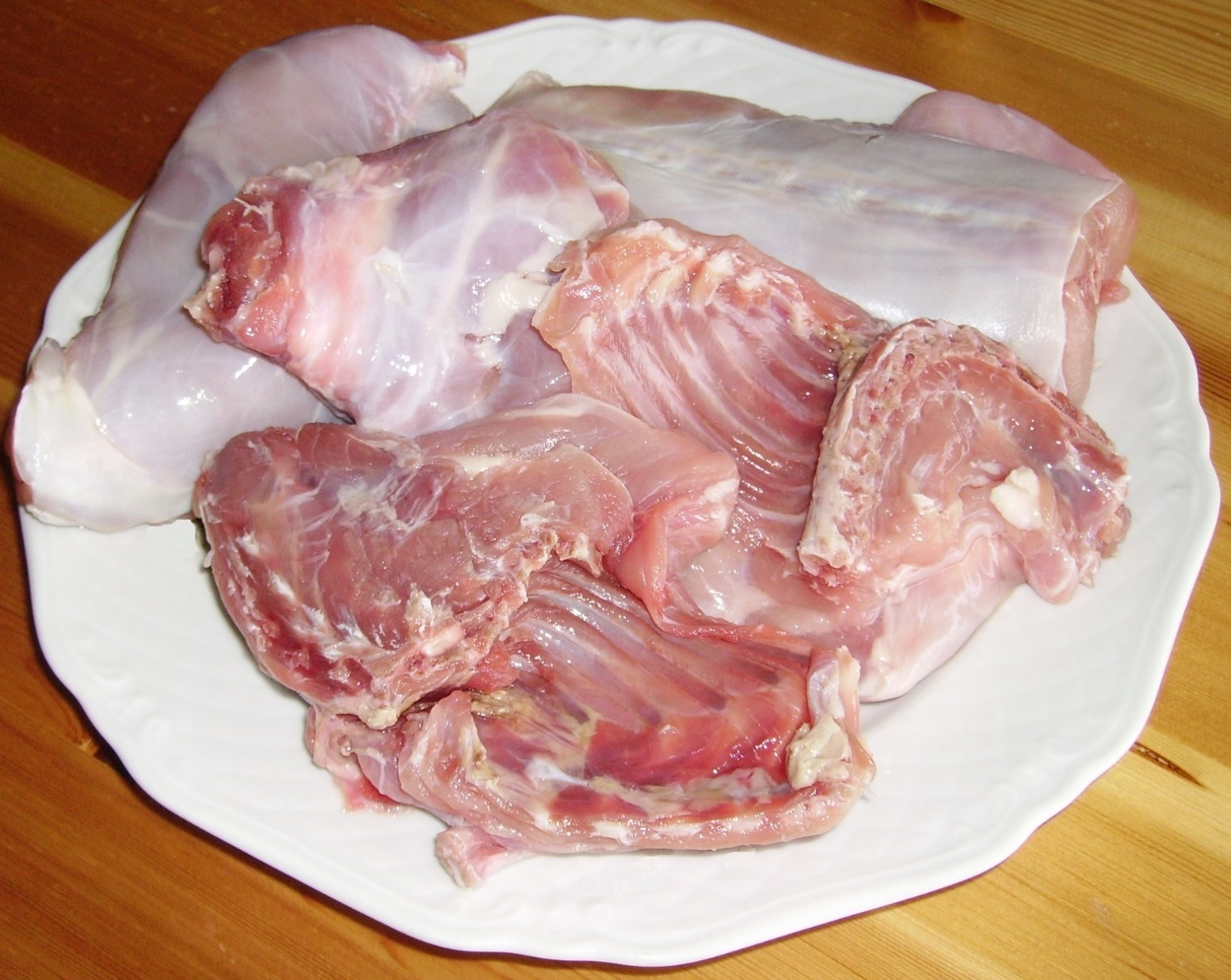
13a.10 Rabbit Marketing
Rabbit meat is fine-grained, lean, and mild and it can be cooked like poultry
Meat rabbits can be sold as fryers or as stewers
Fryers/young rabbit
  Rabbit carcass weighing 1 ½ - 3 ½ lbs.
  Less than 12 weeks of age
Stewer/roaster
  Mature rabbit of any weight (usually > 4 lbs.)
  6 months of age or older

Slide 45
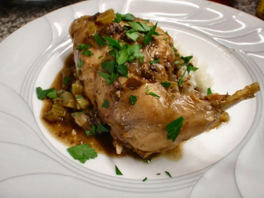
13a.10 Rabbit Marketing
A market report from the American Rabbit Breeders Association is available at https://arba.net/processors/.

Slide 46
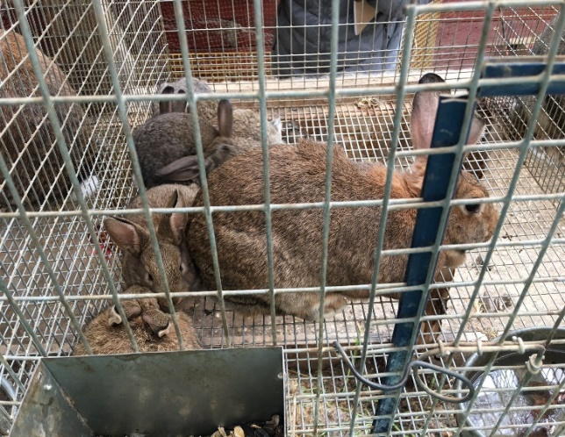
13a.11 Management and budget
Keep good records
  When to put in the nest box
  Selection of replacement stock
  With large numbers might need to tag/tattoo
  Health/treatments
  Financial (inputs, outputs, profits)

Slide 47
13a.11 Management and budget
Assumed production: 35 fryers x 20 does = 700 fryers marketed; 700 x 5 pounds each = 3500 pounds; 3500 pounds x $1.20*/pound = $4,200 Income
$4200 Income-$3,505 expenses = $695 net profit
*For current market prices and to find a processor/buyer see www.arba.net/processors/.
For a sample fryer budget, visit:
https://extension.psu.edu/rabbit-production

