Slide 1
Introduction to Fresh Produce Food Safety
Theresa Pittman
Agriculture Extension Agent, Accomack County

Slide 2
Why worry about produce safety?
Consumers are looking to local farmers for:
Freshness of the products
Meeting the farmer who produced the food
Leaving less of a carbon footprint
Being stewards of the environment
Having safe food
Your responsibility to keep food safe from field to market
liability issue for your farm

Slide 3
Why worry about produce safety?
FOODBORNE ILLNESS

Slide 4
What is foodborne illness?
Any disease caused by food that you eat
Illnesses caused by bacteria like Salmonella, Listeria, E. coli O157:H7, Yersinia
Illnesses caused by viruses like norovirus
Illnesses caused by parasites like Cryptosporidium, Cyclospora, Toxoplasma
Illnesses caused by parasitic protozoans like Giardia

Slide 5
Foodborne illness in the US Each Year
1 out every 6 Americans
128,000 hospitalizations
3,000 deaths
Centers for Disease Control and Prevention, 2011

Slide 6
Produce Associated Outbreaks
From 1996 to 2007: Approximately 72 reported outbreaks of foodborne illness associated with about 20 fresh produce commodities, both domestic and imported
13 outbreaks were associated with tomatoes
11 outbreaks were associated with melons
24 outbreaks were associated with leafy greens such as lettuce and spinach
(lettuce, juice, sprouts, berries, green onions, nuts)

Slide 7
If this…then what?
Food Safety Modernization Act (FSMA) Produce Safety Rule
Most sweeping reform of our food safety laws in more than 70+ years
Aims to ensure US food supply is safe by shifting the focus from responding to contamination to preventing it
Many of the FSMA rules require food safety trainings to fulfill compliance

Slide 9
Produce Safety Rule Approach
Takes a “risk based” approach that looks at “high risk” practices not “high risk” commodities
Allows for different practices
Recognizes further processes and rarely consumed raw
Recognizes not all water or soil amendments are the same
No prescriptive requirements for uncontrollable factors (i.e., wildlife)

Slide 10
Exempt from the Produce Safety Rule if…
Less than 25K total produce sales averaged over 3 years
Commodity is on FDA’s exempt list, such as potatoes; see FDA website for full list
Product is destined for processing, such as tomatoes to paste
Produce is grown for personal consumption (for your family)

Slide 12
Qualified Exempt Farms
Labeling
Display name and complete business address of the farm where the produce was grown
On food packaging label
On poster or sign where produce is sold (if no package) – CLEARLY VISIBLE
Compliance
January 20, 2020

Slide 13
Qualified Exempt Farms
Records:
Demonstrate farm is below sales threshold, selling to more qualified end users than not, and that the purchaser is a qualified end user
Farm must begin keeping records as of January 26, 2016 (~3 month after published rule)
Farm must also keep written record that reflects annual review and verification of farm’s continued eligibility of qualified exemption

Slide 14
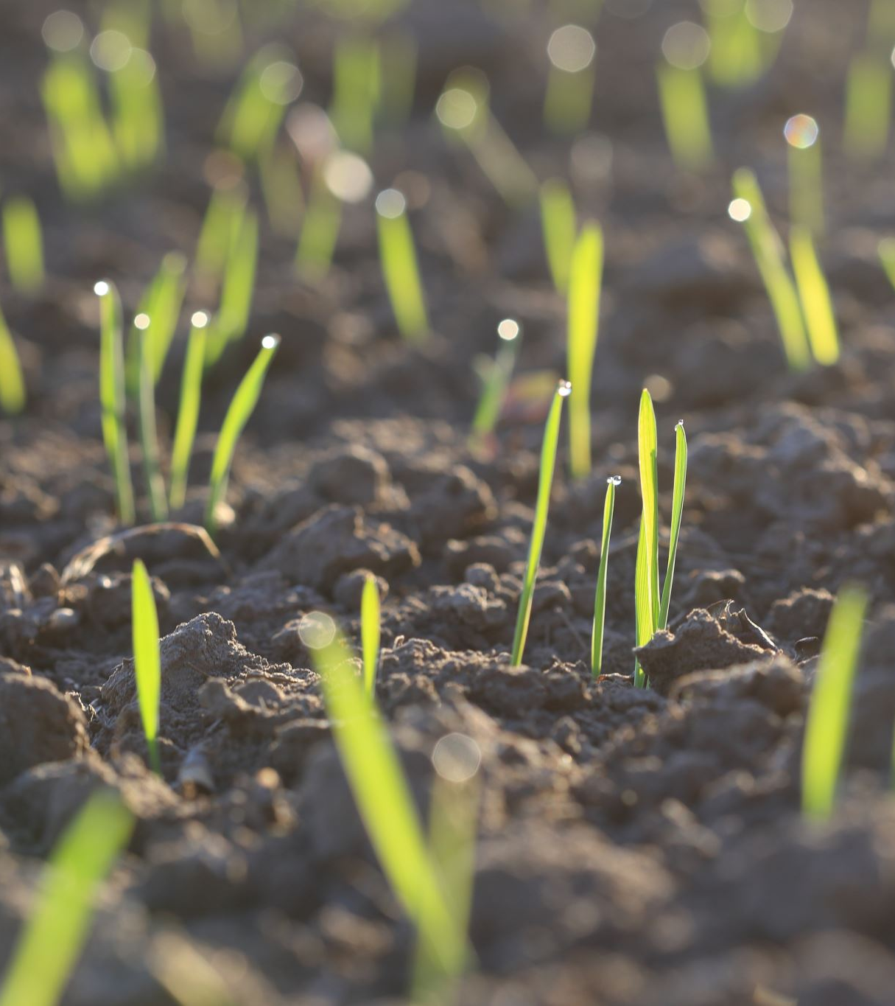
How do we keep our produce safe?
Use clean land and soil
Minimize human pathogens in the soil
Follow safe guidelines for manure use
Observe the specific waiting period between raw manure application and harvest
90 day waiting period after application for crops that do not touch the soil – tomatoes, corn, etc.
120 day waiting period for crops that touch the soil – carrots, turnips, etc.

Slide 15
The problem…
Once produce is contaminated, it’s difficult, if not impossible to remove contamination
Plants have opening on leaves to allow for gas exchange
Contaminated water can enter these openings
Contamination may not just be on the surface- can be inside plant
Ex: listeria in cantaloupes

Slide 16
Composting
Follow guidelines for proper composting
Pile size – beginning at 5x5x5 feet
Carbon to nitrogen ratio 25:1
Temperatures between 131 and 170°F
Maintain for 3 days in vessel
Maintain for 15 days in windrow or pile
Turn at least 5 times
Use a thermometer and check the temperature
Great VT resources on composting!
https://ext.vt.edu/natural-resources/composting.html

Slide 17
Water
Use clean water - Best practice
Well water preferred to surface water
Monitor water quality – test well water at least once a year
Use water that is safe to drink to rinse fruits and vegetables, etc.
Test any water that is used post-harvest for washing

Slide 18
If you must use surface water to irrigate
Test frequently
Use drip irrigation rather than overhead irrigation
Best practice - wait two weeks after last application to harvest
Drip irrigation reduces contamination of the produce- think about what touches the “edible portion” of the produce
Keep pets, farm animals and wild animals out of surface water used for irrigation

Slide 19
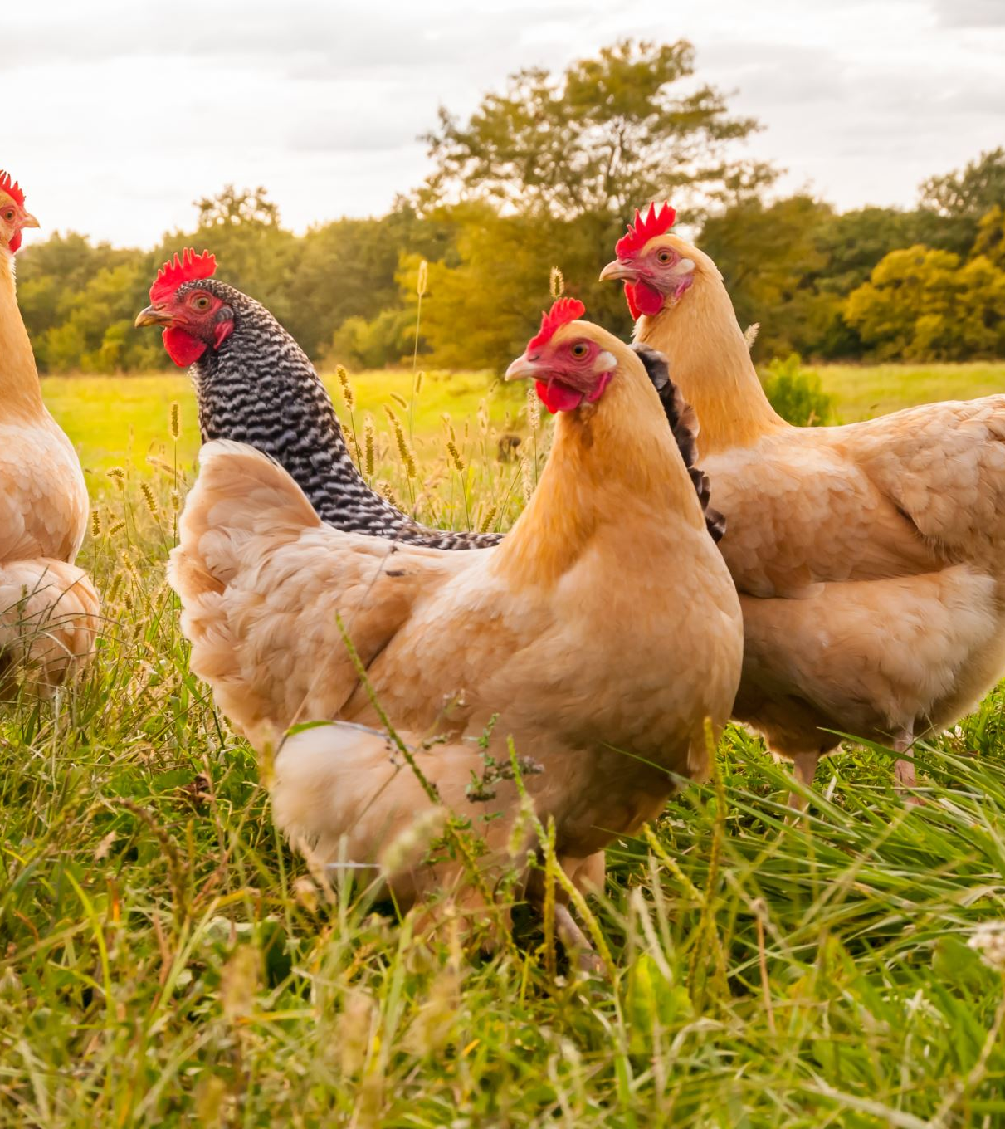
Animals and Wildlife
Working animals vs pets
Livestock allowed in produce fields
i.e., chickens!
Wild animal control

Slide 20
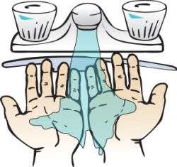
Worker Health and Hygiene
Good personal hygiene in the field and any post harvest handling is essential!
Clean clothes, no jewelry, no eating, no drinking, no smoking, etc.
Teach individuals how and when to wash their hands
Make handwashing facilities accessible
Wet Hands
Apply Soap
Rub Hands Together at least 20 sec & Clean Nails
Rinse Hands
Dry With Clean Paper Towel
Use Towel to Turn Faucet & Open Door

Slide 21
Worker Health
Exclude sick workers from handling produce
Diarrhea, vomiting, GI upset – wait until symptom free for at least 24 hours
Jaundice – require a doctor’s release
Sore throat, etc. – reassign to non-food- handling, non-container-handling duties

Slide 22
Worker Health
Handwashing Facilities
Must be near produce fields where employees are working
Must be well stocked
Single use towels (i.e. paper towels)
Emphasize why handwashing is important
Toilet Facilities
Must be within ¼ mile or 5 minute drive
Emphasize no bathroom use in the field- must be done in the toilet

Slide 23
Cleaning and Sanitizing
Wash and sanitize work surfaces, packing bins, utensils, etc.
Pressure washing
Detergent
Type needed varies by situation
Sanitizer
Strength needed varies by situation
YOU CANNOT SANITIZE A DIRTY SURFACE!

Slide 24
Cleaning and Sanitizing
Procedure:
Example:
1. Rinse
2. Wash
3. Rinse
4. Sanitize
Food contact surfaces – 200 ppm chlorine
1 tablespoon plain household bleach per gallon of water
Surfaces not contacting food – 400 ppm chlorine
2 tablespoons plain household bleach per gallon of water

Slide 25
Cleaning and Sanitizing
Practice good personal hygiene
Use clean and sanitized equipment
Label plots and containers (traceability)
Wash produce before entering packing facility
Different containers for field and market
Clean storage areas

Slide 26
Cleaning and Sanitizing
Do not reuse
Do not reuse produce containers
Wash/Sanitize Equipment
Make sure everything you use at the farmers market can be washed and sanitized
Display baskets, cloths, tables, etc
Anything that produce touches needs to be able to be cleaned and sanitized
Wash Produce
Encourage people to wash produce before consuming- no matter what
How many times do apples/tomatoes get handled before purchase? Customers “feeling” them

Slide 27
Produce Handling
Monitor storage temperatures
Removing field heat as soon as possible preserves quality and enhances safety
Lower temperatures lower the growth rate of most microorganisms
Bacteria multiplies rapidly between 60-120 degrees F
Most can be stored at 41F; some susceptible to chill injury
www.caes.uga.edu/applications/publications/files/pdf/FS%20100_2.PDF

Slide 28
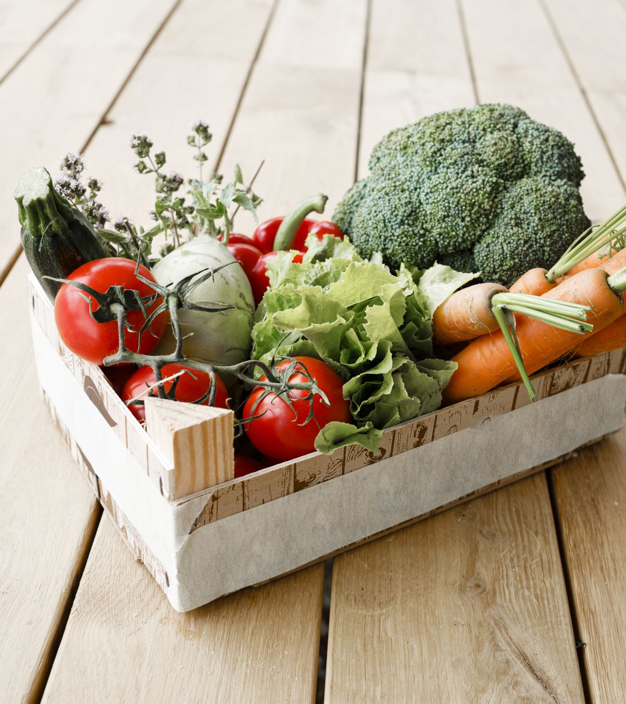
So, why does this all matter?
Any produce, whether organically grown or conventionally grown, whether from your own back yard or thousands of miles away, can be contaminated if it is not handled properly all the way from the farm to the market.

Slide 29
What Next?
Food Safety Plan
Think through flow on your farm
What happens where and where possible contamination could occur
Enhancing the Safety of Locally Grown Produce Training
VT resources
https://www.hort.vt.edu/producesafety/producers/index.html
Virginia Cooperative Extension training by Fresh Produce Food safety Team

Slide 30
Questions?
Theresa Pittman
Agriculture Extension Agent
tpittman@vt.edu
757.787.1631

