Slide 1
Beef Cattle Production
Presented by Rachel Lawmaster
Urban Ag. Program Assistant
Some information adapted from Dahlia O’Brien, PhD.
Virginia State University, Cooperative Extension
Niki Whitley, Fort Valley State University, Cooperative Extension
© 2022 All material and content is intellectual property of VSU
College of Agriculture. Do not duplicate or otherwise utilize without
written permission from VSU Urban Agriculture Certification Program.

Slide 2
Three phases of beef cattle production
Phase One: Cow-Calf Operation
Raises young calf until 6-10 months (400-650 Lb.)
Most common in VA
Phase Two: Stocker-Yearling
Grows the calf to 600-800 Lbs.
Phase Three: Feedlot
Finish cattle to desirable slaughter weight (900-1,300 Lbs. )
Some information adapted from Dahlia O’Brien, PhD., Virginia State University, Cooperative Extension

Slide 3
animal selection
1. Purpose – pleasure or profit
2. Market – Will you be able to sell the calves?
3. Uniformity - in size and type; important to the buyer
4. Health - All should be free from diseases and parasites and thrifty
5. Body condition – emaciated (extremely thin) and overfat animals may be bad
6. Age and longevity – start with majority of mature cows and a proven bull; a younger bull can be purchased with limited capital (money); average culling age is around 9.6 years for cows and 6.3 years for bulls
7. Adaptation –consider temperature and environment
8. Price – should not have to pay much in excess of market price for cows, but should get a superior bull
9. Conformation – correct body structure
Some information adapted from Dahlia O’Brien, PhD., Virginia State University, Cooperative Extension

Slide 4
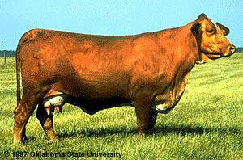
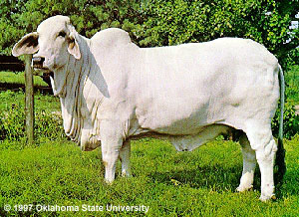
breed selection
Black Angus
They are resistant to harsh weather, undemanding, adaptable, good natured, mature extremely early and have a high carcass yield with nicely marbled meat
Beefmaster
Developed in the U.S. from Brahman, Hereford, and Shorthorn breeds known for its six essentials - Weight, Conformation, Milking Ability, Fertility, Hardiness and Disposition
Brahman
Through centuries of exposure to inadequate food supplies, insect pests, parasites, diseases and the weather extremes of tropical India, the native cattle developed some remarkable adaptations for survival
Some information adapted from Dahlia O’Brien, PhD., Virginia State University, Cooperative Extension

Slide 5
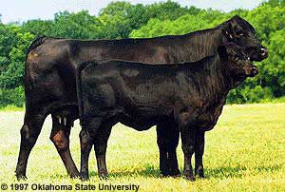
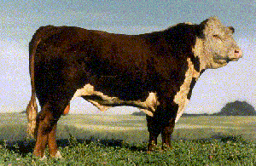
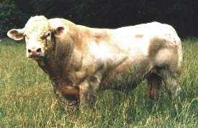
breed selection
Brangus
A cross between Angus and Brahman to utilize the superior traits of each
Herfords
Polled Herefords are a heritage breed developed from the horned Hereford breed and among the horned Herefords an occasional calf would be born which did not develop horns
Charolais
Originated in France, medium to large framed white beef cattle that demonstrate a definite superiority in growth ability, efficient feedlot gains, and in carcass cut-out values
Some information adapted from Dahlia O’Brien, PhD., Virginia State University, Cooperative Extension

Slide 6
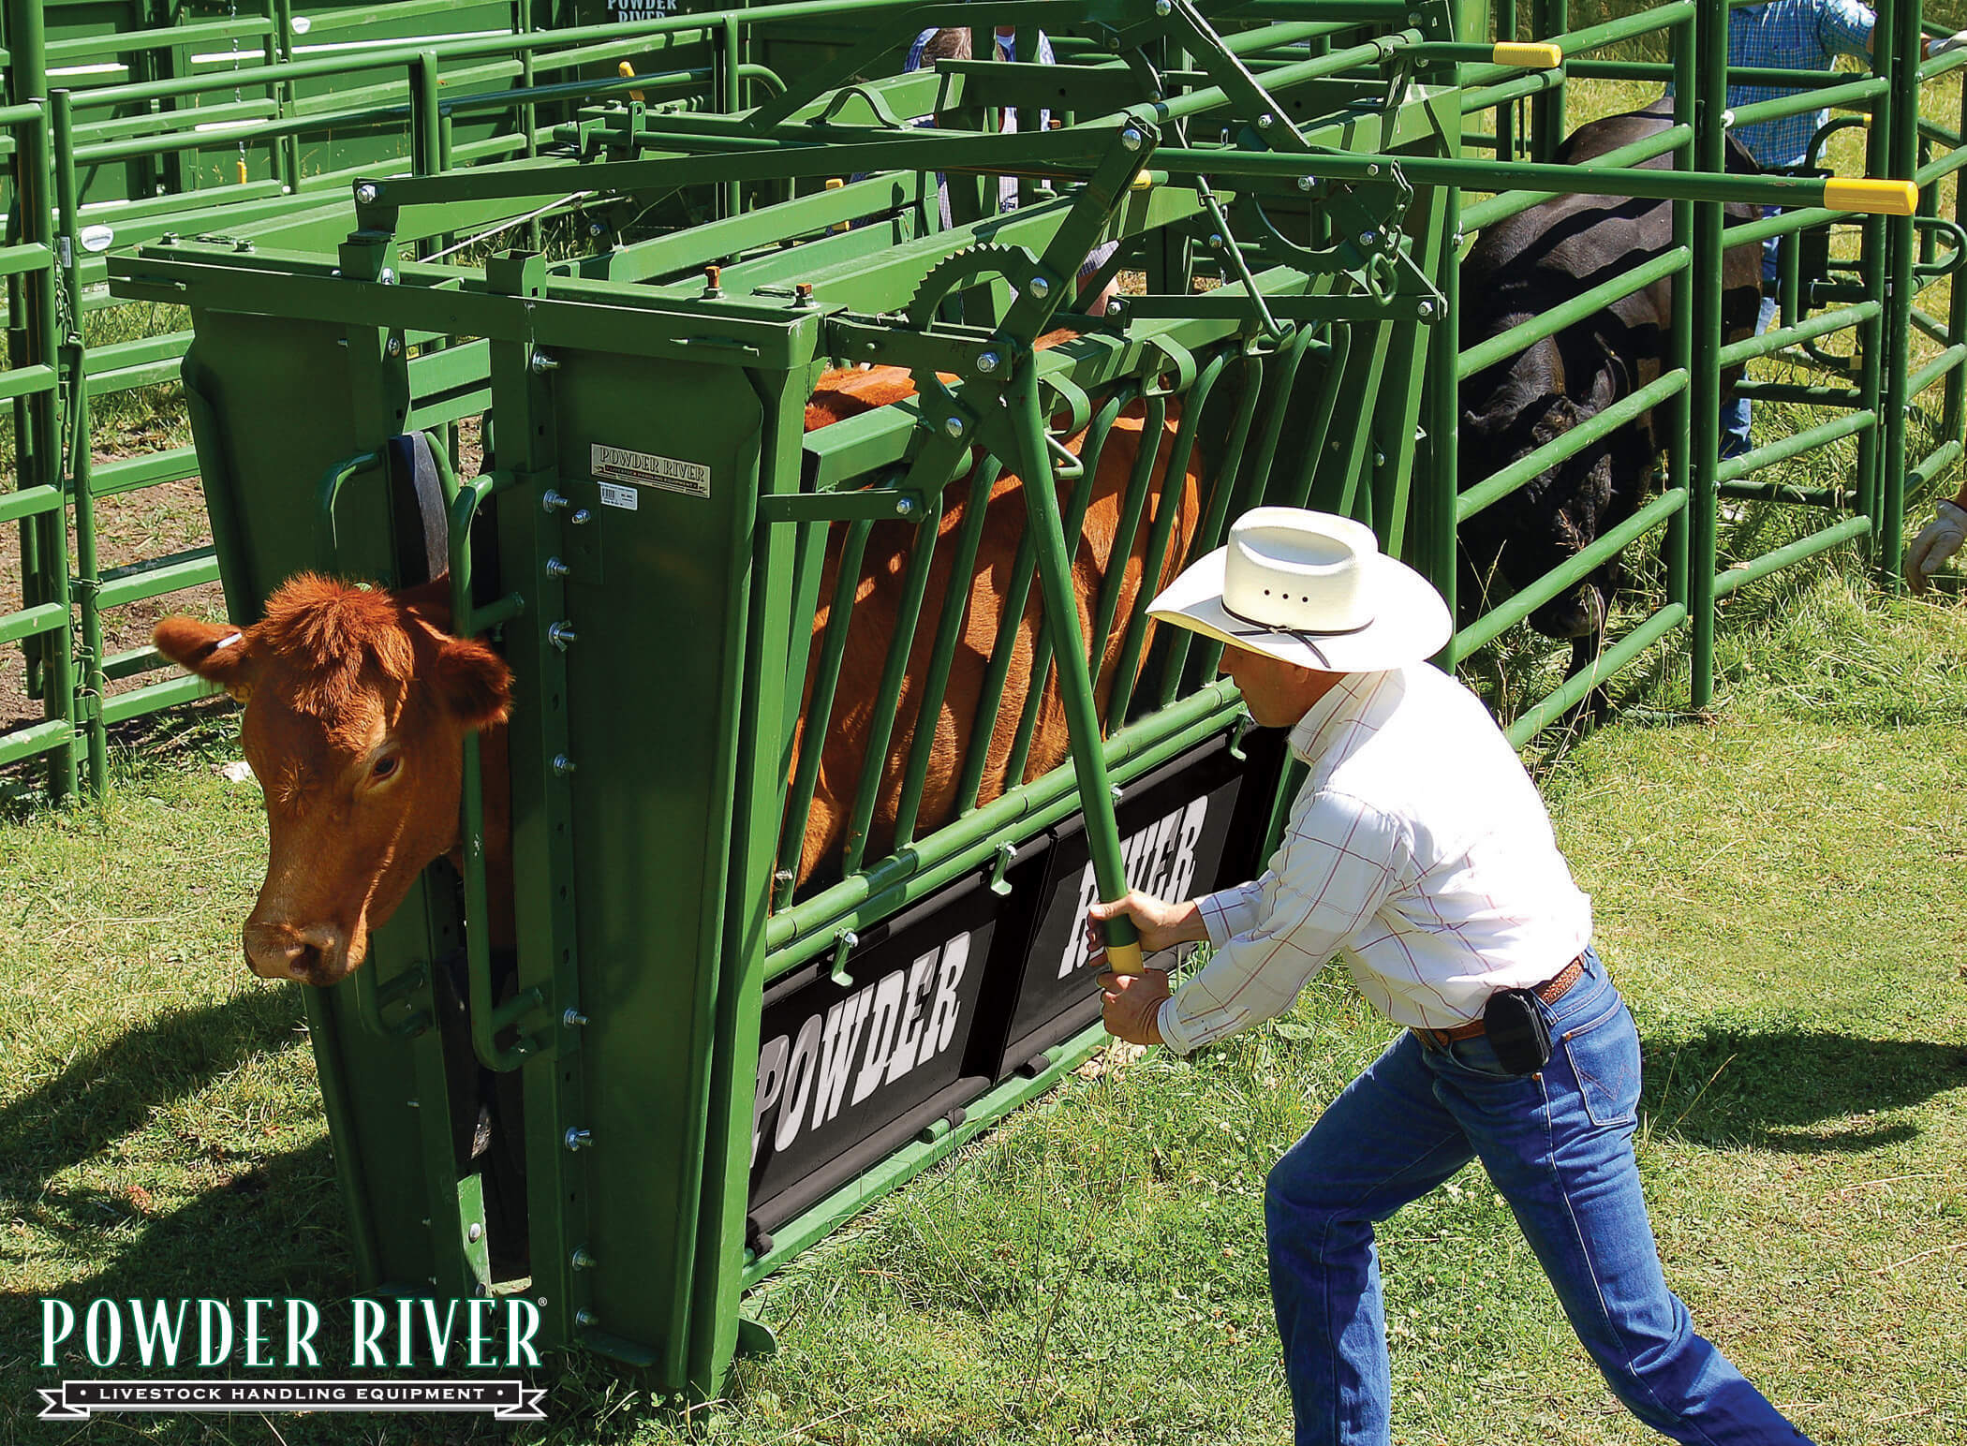
Housing requirements
Water
Ball waters, trough with a float ball
Accessible at all times
Fencing
Paddock size & stocking rate
Depends on forage, animal, and supplemental feed
About ½ acre for every 500 Lbs.
High tensile wire (strand/woven)
Working Area/Corral
Area to work cattle (vaccine/vet checks) & load cattle
Head gate/squeeze chute
Sorting pens (Bull/quarantine pen)

Slide 7
Nutrition
Forage/Pasture
Main diet
Most economical, make use of marginal land
Hay/Silage
Supplement when needed
Can add diversity to diet
Feed
Supplemental protein/weight gain
Finishing off
Bucket Training
Mineral
Supplemental nutrients important for calf growth, milk production, reproductive support
Commonly fed in winter & spring to offset low magnesium in cool-season grasses (grass tetany)

Slide 8
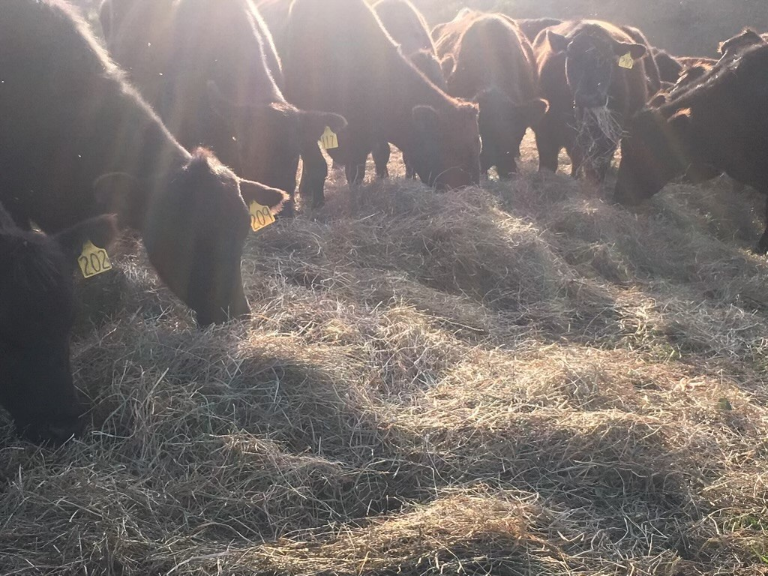
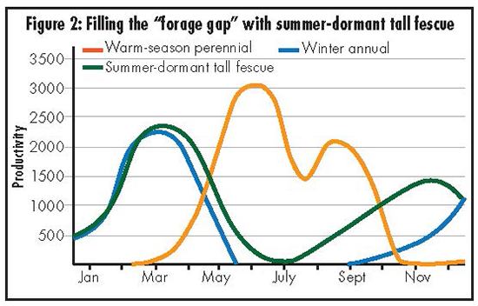
Pasture management
In VA we can grow cool and warm season crops to provide year-round forage
Cuts down on feed (hay & grain) cost
Rotational Grazing
Moving cows between smaller paddocks
Increases forage yield & allows for diversity to fill forage gaps
Reduces weed pressure and overgrazing (with proper management)
More even manure distribution and grazing
Temporary fencing can further subdivide paddocks and allow for strip/mob grazing

Slide 9
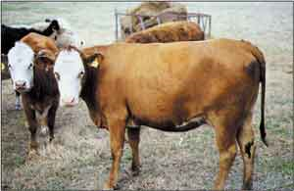
Health
Keep Records
ID (ear tags), vaccines, BCS, pregnancy, age, etc.
Notes of injuries & changes in health/behavior
Regular Veterinary Checks(1-2/year)
Vaccines
Health checks
Palpation (pregnancy check) & AI
Castration/Banding
Body Condition Score (BCS)
Scale that describes the body condition from1-emaciated to 9-Extremely overweight
Target BCS 5-7
Example of BCS 6:
Firm pressure now has to be applied to feel spinous processes. A high degree of fat is palpable over ribs and around tail-head
Some information adapted from Dahlia O’Brien, PhD., Virginia State University, Cooperative Extension

Slide 10
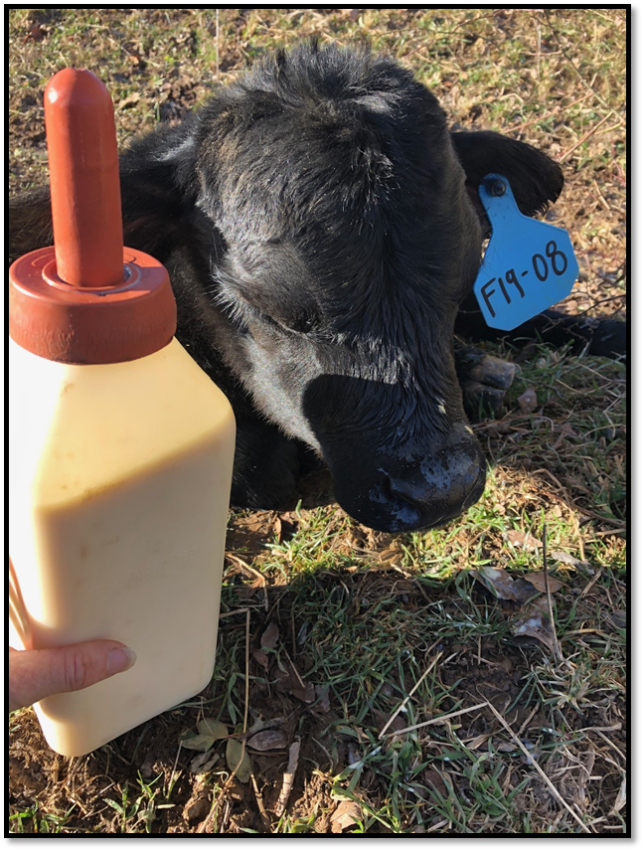
breeding
Natural
One Bull to 30 cows
Cost to purchase & maintain bull
Issues with keeping replacement heifers
AI
Select for desirable genetics
Timing & vet expenses
Synchronized birthing
Clean up bull
Fall v. Spring Calving
Weaning
6-8 Months old
Creep grazing

Slide 11
marketing
USDA inspected meat
Check slaughterhouse
Home consumption for non USDA
Check live cattle prices
Prices usually higher in spring and lower in the fall (due to culled cattle)
Local/State livestock auction markets
Transportation/auction costs
Some markets pay premiums for certain breeds, grades, and program certifications (VA Beef Quality Assurance)

Slide 12
budgeting
Keep Records
Track cost/animal
May be better to cull
Feed cost is usually highest
Make use of available forages
Sample budgets available online
Use them as guides and update to make your own
Each farm is different

Slide 13
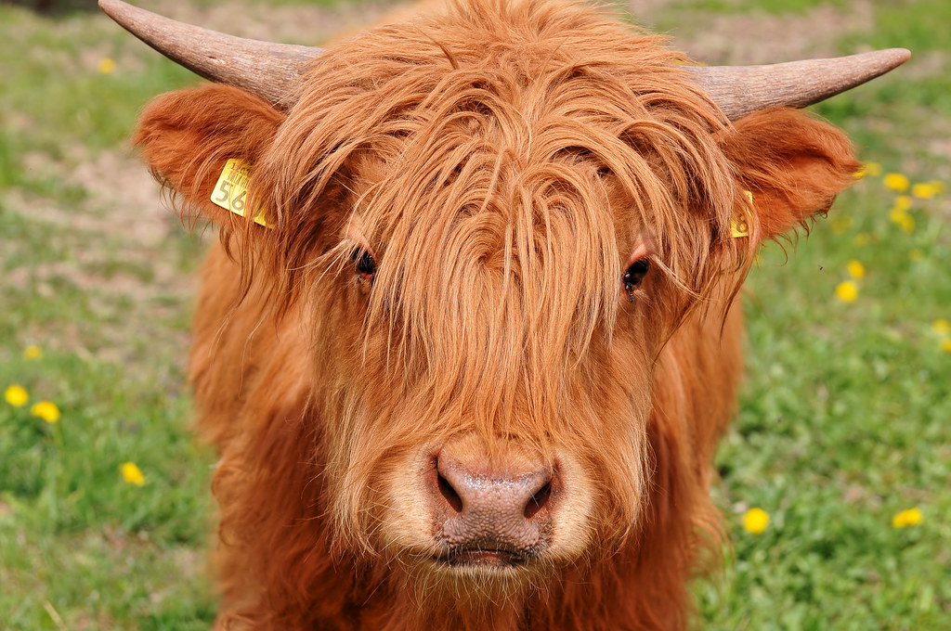
QUESTIONS?
Dr. O’Brien
dobrien@vsu.edu
Rachel Lawmaster
rlawmaster@vsu.edu
This Photo by Unknown Author is licensed under CC BY-ND

