Slide 1
Backyard Rabbit Production
(Condensed)
Presented by Rachel Lawmaster
Urban Ag. Program Assistant
Some information adapted from Dahlia O’Brien, PhD.
Virginia State University, Cooperative Extension
Niki Whitley, Fort Valley State University, Cooperative Extension
© 2022 All material and content is intellectual property of VSU
College of Agriculture. Do not duplicate or otherwise utilize without
written permission from VSU Urban Agriculture Certification Program.

Slide 2
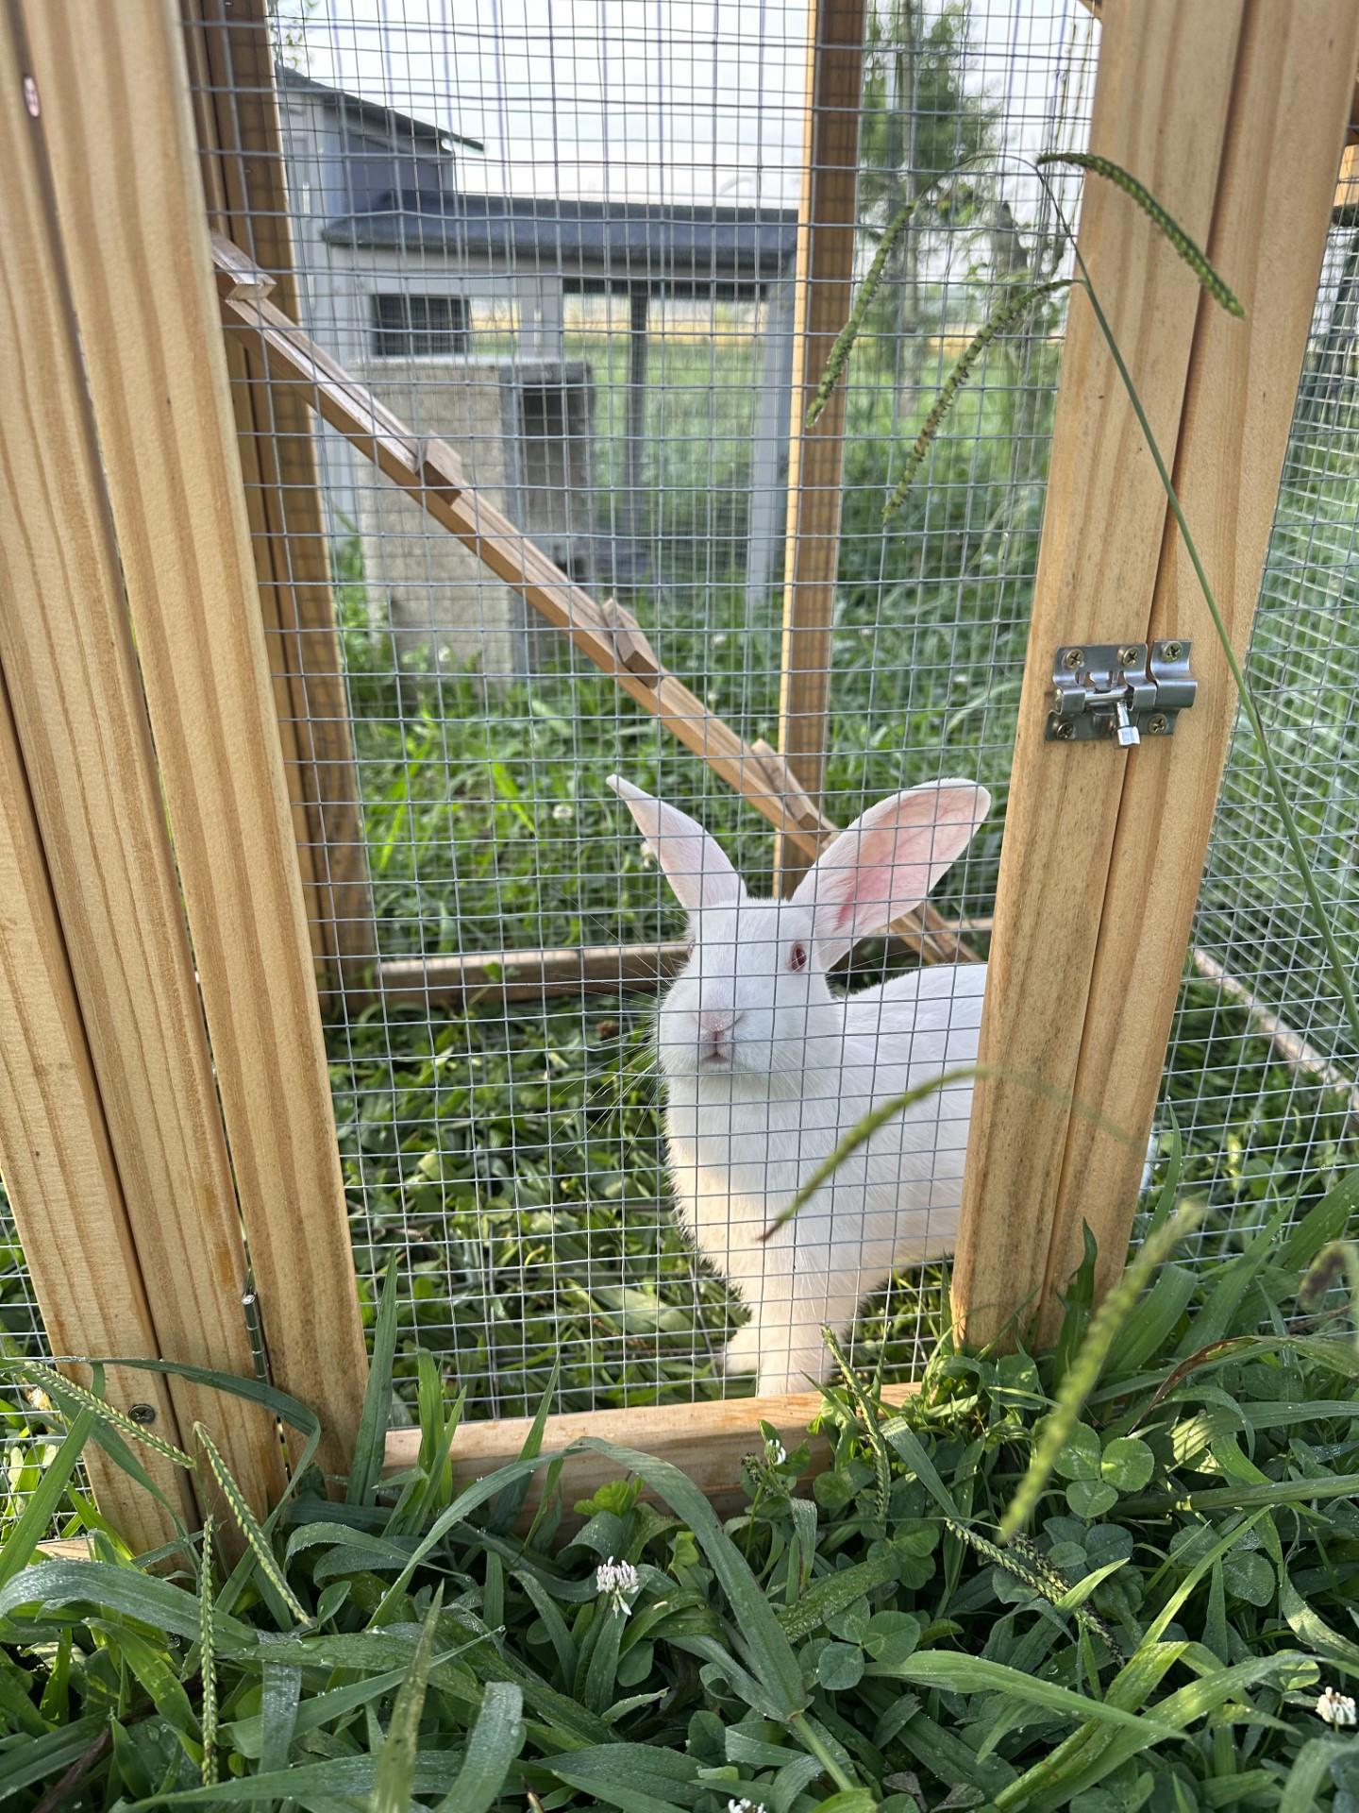
Why Raise Rabbits?
Meat
Fur, (pelts/wool)
Laboratory
Pets/Hobby/Therapeutic
Educational/Show
Manure
Animal Food

Slide 3
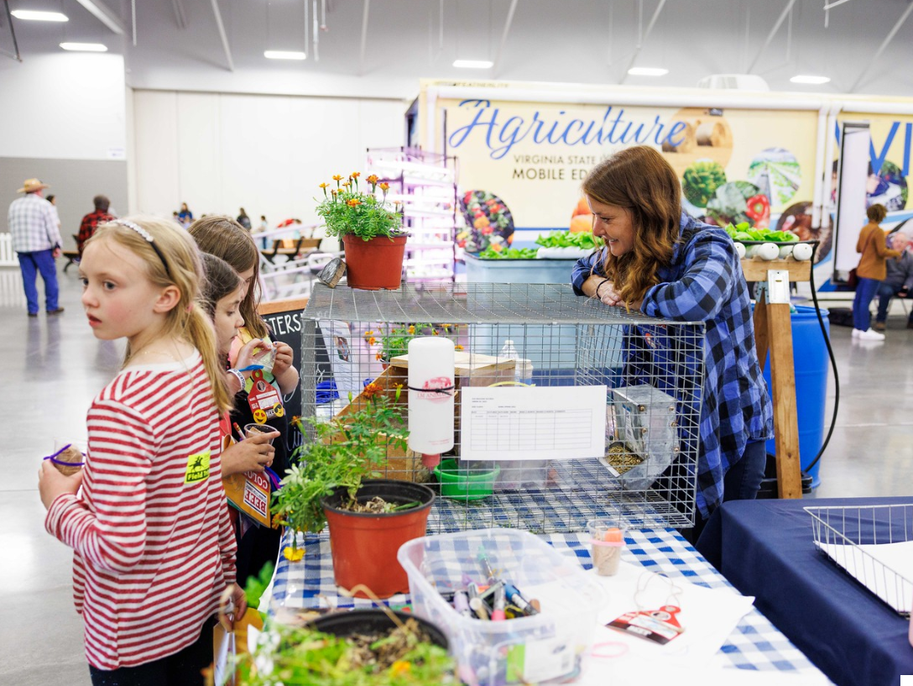
Benefits of Backyard Rabbits
Rabbits are quiet and small
Do not require large equipment and lots of land
Litters are large with short generation intervals
They are efficient at extracting protein from forage
Educational experiences for youth

Slide 4
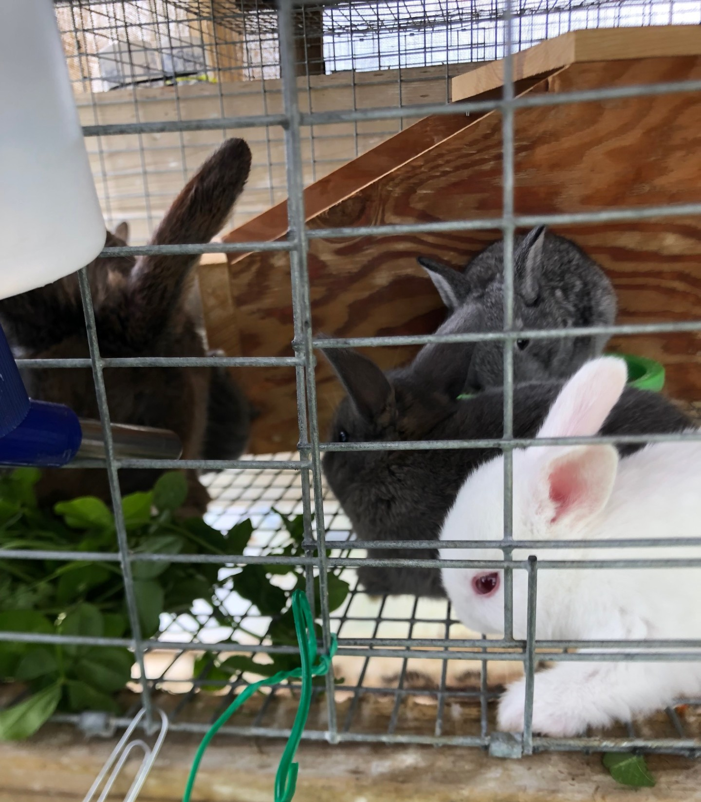
Challenges with Backyard Rabbits
Zoning codes
  Check all local ordinances, and property association laws. https://www.municode.com/library/va
Raising rabbits is a labor-intensive endeavor
  Very small industry (mostly pets/hobby)
  Few approved drugs/exotic vets
  Not widely consumed meat

Slide 5
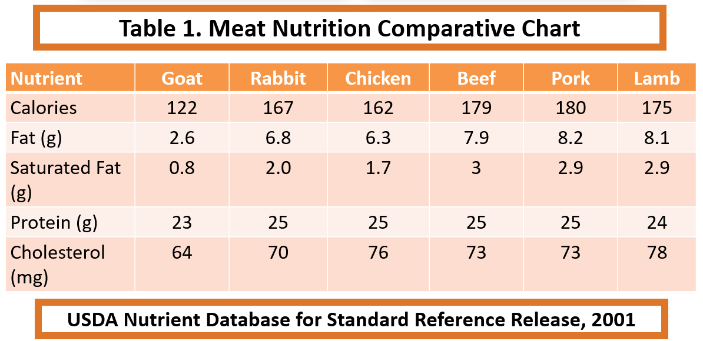
Meat Production
Nutritious meat (low fat, calorie, cholesterol and high protein)
Potential income
  Demand for healthy, low-fat, novel and locally produced food has led to resurgence in rabbit meat
  Organic market is untapped

Slide 6
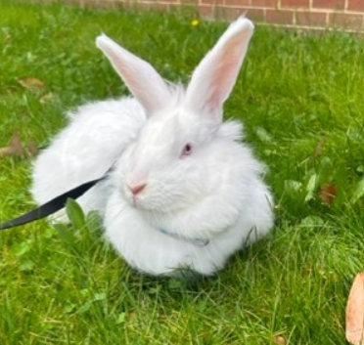
Pelts/Wool
Rabbit pelts can be a secondary product from meat rabbits
Angora wool is a high value product that can be spun into yarn
  Labor intensive, limited information on home production budgets
  Harvesting the fiber
    Pluck during molt (not Giants/Germans) or every 10-11 weeks; shear (with scissors) every 10-11 weeks
    Average of 15 ounces/year ($8.50-$15/ounce on Etsy)

Slide 7
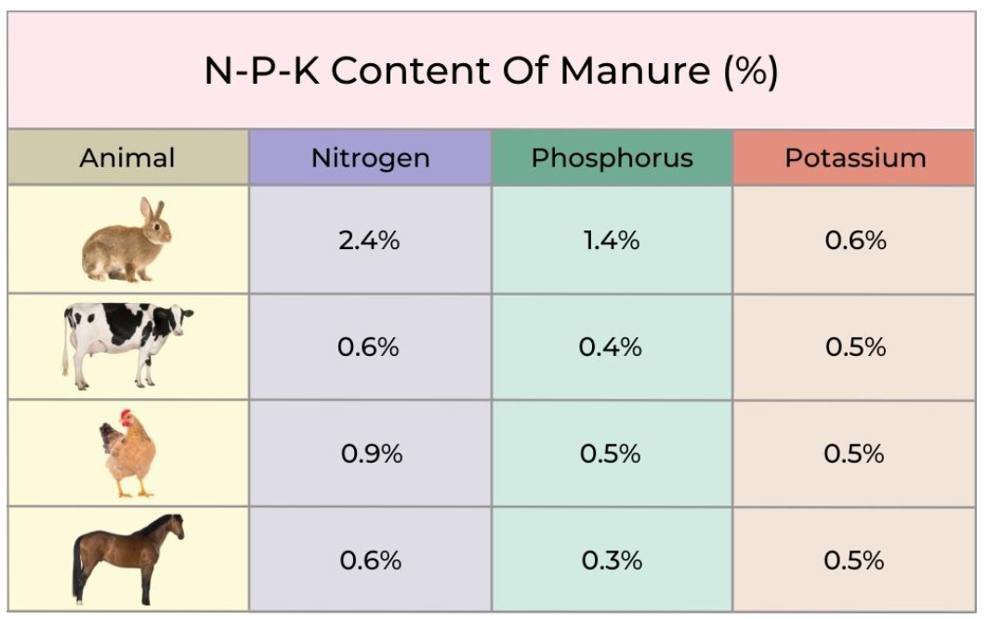
Manure
Bunny berries” or “Bunny honey”
Production (10 lb. doe)
  0.31 lbs./day (feces and urine)
  0.056 ton/year
Four times more nutrients than cow or horse manure
Higher in nitrogen and phosphorus
Twice as rich as chicken manure
Doesn’t need composting
Not as smelly
Worms can be raised in the rabbit manure to produce fishing bait and worm castings

Slide 8
Rabbit Breed Selection
Breeds | Size | Use | Mature Weight (lbs)
Angora | medium | wool; meat | 9-12
American Chinchilla | medium | fur | 9-12
Californian | medium | meat | 8-11
Champagne d'Argent | medium | meat | 9-12
Checkered Giants | large | fur | 11+
Dutch | small | lab | 3-6
English Spot | medium | meat; lab | 9-13
Flemish Giants | large | meat | 13+
Himalayan | small | lab | 2-6
New Zealand | medium | meat | 9-12
Polish | small | lab | 3-4
Rex | medium | fur | 8-11
Silver Martens | medium | fur | 6-10
Heritage/rare breeds - https://livestockconservancy.org/index.php/heritage/internal/conservation-priority-list#Rabbits

Slide 9
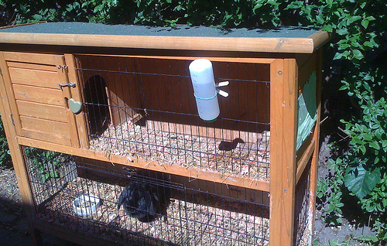
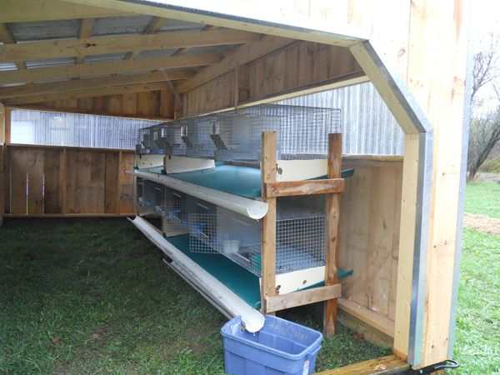
Housing
Housing should provide the following:
  Protection from predators & extreme weather
  Prevention from escape
  Easy access & clean
  Affordable to build and maintain
Outdoor
  Shed or outbuilding in your backyard as long as they are in a dry and draft free environment, can be covered in winter
Ventilation is important in reducing ammonia buildup and the incidence of disease and other health-related problems

Slide 10
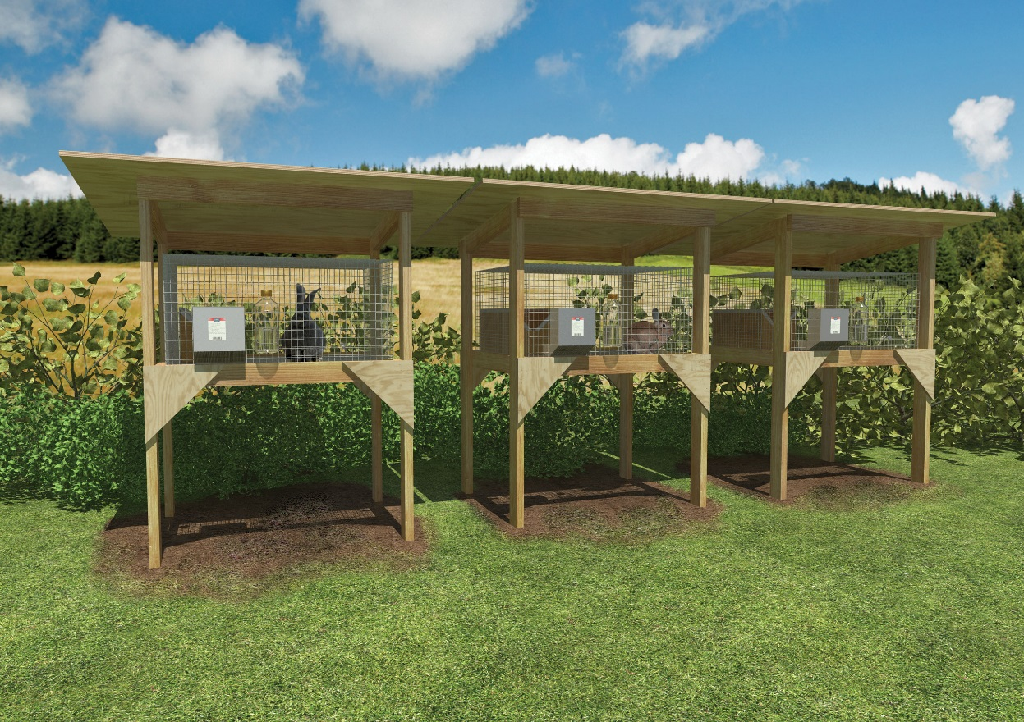
Housing: Cages
Cages are a necessity
Rabbits are territorial
  Crowded conditions may cause aggression, rabbits must be kept in separate cages
Sizes vary depending on size of the rabbits
Cage size for medium sized meat breeds are 24″W x 36″L x 18″H
Cages for bucks or young replacement breeding stock should be - 24″W x 24″L x 18″H or a 24″W x 30″L x 18″H
Larger size allows for a nesting box
  30″W x 36″L x 18″H
  Need enough space for a doe and her litter
  Allows doe to kindle (give birth) and houses young rabbits until they are weaned

Slide 11
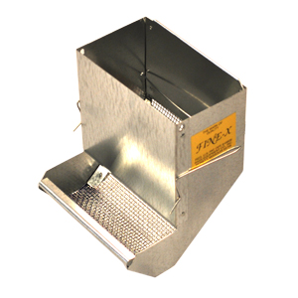
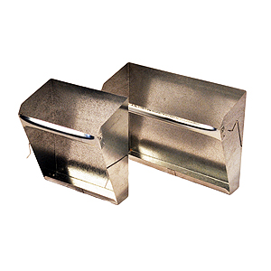
Housing: Equipment
Pellets:
  Self feeders (hoppers; screen), creep feeders, unbreakable vinyl bowls, ceramic crocks, pans
Hay:
  Hanging feeders, hoppers, on top/side of pen
Water:
  Automatic (Gravity fed, tubes)
  Manual (water bottle, bowls)

Slide 12
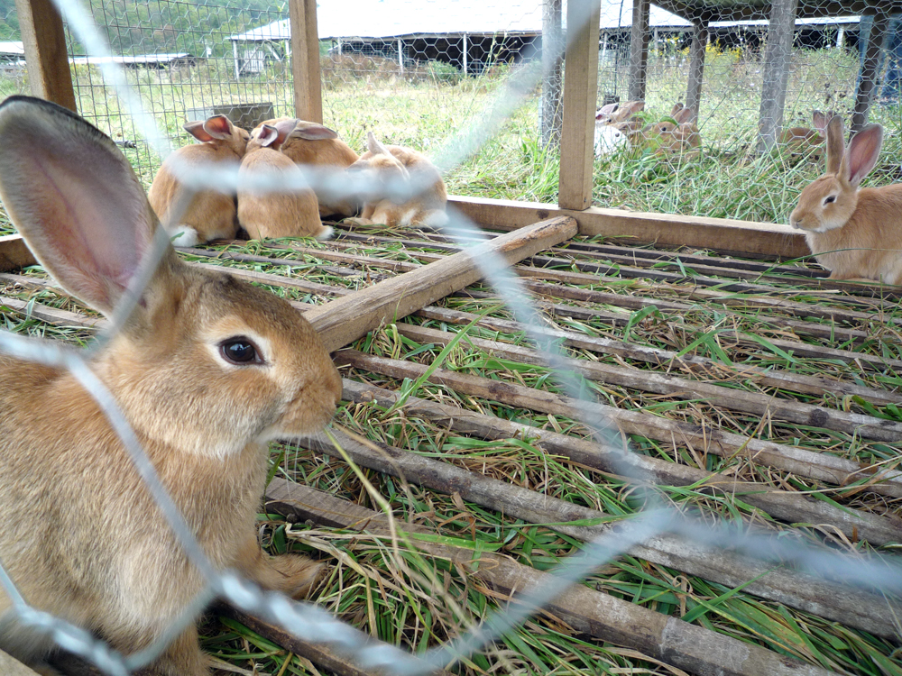
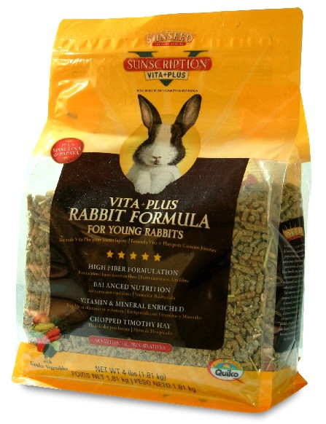
Feeding
Rabbits are classified as non-ruminant herbivores and hind-gut fermenters
Pellets (Rabbit formula)
  Main feed source for meat rabbits
  High in protein
  Found at most feed stores
Hay
  Main feed source for other rabbits
  High in fiber, helps prevent wool block
Fresh greens/forage
  Should not be the main feed source, provides some nutrients & diversity
  Help to cut down on feed cost
  Can graze in outdoor pens, should be moved daily
    To prevent the spread of coccidiosis, rabbits should not be allowed to graze the same area of pasture again for at least 6 months
Treats
  Should only be 1% of diet
  High in sugar (carrots, berries, etc.)

Slide 13
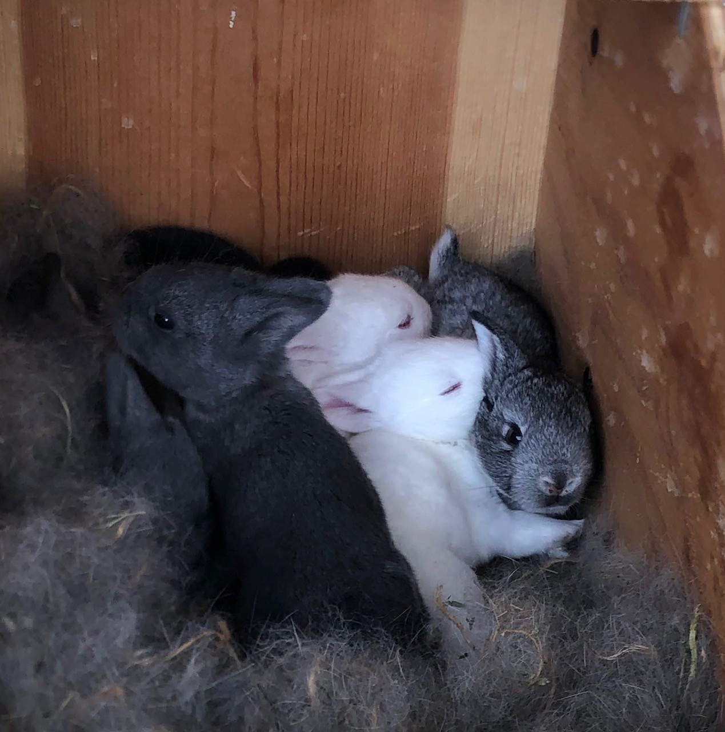
Breeding
Rabbits are induced ovulators
  Meaning ovulation does not occur until the actual mating by the buck
Most meat size rabbits are ready to breed between 5 to 8 months of age
  Young bucks attempt to breed as early as 3 months
When mating, take the doe to the bucks cage
  Watch carefully, remove doe right after
  A ratio of one buck for every 10 – 15 does is recommended

Slide 14
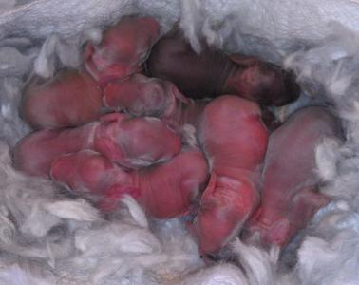
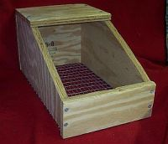
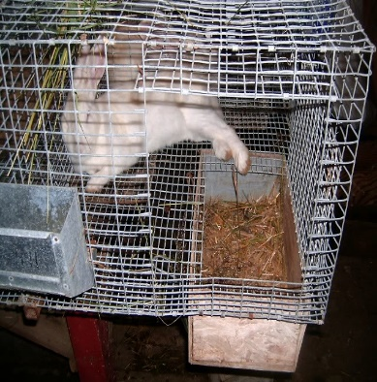
Rabbit Reproduction
Palpating the doe’s abdomen 10 to 14 days after breeding can determine pregnancy (YouTube videos)
  The embryos are round and feel like grapes
Gestation period - 31 to 32 days
The nest box should be put in the does cage on day 27 from breeding
  Wood shavings or bedding and the doe’s fur
  Nest boxes should be cleaned and disinfected after use
Rebreeding can be done within 14-45 days
  4 – 8 litters/year
  1 – 14 kits (average 8)
Accelerated systems rebreed one to seven days after kindling for maximum production
  11 litters per year
  Requires top nutrition and management
  Rest after 3/4 consecutive

Slide 15
Health
It is important to provide preventative health care yourself, including proper grooming, good nutrition, and suitable housing
  Limited veterinarian expertise and approved drugs
Health Issues
  Heat stroke - hot weather is more of a concern than cold weather
    Adult rabbits overheat at temperatures above 90°F, Ideal temperature is 62°F
  G.I. Stasis/Hairballs
  Dental Issues
  Sore hocks
    Prevent with good hygiene and board or mat to rest on
    Treat with antiseptics and antibiotics
Diseases
  Snuffles
    Respiratory (bacterial), prevent with good sanitation
    Treat with antibiotics
  Coccidiosis (Eimeria)
    Prevent with good hygiene and sanitation
    Treat with antibiotics
  Enteritis (complex)
    Prevent with good hygiene, gradual changes in diet, adequate fiber
    Treat with antibiotics and supportive care
  Wry neck (head tilt)
    Caused by ear canker (ear mites)
    Treat with mineral oil or Ivermectin (Rx)

Slide 16
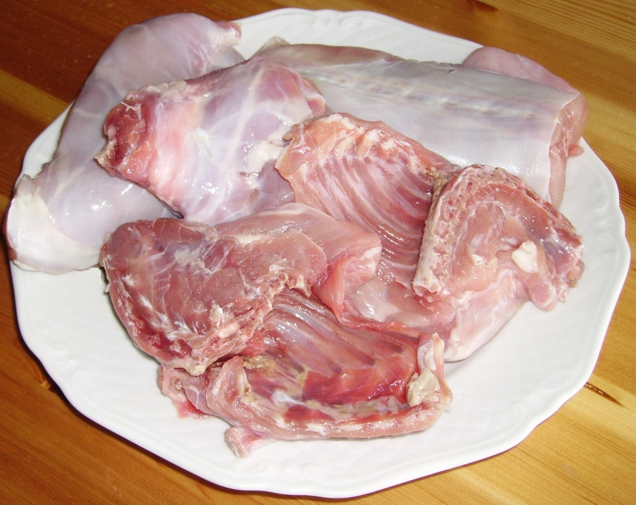
Rabbit Marketing: Meat
Rabbit meat is fine-grained, lean, and mild and it can be cooked like poultry
Meat rabbits can be sold as fryers or as stewers
Fryers/young rabbit
  Rabbit carcass weighing 1 ½ - 3 ½ lbs.
  Less than 12 weeks of age
Stewer/roaster
  Mature rabbit of any weight (usually > 4 lbs.)
  6 months of age or older

Slide 17
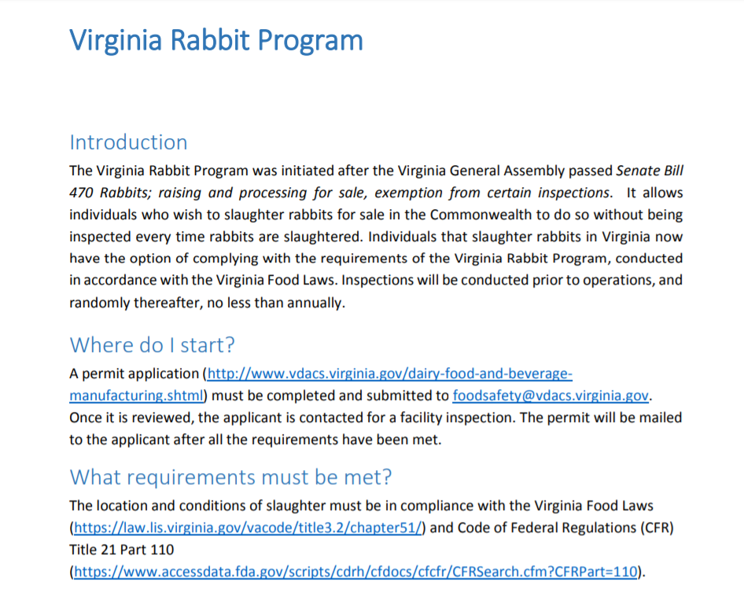
Rabbit Marketing: Meat
Virginia Rabbit Program
https://www.vdacs.virginia.gov/pdf/outreachrabbitprogram.pdf
Allows slaughter of rabbits and sale without inspection at each slaughter
  Permit required – renewed annually
  Inspection (no-cost) prior to operating and random/period afterwards
  Correctly labelled and stored (refrigerated temps)
  Only domesticated breeds
  Comply with VA Food Laws and GMPs
Across state lines require inspection by FDA or voluntary inspection from VDACS-OMPS/USDA-FSIS

Slide 18
management & budget
Assumed production: 35 fryers x 20 does = 700 fryers marketed; 700 x 5 pounds each = 3500 pounds; 3500 pounds x $1.20*/pound = $4,200 Income
$4200 Income-$3,505 expenses = $695 net profit
*For current market prices and to find a processor/buyer see www.arba.net/processors/.
For a sample fryer budget, visit:
https://extension.psu.edu/rabbit-production

Slide 19
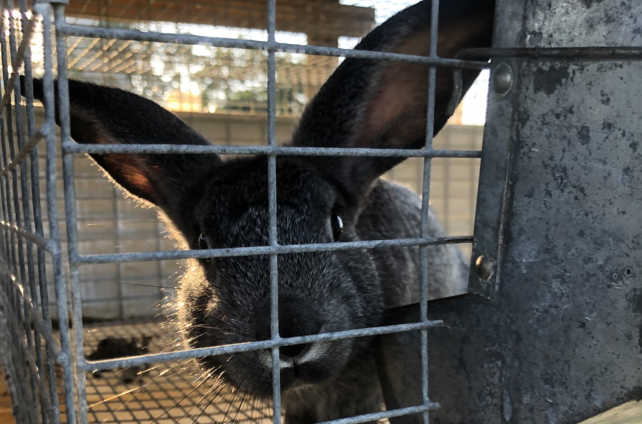
Questions?
Dr. Dahlia O’Brien
dobrien@vsu.edu
Rachel Lawmaster
rlawmaster@vsu.edu

