Slide 1
Overview of Terminology
Beef – meat from cattle older than calves
Bovine – general family grouping of cattle
Bull – uncastrated (intact) male bovine
Bullock – young bull (less than 20 months)
Calf – sexually immature young of cattle
Calving – act of giving birth
Cow – mature female, usually having had at least one calf

Slide 2
Overview of Terminology
Cull – animal removed from the herd because it is below standards
Dam- female parent
Dystocia – difficulties in giving birth
Heifer – female that has not given birth
Sire – male parent
Stag – male castrated after “puberty”
Steer – male castrated early, before puberty

Slide 3
Beef Industry
Contribute food, fiber, fuel, and draft animal power
Bos Indicus (Zebus)
Developed in tropical countries (characterized by hump, pendulous ears, pendulous sheath, and dewlap)
Bos Taurus (domestic cattle)
Developed in temperate zones (more conventional in appearance)

Slide 4
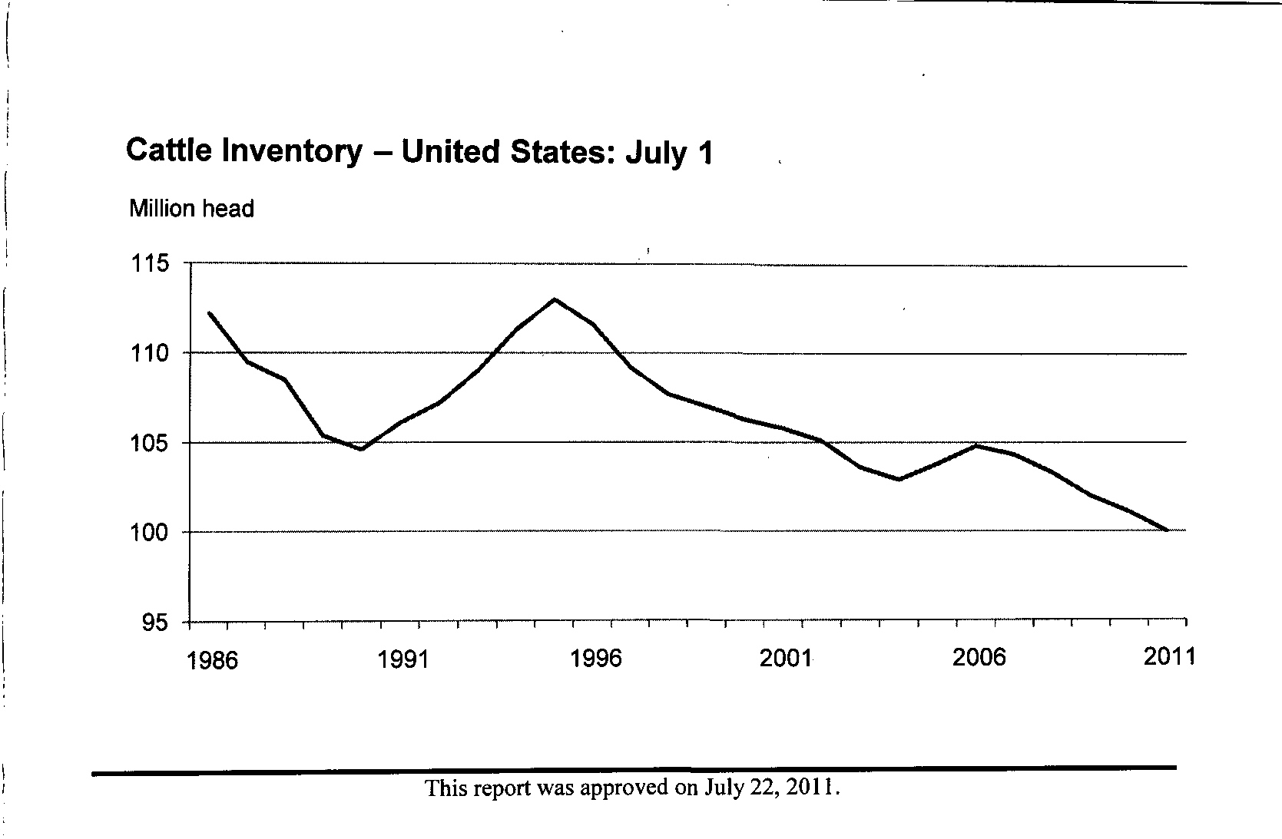
U.S. Cattle Inventory (1986 – 2011)
100.0 million

Slide 5
U.S. Beef Cow Inventory (1986-2011
36.1
32.9
31.4 million
33.4

Slide 6
Beef Industry (Global)
In most developed countries, beef is the primary product
Secondary to draft power and milk in most developing countries
U.S. leads in beef (meat) production, but not in cattle numbers and per capita consumption

Slide 7
Beef Industry
Country | # Cattle (mil head) | Country | Production (bil (lb)) | Country | Per capita supply (lb)
1. India | 175 | 1. U.S. | 26.9 | 1. Argentina | 123
2. Brazil | 175 | 2. Brazil | 19.9 | 2. Uruguay | 94
3.U.S | 97 | 3. China | 12.9 | 3. U.S. | 94
4. China | 83 | 4. Argentina | 6.2 | 4. Australia | 85
5. Argentina | 51 | 5. Australia | 5.1 | 5. Brazil | 79
World Total | 1,347 |  | 137 |  | 21
USDA

Slide 8
Beef Industry – Export Trade
Increasing demand
Japan
4.5 million cattle and 127 million people
High per capita beef consumption
Australia
27.5 million cattle and 19 million people
Argentina
51 million cattle and 37 million people

Slide 9
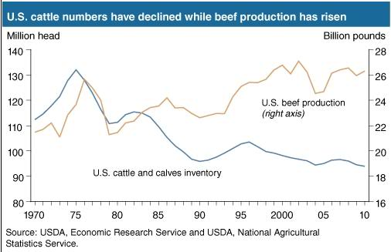

Slide 10
U.S. Beef Industry
Beef production has increased even though # cattle has decreased
Why?
Average carcass weight has increased (579lb in 1975 to 776lb in 2007)
Increased # of cattle fed per feedlot (2.4 times the feedlot capacity)
Market age of cattle has decreased
More crossbreeding and faster gaining European breeds
More Canadian and Mexican calves are imported and fed in the U.S.

Slide 11
U.S. Beef Industry
Commercial beef cattle production occurs in 3 phases
Cow-calf
Raises the young calf from 6-10 months old (400 – 650lb)
33 million head of beef cows throughout the country
Located where forage is most abundant (Plains, Corn Belt, and southeastern states)
60% of operations have <50 cows
70% of cow inventory in operations with >100 cows

Slide 12
U.S. Beef Industry
2 types of operations
Commercial cow calf producers
Potential slaughter steers and heifers
Seedstock breeders/specialized cow-calf producers
Breeding cattle and semen
DE – 4,000; MD-41,000; NJ-10,000; PA-160,000; VA-665,000

Slide 13
U.S. Beef Industry
Stocker-yearling
Grows the calf to 600 – 800 lbs (mainly on roughage)
Includes cattle (steers and heifers) destined for feedlot and also replacement heifers
Useful for early-maturing cattle that need slower gains to heavier slaughter weights
Feedlot
High-energy rations to finish cattle to desirable slaughter weight (900 – 1,300 lb)
Marketed between 15-24 months of age
Only 10-15% of all cattle are pasture finished

Slide 14
U.S. Beef Industry
Both commercial and farmer feeders exist
Commercial-feeders
Owned by individual or partnership
Most often cooperation owned
Feedlot capacity of over 1,000 head (95%)
A number have capacities of ≥ 40,000 head and a few have > 100,000
Farmer-feeders
Owned and operated by an individual or a family
Feedlot capacity of under 1,000 head

Slide 15
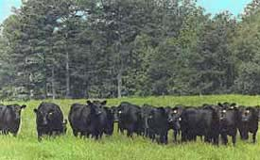
Angus are solid black cattle, although white may appear on the udder
They are resistant to harsh weather, undemanding, adaptable, good natured, mature extremely early and have a high carcass yield with nicely marbled meat
Angus are renowned as a carcass breed
They are used widely in crossbreeding to improve carcass quality and milking ability
Angus females calve easily and have good calf rearing ability
They are also used as a genetic dehorner as the polled gene is passed on as a dominant characteristic

Slide 16
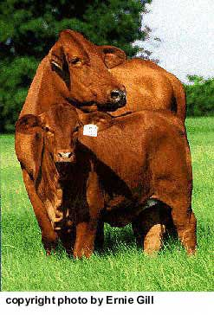
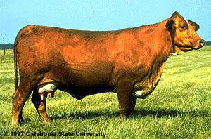
Beefmaster – various colors, horned
Developed in the U.S. from Brahman, Hereford, and Shorthorn breeds
Breed known for its six essentials - Weight, Conformation, Milking Ability, Fertility, Hardiness and Disposition

Slide 17
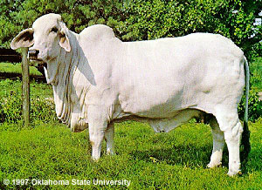
Brahman are easily identified by the hump on their back and long floppy ears
Also called “Brahma” or “zebu.”
Various colors - most common colors are solid gray or solid red
Originated from Bos indicus cattle originally brought from India
Through centuries of exposure to inadequate food supplies, insect pests, parasites, diseases and the weather extremes of tropical India, the native cattle developed some remarkable adaptations for survival
Brahman have loose saggy skin with sweat glands and the ability to sweat freely through the pores of the skin, which contributes materially to their heat tolerance
They can walk long distances to water and these cattle thrive where other types of cattle, at best, merely survive

Slide 18
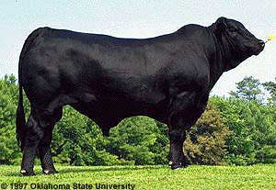
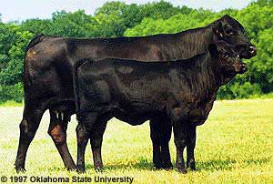
The Brangus breed was developed to utilize the superior traits of the Angus and Brahman breeds
3/8 Brahman and 5/8 Angus
Brangus – black and polled predominate
U.S. breed developed around 1912
There are red Brangus which is a separate breed

Slide 19
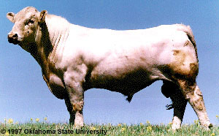
Charolais cattle have changed beef production concepts almost as much as the original British breeds did in the American Southwest more than a century ago
They originated around Charolles in Central France
Charolais are medium to large framed beef cattle with a very deep and broad body
Their color is white to cream with a pink muzzle and pale hooves
They have a short, broad head and heavily muscled loins and haunches
Demonstrated a definite superiority in growth ability, efficient feedlot gains and in carcass cut-out values
With excellent meat conformation, especially of the valuable parts and relative late maturity they are well suited to fattening for high finished weight
Heifer calving can be difficult
They are well suited to all purpose cross breeding

Slide 20
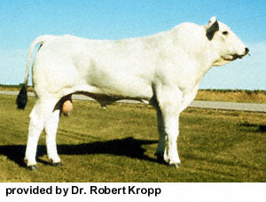
Chianina are big cattle! Chianina (pronounced Kee-a-nee-na) is one of the oldest breeds of cattle in the world
Originating in Central Italy, Chianina were initially introduced into the United States in 1971, when the first Chianina semen was imported
Chianina have short hair that varies from white to steel gray in color - bulls are often a darker gray around their front ends
Both sexes have black pigmented skin
The short horns curve forward and are usually black in the younger animals but become lighter, beginning at the base, as the animals mature
The most noticeable characteristic of the breed is the extensive and well-defined muscling
The shoulders, back and rear quarters are especially well formed. The legs are longer than most breeds and the bodies are not proportionally as long as some breeds that have shorter legs
The faces are rather long and straight

Slide 21
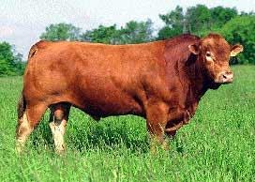
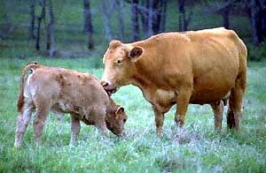
Gelbvieh (Gelp-fee) - – golden colored; horned or polled
Originated in Austria and Germany
Developed as a dual purpose breed used for draft, milk, and meat
Proponents of the breed claim the breed has superior fertility, calving ease, mothering ability, and growth rate of the calves

Slide 22
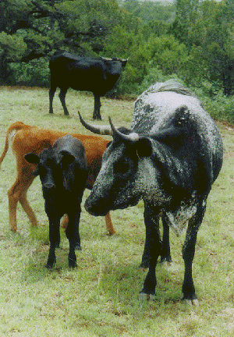
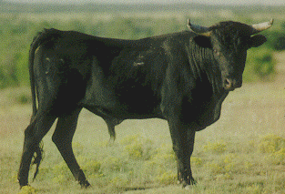
The Corriente can be traced back to the first cattle brought to the new world by the Spanish as early as 1493
In Florida, the few remaining small, native cattle - cousins of the Mexican Corriente are called Scrub cattle or Cracker cattle, and similar cattle in Louisiana are called Swamp cattle
"Corriente" are is the most common term used at the Northern Mexico border to refer to the cattle purchased for rodeo use
Corriente are small, narrow, lean, agile cattle with well attached medium length, curved horns
That's why they are the favorite of ropers and doggers at rodeos
The North American Corriente Association was established in 1982

Slide 23
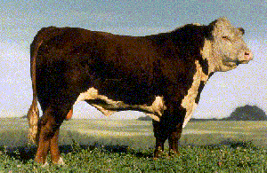
Herefords are an ancient breed
They have short thick horns that typically curve down at the sides of the head
Polled Herefords were developed from the horned Hereford breed and among the horned Herefords an occasional calf would be born which did not develop horns
This change from parents' characteristics is known as a "mutation."
These cattle soon came to be called "polled," which means naturally hornless
Both Hereford breeds are medium framed cattle with distinctive red body color with the head and front of the neck, the brisket, underside, and switch in white
They have well developed fore-quarters, a deep brisket, broad head and stocky legs
They are generally docile and fast growing cattle with good beef quality

Slide 24
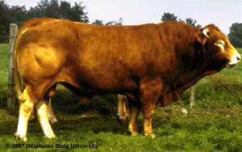
Limousin originated in an area in the middle of France and were first imported into US in 1971
They are medium to large framed beef cattle of rectangular shape
The hair is yellow straw colored to reddish gold with lighter circles around the eyes and muzzle, and shading to a lighter color on the legs
Limousin have a long length of body and exceptional rump
They are heavily muscled with a relatively small head and pale horns and hooves
They have the ability to put long hair on for colder climates and short hair for warmer climates and are prolific and long lived
Limousin on feed show high daily weight gain with high carcass yield
The combination of good cutability and medium size has given the Limousin its reputation for feed efficiency
Feedlot operators like them because they tend not to put on fat. Well suited to all purpose cross breeding
Moderate birthweights contribute to a substantially lower incidence of calving problems relative to other breeds, while there is also a consistent pattern of increased weaning and yearling weight in crossbred calves
They can be temperamental

Slide 25
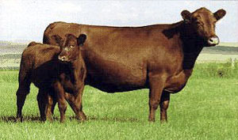
The Red Angus breed originated in the British Isles and recorded reference to the appearance of red cattle dates back to 1805
Growing notoriety of the breed is bringing worldwide demand for breeding stock from South Africa, Australia and South America, where the majority of the cattle are red in color
Red Angus has become the leading U.S. beef breed in semen exports
In the U.S., the number of Red Angus has tripled from the mid-1980’s through the mid-1990’s
The main difference between Red Angus and black Angus is color

Slide 26
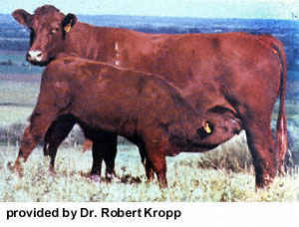
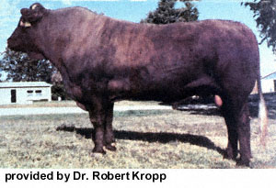
Salers (Sa'lair) - Uniform mahogany red with medium to long hair
The breed is considered to be one of the oldest and most genetically pure of all European breeds
Horned
Raised in the mountainous area of France, where they were selected for milk, meat, and draft

Slide 27
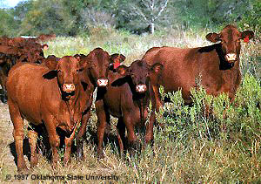
Santa Gertrudis were developed on King Ranch to function in hot, humid, and unfavorable environments
Developed by crossing Indian Brahman cattle with British Shorthorns
In 1940, Santa Gertrudis was recognized by the U.S. Department of Agriculture as the first beef breed developed in the United States
Even today Santa Gertrudis are referred to as America's original beef breed
Santa Gertrudis cattle are approximately five-eighths Shorthorn and three-eighths Brahman
They are a deep cherry-red color with a relatively high degree of both heat and tick resistance
Santa Gertrudis females are known for their exceptional maternal traits
Their characteristics include ease of calving, good mothering ability and abundant milk supply

Slide 28
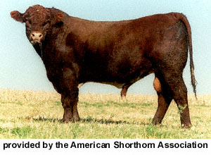
Shorthorn originated Tees River Valley in the northeastern part of England in the counties of Northumberland, Durham, York and Lincoln
They were brought to America in 1783 and were popular with America's early settlers
Over 30 other breeds of cattle show traces of Shorthorn in their parentage
Although color ranges from red to roan to white, roan (a mixture of red and white) and red are the predominant colors
They are a medium size breed with a truly rectangular shape with a short, broad head and wide set eyes
And, you guessed it, they have short horns
Shorthorns are known for their early maturity, adaptability, mothering ability, reproductive performance, hardiness, good disposition, feed conversion, and longevity
In the feedlot, these cattle attain 1,000 to 1,200 pound weights at an early age and have no trouble producing carcasses that grade Choice

Slide 29
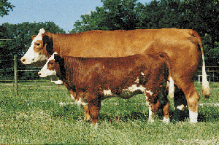
Simmentals came from western and northern Switzerland
The Simmental, one of the more docile and easy to manage breeds, is known for a long straight topline with deeply muscled back and loin
Medium to large cattle with strong bones, bulls typically weigh 2200 to 2800 pounds at maturity and cows 1200 to 1600 pounds
The females have a productive lifetime of ten to twelve years and high milk production
Simmental are spotted, occasionally with just a few white markings
The color varies from pale gold to dark reddish brown
The head is usually white in front of the eyes with the lower parts of the legs also largely white
In the feedyard they have a weight gain of 2 to 3 pounds a day and excellent feed conversion with about a 63% carcass yield
They are suited to all-purpose crossing with smaller breeds

Slide 30
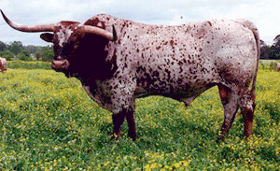
Texas longhorns were brought by the Spanish via Mexico into Texas in the sixteenth century
After the Civil War (1861-65) there was an explosive increase in their population
Cattle intended for slaughter were driven slowly along the wide 'cattle trails', often taking two years to reach market in the more densely populated north east
After the extremely hard winter of 1885/86, and the subsequent extremely dry summer and an unusually severe blizzard in January 1887, holdings completely collapsed and the importance of this breed was practically destroyed
By the 1920s there were only a few hundred Longhorns remaining
They are small, slim cattle, very variable coloring
An individual animal may have areas of black, gray, brown and white
There are examples which are mono-colored, or have patches, spots or brindling
They are long legged, slim and lightly muscled
Very easy calving
The horns are impressively long and spreading

Slide 31
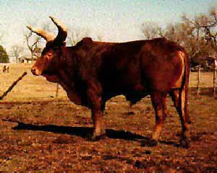
Watusi are medium-sized animals, with long, large-diameter horns, they attract attention wherever they appear
These regal animals can easily trace their ancestry back more than 6,000 years and have often been referred to as "cattle of kings."
The Ankole-Watusi cattle are distributed from Lake Mobutu to Lake Tanganyika in eastern Africa
Horns are long and symmetrical, with a base large and proportional to horn length
Lyre and circular shapes are preferable to flat
The Ankole-Watusi is medium in size, with cows weighing 900 - 1200 pounds and bulls weighing 1000 - 1600 pounds
Newborn calves weigh 30 - 50 pounds
This small birth-weight makes Ankole-Watusi bulls useful for breeding to first-calf-heifers of other breeds

Slide 32
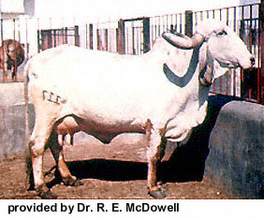
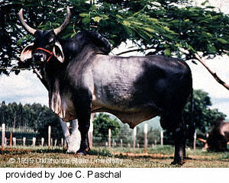
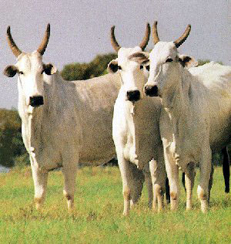
Zebu cattle breeds include Gyr, Guzerat, Indu-Brazilian, Nelore, Red Zebu and Gray Zebu
They originated in India, and are thought to be the world's oldest domesticated cattle
They were introduced into the United States as early as 1849
The first importations of Zebu were bullocks for draft purposes, but they later interbred with other cattle breeds and produced hybrids which were bigger, faster growing, and more thrifty
These cattle often did better than the cattle which the colonists had brought from Europe
These Bos indicus breeds add environmental adaptability to tropical and subtropical conditions, insect tolerance and some disease resistance, longevity, and maternal ability, especially in crosses with Bos taurus breeds
The cattle are gentle without a disposition problem and are fertile under adverse conditions

Slide 33
Beef Cattle Selection, evaluation and genetics

Slide 34
Animal Selection for
production systems
Selection:
Purebreds are often selected on the basis of personal preference or the preference of the consumer in the area.
For commercial breeders, smart producers will choose a cow breed that matches size and milk production to the available feed and environment and will choose a bull breed that matches what the market wants.
However, with so many good breeds available and germplasm (like sperm and eggs/embryos) technologies making them easy to access worldwide, it may be difficult to make a decision. Over 50 breeds in US, only 8 are widely used in crossbreeding systems.

Slide 35
Animal Selection for
production systems
Commercial Producers should consider:
1. Purpose – pleasure or profit
2. Market – Will you be able to sell the calves?
3. Uniformity - in size and type; important to the buyer
4. Health - All should be free from diseases and parasites and thrifty
5. Body condition – emaciated (extremely thin) and overfat animals may be bad
6. Age and longevity – start with majority of mature cows and a proven bull; a younger bull can be purchased with limited capital (money); average culling age is around 9.6 years for cows and 6.3 years for bulls

Slide 36
Animal Selection for
production systems
7. Adaptation –consider temperature and environment
8. Price – should not have to pay much in excess of market price for cows, but should get a superior bull
9. Conformation – correct body structure

Slide 37
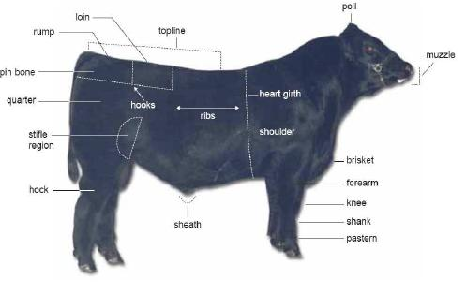
External Parts of Beef Cattle

Slide 38
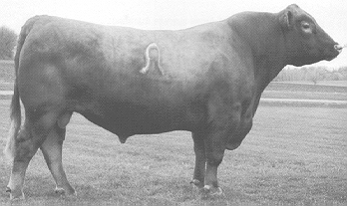
Desirable Skeletal Structure Beef

Slide 39
BCS in Cattle
Guidelines for BCS
A thin cow looks very sharp, angular and skinny while a fat one looks smooth and boxy with bone structure hidden from sight or feel
All others fall somewhere in between

Slide 40
BCS in Cattle

Slide 41
BCS in Cattle
1. EMACIATED: Starving and weak. No palpable fat detectable over back, hip bones or ribs. Tail-head and ribs project quite prominently

Slide 42
BCS in Cattle
2. POOR: Poor milk production and reproduction. Chances of rebreeding slim. Cow still emaciated but tail-head and ribs less prominent. Backbone is still rather sharp to the touch but some tissue exists along the backbone

Slide 43
BCS in Cattle
3. THIN: Poor milk production and reproduction. Ribs are still individually identifiable but not quite as sharp to the touch. Obvious palpable fat along the spine and over the tail-head with some tissue over top portion of the ribs

Slide 44
BCS in Cattle
4. BORDERLINE: Reproduction bordering on inadequate. Individual ribs no longer visually obvious. Individual spines can be identified on palpation but fell rounded rather than sharp. Some fat cover over ribs and hip bones.

Slide 45
BCS in Cattle
5. MODERATE: Minimum necessary for efficient rebreeding and good milk, production. Cow has generally good overall appearance. Upon palpation, fat cover over ribs feels spongy and area on either side of tail-head now has palpable fat cover

Slide 46
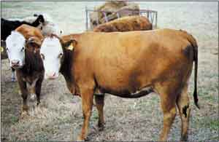
BCS in Cattle
6. OPTIMUM: Milk production and rebreeding very acceptable. Firm pressure now has to be applied to feel spinous processes. A high degree of fat is palpable over ribs and around tail-head

Slide 47
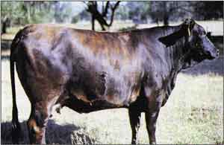
BCS in Cattle
7. GOOD: Maximum condition needed for efficient reproduction. Cow appears fleshy and obviously carries considerable fat. Very spongy fat cover over ribs and around tail-head. Some fat around vulva and crotch.

Slide 48
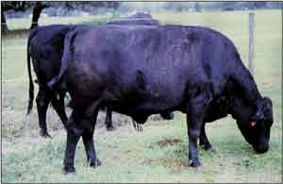
BCS in Cattle
8. FAT: Very fleshy, no advantage in having cow this condition. Backbone almost impossible to palpate. Cow has larger fat deposits over ribs, around tail-head and below vulva

Slide 49
BCS in Cattle
9. EXTREMELY FAT: The fat may cause calving problems. Cow extremely wasty and patchy. Tail-head and hips buried in fatty tissue. Bone structure no longer visible and barely palpable. Animal's mobility maybe impaired by fat deposits

Slide 50
Genetics
Gametogenesis – production of gametes
Spermatogenesis – production of sperm
Oogenesis – production of ova
Meiosis – type of division in which gametes are formed
Each gamete carries half the number of chromosomes of a typical body cell in that species (haploid; n)
Diploid (2n) – has chromosomes in pairs; one member from each pair comes from the sire and one member comes from the dam

Slide 51
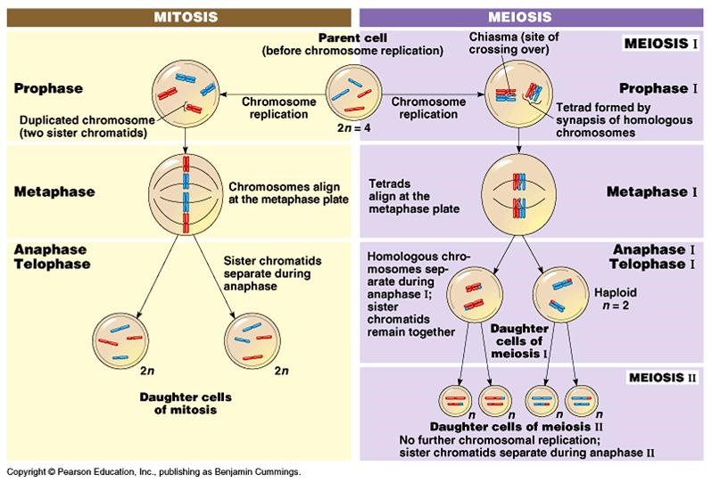

Slide 52
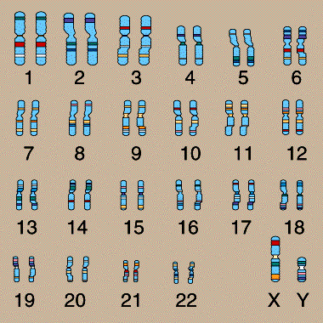
Genetics
Phenotype – what you see
Genotype – genetic make-up
Chromosome – rod-like structures within the nucleus that contains genetic codes
Gene – located on the chromosome and contains coded information that affects a characteristic or trait

Slide 53
Genetics
Species | Number of Pairs
Turkeys | 41
Chickens | 39
Horses | 32
Cattle | 30
Goats | 30
Sheep | 27
Humans | 23
Swine | 19

Slide 54
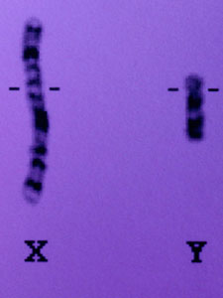
Genetics
X and Y chromosomes determine the sex of mammals
XX = females
XY = males
Female contributes X, while male contributes X or Y to offspring
Homozygous – same genetic code on a pair of genes
Heterozygous – different genetic code on a pair of genes
Alleles – Genes that occupy corresponding loci in homologous chromosomes but that affect the same characteristics in different ways (eg. Black or red color)
Dominant allele – allele that overpowers or dominates
Recessive allele – allele whose expression is suppressed

Slide 55
Genetics
B
B
B
BB | BB
BB | BB
Simple Inheritance – (Qualitative traits) : simple coat colors, polled vs horned, etc.
Usually dominant gene and recessive gene, but in the case of roan coloring, there is partial or incomplete dominance
Six types of mating
Homozygous dominant X Homozygous dominant
BB X BB
Homozygous dominant X Heterozygous
BB X Bb
Homozygous dominant X Homozygous recessive
BB X bb
All Black
B
B
b
B
BB | Bb
BB | Bb
All Black
B
b
b
B
Bb | Bb
Bb | Bb
All Black
B

Slide 56
Genetics
B
b
B
BB | Bb
Bb | bb
Heterozygous X Heterozygous
Bb X Bb
Heterozygous X Homozygous recessive
bb X Bb
Homozygous recessive X Homozygous recessive
bb X bb
3 Black; 1 Red
b
B
b
b
Bb | bb
Bb | bb
2 Black; 2 Red
b
b
b
b
bb | bb
bb | bb
All Red
b

Slide 57
Multiple Gene Pairs
Multiple-gene inheritance (Quantitative traits): milk production, meat production – characters for which many genes are responsible and for which there are “gradations”
B = black (dominant); b = red (recessive); P = polled (dominant); p = horned (recessive)
Heterozygous X Heterozygous (BbPp X BbPp)
BP
Bp
bP
bp
BP
BBPP | BBPp | BpPP | BbPp
BBPp | BBpp | BbPp | Bbpp
BbPP | BbPp | bbPP | bbPp
BbPp | Bbpp | bbPp | bbpp
9 Black and polled
3 Black and horned
3 Red and polled
1 Red and horned
Bp
bP
bp

Slide 58
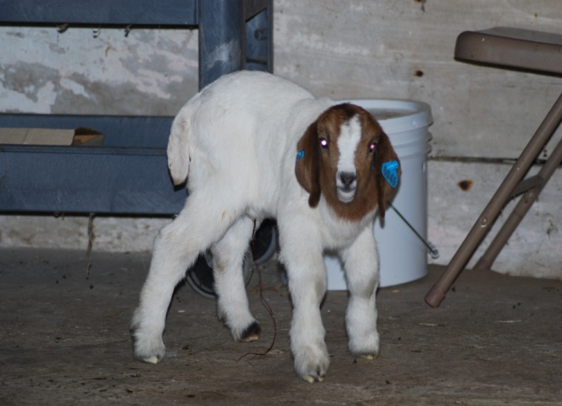
Heritability
Estimate of the percentage of phenotypic variations due to genetics
Quantitative traits – can be measured/described (growth traits, size, speed etc.)
Qualitative traits – subjectively measured (hair color, horned versus polled, etc.)
Selection – preventing some animals from reproducing and allowing others to

Slide 59
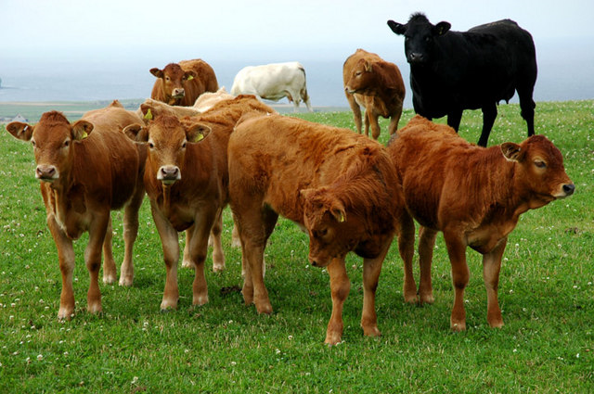
Heritability
Selection differential (reach) – superiority (or inferiority) of the selected animals compared to the herd average
Example – average weaning wt of selected replacement females = 400lb; herd average weaning wt = 350 lbs; Selection differential = 50lbs
Predicting genetic change
Genetic change/year = heritability x selection differential
Generation Interval
Generation interval – Average age of parents when offspring are born
Average age of all breeding females + average age of all breeding males
2

Slide 60
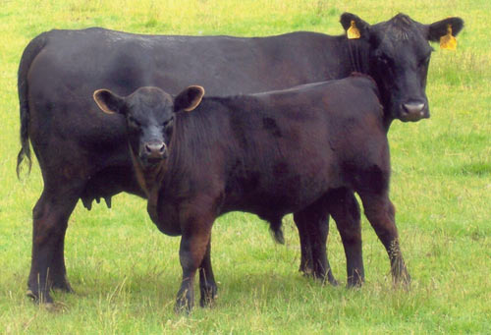
Heritability
Table 13.4
High heritability (40-50%) – carcass traits, weight at puberty, scrotal circumference
Medium heritability (30-35%) – performance traits such as weaning weights, milk performance, etc.
Low heritability (10-20%) – reproductive traits such as calving interval etc.

Slide 61
Heterosis
Biological phenomenon where crossbreds out-produce the average of their parents.
The > the genetic difference between two breeds, the > the heterosis.

Slide 62
Individual Heterosis
%
H
E
T
E
R
O
S
I
S
Individual heterosis results because an
animal is crossbred, regardless of parents, Cundiff et al., 1994

Slide 63
Breed Complementarity
Combine desirable traits from two or more different breeds to produce superior crossbred animals.
More predictable, complementary results are associated with highly heritable traits.
Max benefit achieved with terminal crosses.
> selection for medium to highly heritable traits
feedlot performance, carcass traits, mature size, etc.

Slide 64
Breed Complementarity
Examples:
Climate adaptability
Angus - Brahman
Carcass traits (quality and yield)
Angus - Charolais

Slide 65
Nutrition
Nutrient – any feed constituent that functions in the support of life
Classified as
Concentrates
Include cereal grains (corn, wheat, barley, oats, and milo), oil meals (soybean meal, linseed meal, and cottonseed meal), molasses, and dried milk products
High in energy, low in fiber, and highly digestible
Roughage
Include legume hays, grass hays, and straws
Silage, stovers, soilage, and grazed forage
High fiber, less digestible than concentrates

Slide 66
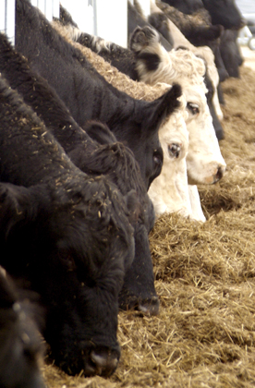
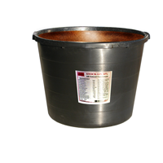
Nutrition
Six basic nutrients
Water, carbohydrates, fats, protein, vitamins and minerals

Slide 67
Nutrition
Water
Contains hydrogen and oxygen
Water and moisture used interchangeably
Water refers to drinking water
Moisture refers to the amount of water in feed or ration
Moisture in feed ranges from 10 (air dry feeds) to >80% (fresh green forage)
After accounting for moisture, the remainder of the feed is referred to as dry matter (DM)
Animals die faster from lack of water than any other nutrient
Beef cattle 4–15 gallons; sheep and goats 2-3 gallons

Slide 68
Nutrition
Carbohydrates
Found in plant and animal tissue
Contain carbon, hydrogen, and oxygen
Energy source
Simple (starch) or complex (cellulose)
Grazing ruminants make the most effective use of forages

Slide 69
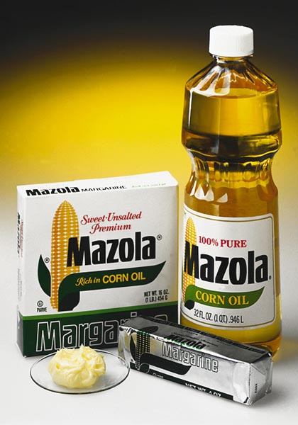
Nutrition
Fats
Fats and oils (lipids)
Contains carbon, hydrogen, and oxygen
Fats are solids and oils are liquid at room temperature
Fats contain 2.25 times more energy/lb than carbohydrates

Slide 70
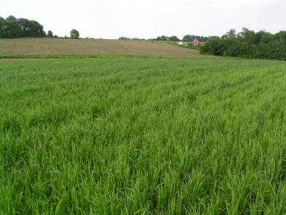
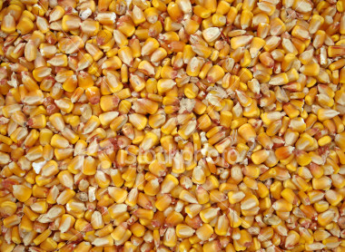
Nutrition
Fatty acids
Saturated – single bonds
Unsaturated – one or more double bonds
Polyunsaturated – those having more than one double bond
Linoleic (omega-6 fatty acid) and alpha-linoleic (omega-3 fatty acid) – essential fatty acids

Slide 71
Nutrition
Proteins
Polypeptides containing hydrogen, oxygen, carbon, and nitrogen
Amino acids are building blocks
Protein in feed contain 16% nitrogen on average
Feeds are analyzed for the %N
% multiplied by 6.25 (100%/16% = 6.25) to convert to % protein
Example – if a feed is 3% nitrogen (3 x 6.25 = 18.75% protein)
Amino acids classified as essential or non-essential

Slide 72
Nutrition
Essential – must be provided via dietary means
Non-essential – are required, but synthesized by the animal
Minerals
Inorganic – contain no carbon
Macro minerals – required in larger amounts
Micro minerals – required in small amounts
Selenium and vitamin E work together to help prevent White Muscle Disease

Slide 73
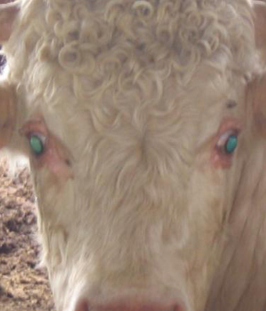
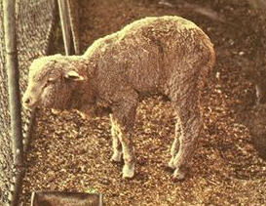
Nutrition
Vitamins
Organic nutrients needed in small amounts to provide for specific body functions
16 known vitamins that function in animal nutrition
Classed as either fat soluble (A, D, E, and K) or water soluble (B and C)

Slide 74
Nutrition
Fat soluble
Vitamin A – maintains proper repair of internal and external body linings
Adversely affect the eyes (have inner linings)
Vitamin D – needed for proper use of Ca and P in bone growth and repair
Produced by the action of sunlight on sterols of the skin)
Vitamin E – excellent antioxidant (preventing the breakdown of cells by free radicals)
Vitamin K – important in blood clotting; hemorrhage might occur if not present

Slide 75
Nutrition
Water-soluble vitamins
Ascorbic acid (Vitamin C)
B Vitamins – biotin, choline, cyanocobalamin (vitamin B₁₂), folic acid, niacin, pantothenic acid, pyridoxine (vitamin B₆), riboflavin (vitamin B₂), and thiamin (Vitamin B₁)
Microorganisms make all the water soluble vitamins
Most fat soluble vitamins are not synthesized by ruminants and must be supplied in the diets (with the exception of vitamin K which is synthesized by rumen bacteria)

Slide 76
Nutrition
Proximate analysis
Separates feed components into groups according to their feeding value
Determines the nutrient composition of feed
Determines inorganic and organic components
Including water, crude protein, crude fat (ether extract), crude fiber, nitrogen-free extract (NFE), and ash (minerals)

Slide 77
Nutrition
Digestibility – refers to the amount of various nutrients in a feed that are absorbed from the digestive tract
Feeds and nutrients vary greatly in digestibility
Digestibility trials
Feeds with known composition are fed and feces analyzed to determine absorption
For example, digestibility of protein
Nitrogen in feed – nitrogen in feces X 100
Nitrogen in feed
25lbs of feed contain 3.2g Protein and 100 g of feces contains 0.8 g of nitrogen, % digestibility =
3.2 – 0.8 X 100 = 75%
3.2

Slide 78
Nutrition
Energy evaluation of feeds
Carbohydrates, fats, and proteins
Carbohydrates – most economical energy source
Energy needs account for the largest portion of feed consumed
Total digestible nutrient (TDN) – historically the most commonly used energy estimate system
Expressed as lbs, kg, or %

Slide 79
Nutrition
TDN is being replaced by estimates of net energy (NE)
More precise than TDN
Calories (cal) – amount of energy or heat required to raise the temperature of 1 g of water 1°C
Kilocalories (kcal) - amount of energy or heat required to raise the temperature of 1 kg of water 1°C
Megacalorie (Mcal) – equal to 1,000 Kcal or 1 million calories

Slide 80
Nutrition
Maintenance and Production
Feeds provide energy for 1) maintenance and 2) production
Maintenance – energy used to maintain basal metabolism, generate heat to warm body, energy to cool body, provide for voluntary activity of the animal
Production – fetal development, semen production, growth, fat deposition, production of milk, eggs, and wool
Measurement of Energy
Bomb calorimeter

Slide 81
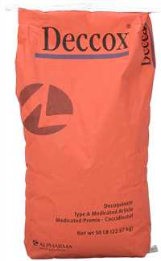
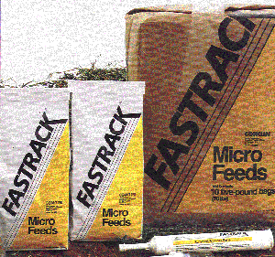
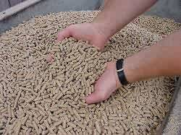
Nutrition
Classification of feeds
Feeds – naturally occurring ingredients in diets of farm animals used to sustain life
Feedstuff – includes non-nutritive products such as additives to promote growth, and reduce stress, to give flavor and palatability, to add bulk or to preserve feeds in the ration

Slide 82
Nutrients
National Research Council (NRC) classifies feedstuff as:
Dry roughages and forages (hay, straw, fodder, stover, hulls and shells)
Range pasture plants, and green forages
Silages (corn legume, and grass)
Energy feeds (cereal grains, mill-by products, fruits, nuts, and roots)
Protein supplements (animal, marine, avian, and plant)
Mineral supplements
Vitamin supplements
Non-nutritive additives (antibiotics, coloring, flavors, hormones, preservatives, and medicants)
Feedstuff that contain >20% protein (soybean meal) are classified as protein supplements)

Slide 83
Digestion
Digestion – reduction in particle size of feed so that the feed becomes soluble and can pass across the gut wall into the vascular or lymph system (absorption)
Digestion includes
Mechanical action
Chewing and contractions of the intestinal tract
Chemical action
Secretion of HCl, bile, and the action of emzymes

Slide 84
Digestion
Parts preceding small intestine – reduce particle/feed size
Small intestine – slitting food molecules and absorbing nutrients
Large intestine – water absorption and forms indigestible waste into a solid called feces

Slide 85
Digestion
Ruminants – have four compartments
Rumen
large fermentation vat where bacteria and protozoa thrive and break down roughages to obtain nutrients for their use
Covered with large papillae to increase surface area
Microorganisms can digest cellulose and synthesize amino acids from non-protein nitrogen
Reticulum
lining looks like a honeycomb
Functions in initiating the mixing activity and provides an additional area for fermentation
Omasum
Folds produce grinding action on feed
Abomasum
True stomach
Performs similar function to monogastric stomach

Slide 86
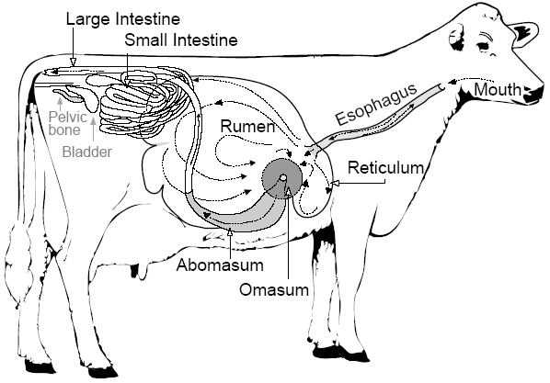
Ruminant Digestive Tract

Slide 87
Ruminant Digestion
Ruminants eat forage rapidly
Later regurgitate (while resting) each bolus of feed (cud) to allow for thorough chewing
Process continues until all feed is thoroughly masticated
Process known as rumination (animals know as ruminants)
During fermentation, large amounts of gas formed (chiefly methane and carbon dioxide)
Gases eliminated by controlled belching called eructation

Slide 88
Ruminant Digestion
Predigestive fermentation occurs in the rumen and reticulum
A condition known as "Hardware Disease" may occur if a metal object such as wire or a nail is swallowed and punctures the reticulum wall
In the abomasum, strong acids destroy bacteria and protozoa
Similar to monogastrics after this point
Bloat occurs if the animal cannot belch to release gases formed during fermentation (death can occur)
Young consumes little or no roughage and digestive tract functions more like a monogastric
Milk is diverted to the abomasum by the esophageal groove (reflex action of suckling)
Rumen takes 6-8 weeks to develop in small ruminants and 12 -16 in cattle

Slide 89
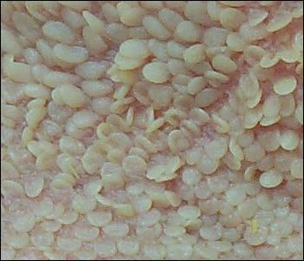
Digestion
Rumen
Reticulum
Omasum
Abomasum

Slide 90
Rumen

Slide 91
Reticulum

Slide 92
Omasum

Slide 93
Abomasum

Slide 94
Beef Cattle Diseases

Slide 95
Beef cattle
Bovine Respiratory syncytical virus (BRSV)
Causative agent – brucellosis bacteria
Signs – labored breathing, pneumonia, abortions
Prevention – vaccination annually (30 days prior to breeding)
Treatment – Antihistamines, corticosteroids

Slide 96
Beef Cattle
Neonatal Diarrhea (Calf Scours)
2nd most costly disease of Beef Cattle
Symptoms
Results in death loss (20%)poor weight gain
Less than 1 month of age
Inadequate colostral intake
Offspring of heifers
Nutrition imbalances
Unsanitary overcrowded calving areas
Wet weather

Slide 97
Beef Cattle
Cause of diarrhea in calves
Bacteria such as E. coli, Clostridium
Viruses
Protozoa such as Cryptosporidium
Most are combinations
To prevent, can vaccinate dam before calving; leave with dam; antibiotics generally don’t work but some human anti-diarrhea treatments have been said to help the scours; treat for dehydration with a commercial formula 2-6 times a day)

Slide 98
Beef Cattle
Mastitis
Causative agent – infectious bacteria (streptococci, staphylococci, or E. coli)
Signs – inflammation of the udder, decreased milk production
Prevention – detect by California mastitis test (CMT), use proper milking techniques
Treatment – most effective antibiotic, frequent milking, anti-inflammatory drugs
Milk Fever
Causative agent – metabolic disorder (low blood calcium associated with a deficiency of vitamin D and phosphorus)
Signs – muscular weakness, drowsiness, cow lies down in curled position
Prevention – proper nutrition and management of cows during dry period
Treatment – intravenous injection of calcium borogluconate

Slide 99
Beef Cattle
Shipping Fever (Pneumonia in Calves)
Most commonly diagnosed Disease in Cattle
1/3 of all calves have pneumonia during their life
10% of calves die due to pneumonia
Risk Factors for pneumonia – STRESS including:
Environmental variables

Slide 100
Beef Cattle
Nutritional deficiencies
The Role of Viruses
IBR (Infectious Bovine Rhinotracheitis)
BVD (Bovine Virus Diarrhea)
(can vaccinate; boost before shipping or any big stress; some people try probiotics which are microbial stimulating agents to stimulate “good” microbes in the rumen before shipping for overall health; house in well ventilated area; some treat with antibiotics before shipping if not going for slaughter)

Slide 101
Beef Cattle
Common reproductive diseases in cattle:
Brucellosis
Leptospirosis
IBR (Infectious Bovine Rhinotracheitis)
BVD (Bovine Virus Diarrhea)
Are infectious diseases that can affect reproductive capabilities

Slide 102
Beef Cattle
Brucellosis (Contagious abortion, Bangs disease)
Although federal and state regulations have helped to control this disease, there is still a threat and prevalence that prompts continued action.

Slide 103
Beef Cattle
Brucellosis is caused by the organism Brucella abortus
Spread from the vaginal discharge of an infected cow or from an aborted fetus
This organism has an affinity for the reproductive tract
Symptoms
Abortions
Retained placenta
Weak calves
Infertility frequently occur
Milk produced from an infected cow may also harbor the organism. The infected milk creates a public health hazard as this is the organism that causes undulant fever in humans.

Slide 104
Beef Cattle
Diagnosis is by blood test or by using a milk ring test from bulk milk tanks to detect infected dairy herds
There is no treatment for Brucellosis. It is controlled by official vaccination and entire herd test and slaughter of infected animals
Quarantines are imposed by state and federal authorities until the herd has been proven free of the disease
Prevention of Brucellosis is accomplished by official calfhood vaccination of heifer calves

Slide 105
Beef Cattle
Leptospirosis (Lepto)
At least five species of leptospira affect cattle in the United States
The most common species affecting cattle is L. pomona.
Clinical signs in adult cattle are:
Icterus (yellow mucous membranes)
Hemoglobinuria (bloody appearing urine), which are seen only occasionally
The milk of lactating cows may become thick, yellow and blood-tinged
Abortion two to five weeks after infection is common, but most occur about the seventh month of gestation

Slide 106
Beef Cattle
Diagnosis is confirmed by a blood test or culturing the organism
Vaccines are available for five of the leptospira species that affect cattle
Vaccination should be done 30 to 60 days before replacement heifers are to be bred, followed by a yearly booster vaccination

Slide 107
Beef cattle
Infectious Bovine Rhinotracheitis (IBR)
Causative agent – virus
Signs – pneumonia; fever, vaginitis, abortion, and infertility in females, preputial infections in males
Prevention – vaccination (cows-40 days prior to breeding, feeder cattle – prior to exposure
Treatment – oxytetracycline, penicillin to minimize infections

Slide 108
Beef Cattle
Bovine Viral Diarrhea (BVD)
Causative agent – virus
Signs
Feeder cattle – diarrhea containing mucus and blood (due to ulcerations throughout digestive tract)
Breeding cattle – abortions, repeat breeding (female won’t catch)

Slide 109
Beef Cattle
Prevention – vaccination, avoiding contact with infected animals
Treatment – symptomatic treatment - antibiotics, force feed

