Slide 1
Backyard Poultry
Tracy Porter
VSU SFOP Agent
Northern Neck, Middle Peninsula, Hampton Roads
Chesapeake, Virginia Beach
Eastern Shore

Slide 2
Learning Objectives
Zoning
Selection
Feeding
Care
Health
Housing and Equipment
Marketing
Processing

Slide 3
Poultry Operations--Considerations
Scope
Space
Time
Marketing/Sales
Inputs

Slide 4
Zoning
Livestock vs Poultry?
Number allowed?
Roosters
Animal trespass or running at large
Animal cruelty
Animal waste
Animals killing livestock or poultry / compensation
Registration, Fees and Inspections
www.municode.com

Slide 5
Zoning
Definitions
Permits
Inspections
Space requirements
Sanitation
Violations & Penalties
Administrative Review

Slide 6
Your Responsibilities
Running at large
Code of Virginia, § 3.2-6544.
Trespass
Code of Virginia, § 3.2-6543(B).

Slide 7
Neighbor’s Responsibilities
Running at large (dogs)
Trespass (dogs)
Animals chasing, maiming or killing poultry
Code of Virginia, § 3.2-6552.
Compensation for poultry killed by animals (dogs)
Code of Virginia, § 3.2-6553.

Slide 8
Selection
Layers vs Broilers vs Dual Purpose
Layers: Egg production
Broilers: Meat Production
Dual Purpose: Layers for 36 +/- months, then stew hen

Slide 9
Layers
Ornamental or Egg Production?
Shell color (Brown, White, Tint)
Egg size (Med through Jumbo)
Egg production (1 a day or not)

Slide 10
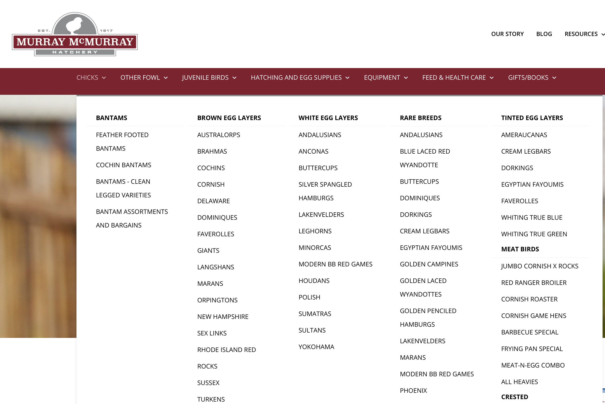

Slide 11
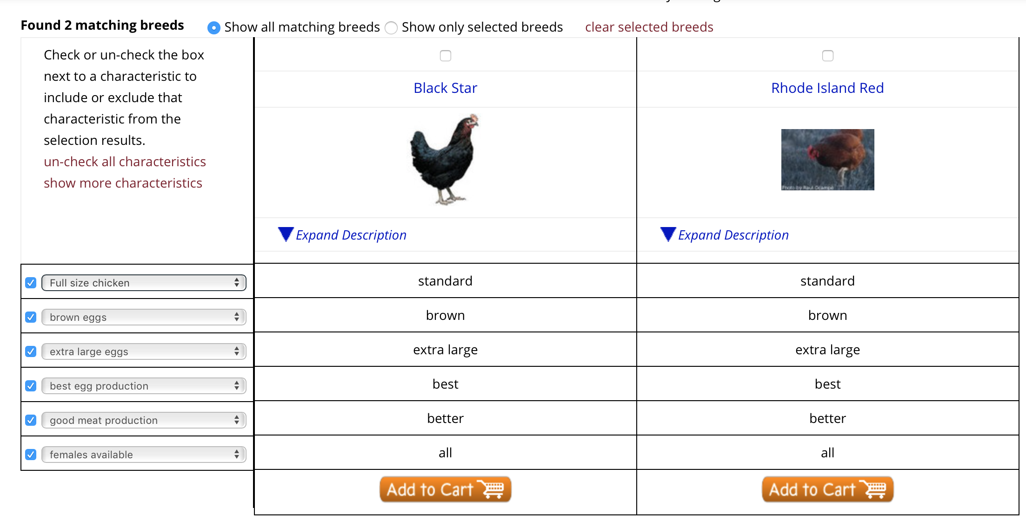

Slide 12
Chicks vs Pullets
 | Chicks | Pullets
Cost | $2-$4 | $8-$24
Quantity | Minimum 6 | Minimum 1
Time to Lay | 22-28 weeks | 3-8 weeks
Feed Cost Until Laying | 22-28 x Feed $ | 3-8 x Feed $
Cost of Electric/Time | More | Less

Slide 13
Broilers
Cornish-Rock Cross
“Red Ranger” or Freedom Ranger
Cornish Game Hen
CGH vs Fryers vs Broilers vs Roasters

Slide 14
Breed Comparison
 | Cornish-Rock | ”Ranger” | Dual Purpose
Butcher Weight | 4-6 weeks | 10-14 weeks | 22-28 weeks
Meat Quality | Large proportions Dry Less flavor | Tender Moist | More tough
Meat Flavor | Less flavor | More flavor | More flavor
Considerations | Health Problems Mortality Rate Scarred Breasts | Higher feed cost | Most feed cost

Slide 15
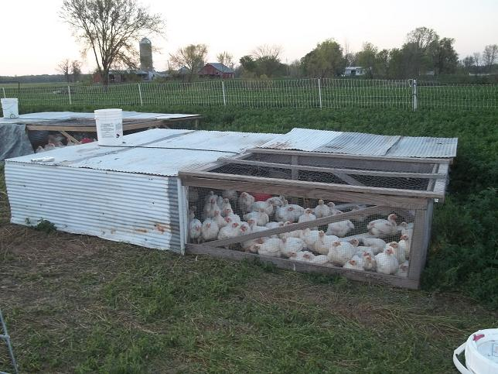
Methods of “Pastured” Poultry

Slide 16
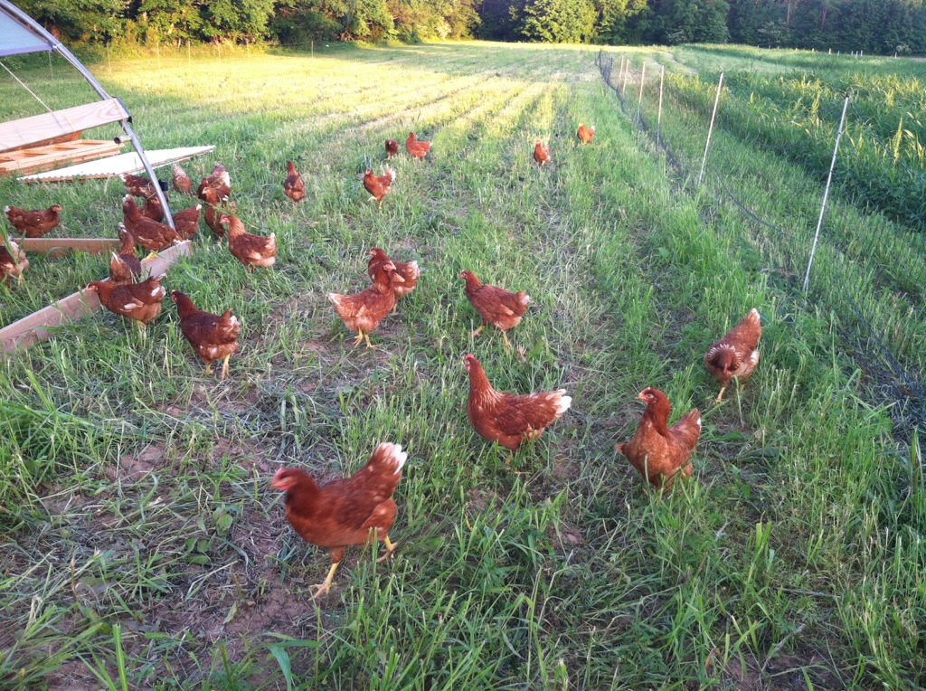
Pastured Layers

Slide 17
Hoop Style Coop & Netting System

Slide 18
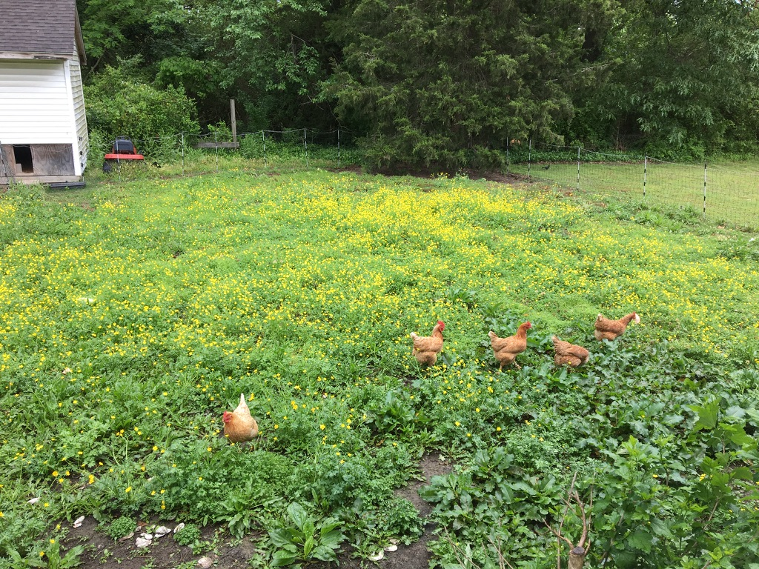
Urban “Free Range”
50’x40’, (2,000 sq ft)
15’ x 10’ coop
½ for layers
½ for brooder space
10-12 layers max

Slide 19
Method | Pros | Cons
Caged | No predator loss Precision manure placement Can be moved by 1 person | Caged High stocking density Move cages 2x/day Refill water buckets 2+x/day Cannibalism Increased heat losses
Free Range | More freedom to move Lower stocking rate Better nutrient management No cannibalism Lower time and labor Better watering system Free choice of food | Loss to hawks/owls Harder to move with one person

Slide 20
Broilers—Our Experience
CxR: 16/50 (32%) marketable as broilers @ 8 weeks
Stroke/Heart Attack/Piling/Scared Breast/Broken Legs
Freedom Rangers: 185/200 (93%) marketable
7% loss (piling, hawks, owls)
76% marketable as broilers
17% Hyperpigmentation (gray fat) are cut up

Slide 21
Feed Conversion/Net Profits Freedom Rangers
9.5 weeks: 3 lb fryer @ $3.50/lb = $10.50 22# x $0.24 = $5.28
10.5 weeks: 4 lb broiler @ $3.25/lb = $13.00 25# x $0.24 = $6.00
11.5 weeks: 5 lb broiler @ $3.25/lb = $16.25 28# x $0.24 = $6.72
12.5 weeks: 6 lb roaster @ $3.00/lb = $18.00 31# x $0.24 = $7.44
All inputs: $3-$6 net profit per bird, depending on processed weight
1,000 bird exemption: $3,000-$6,000 for 5 months

Slide 22
Care and Feeding
Plan for arrival
Brooder
Water with electrolyte and probiotic
Chick starter mash
Pine shavings (flake not fine)
Heat lamp
Thermometer

Slide 23
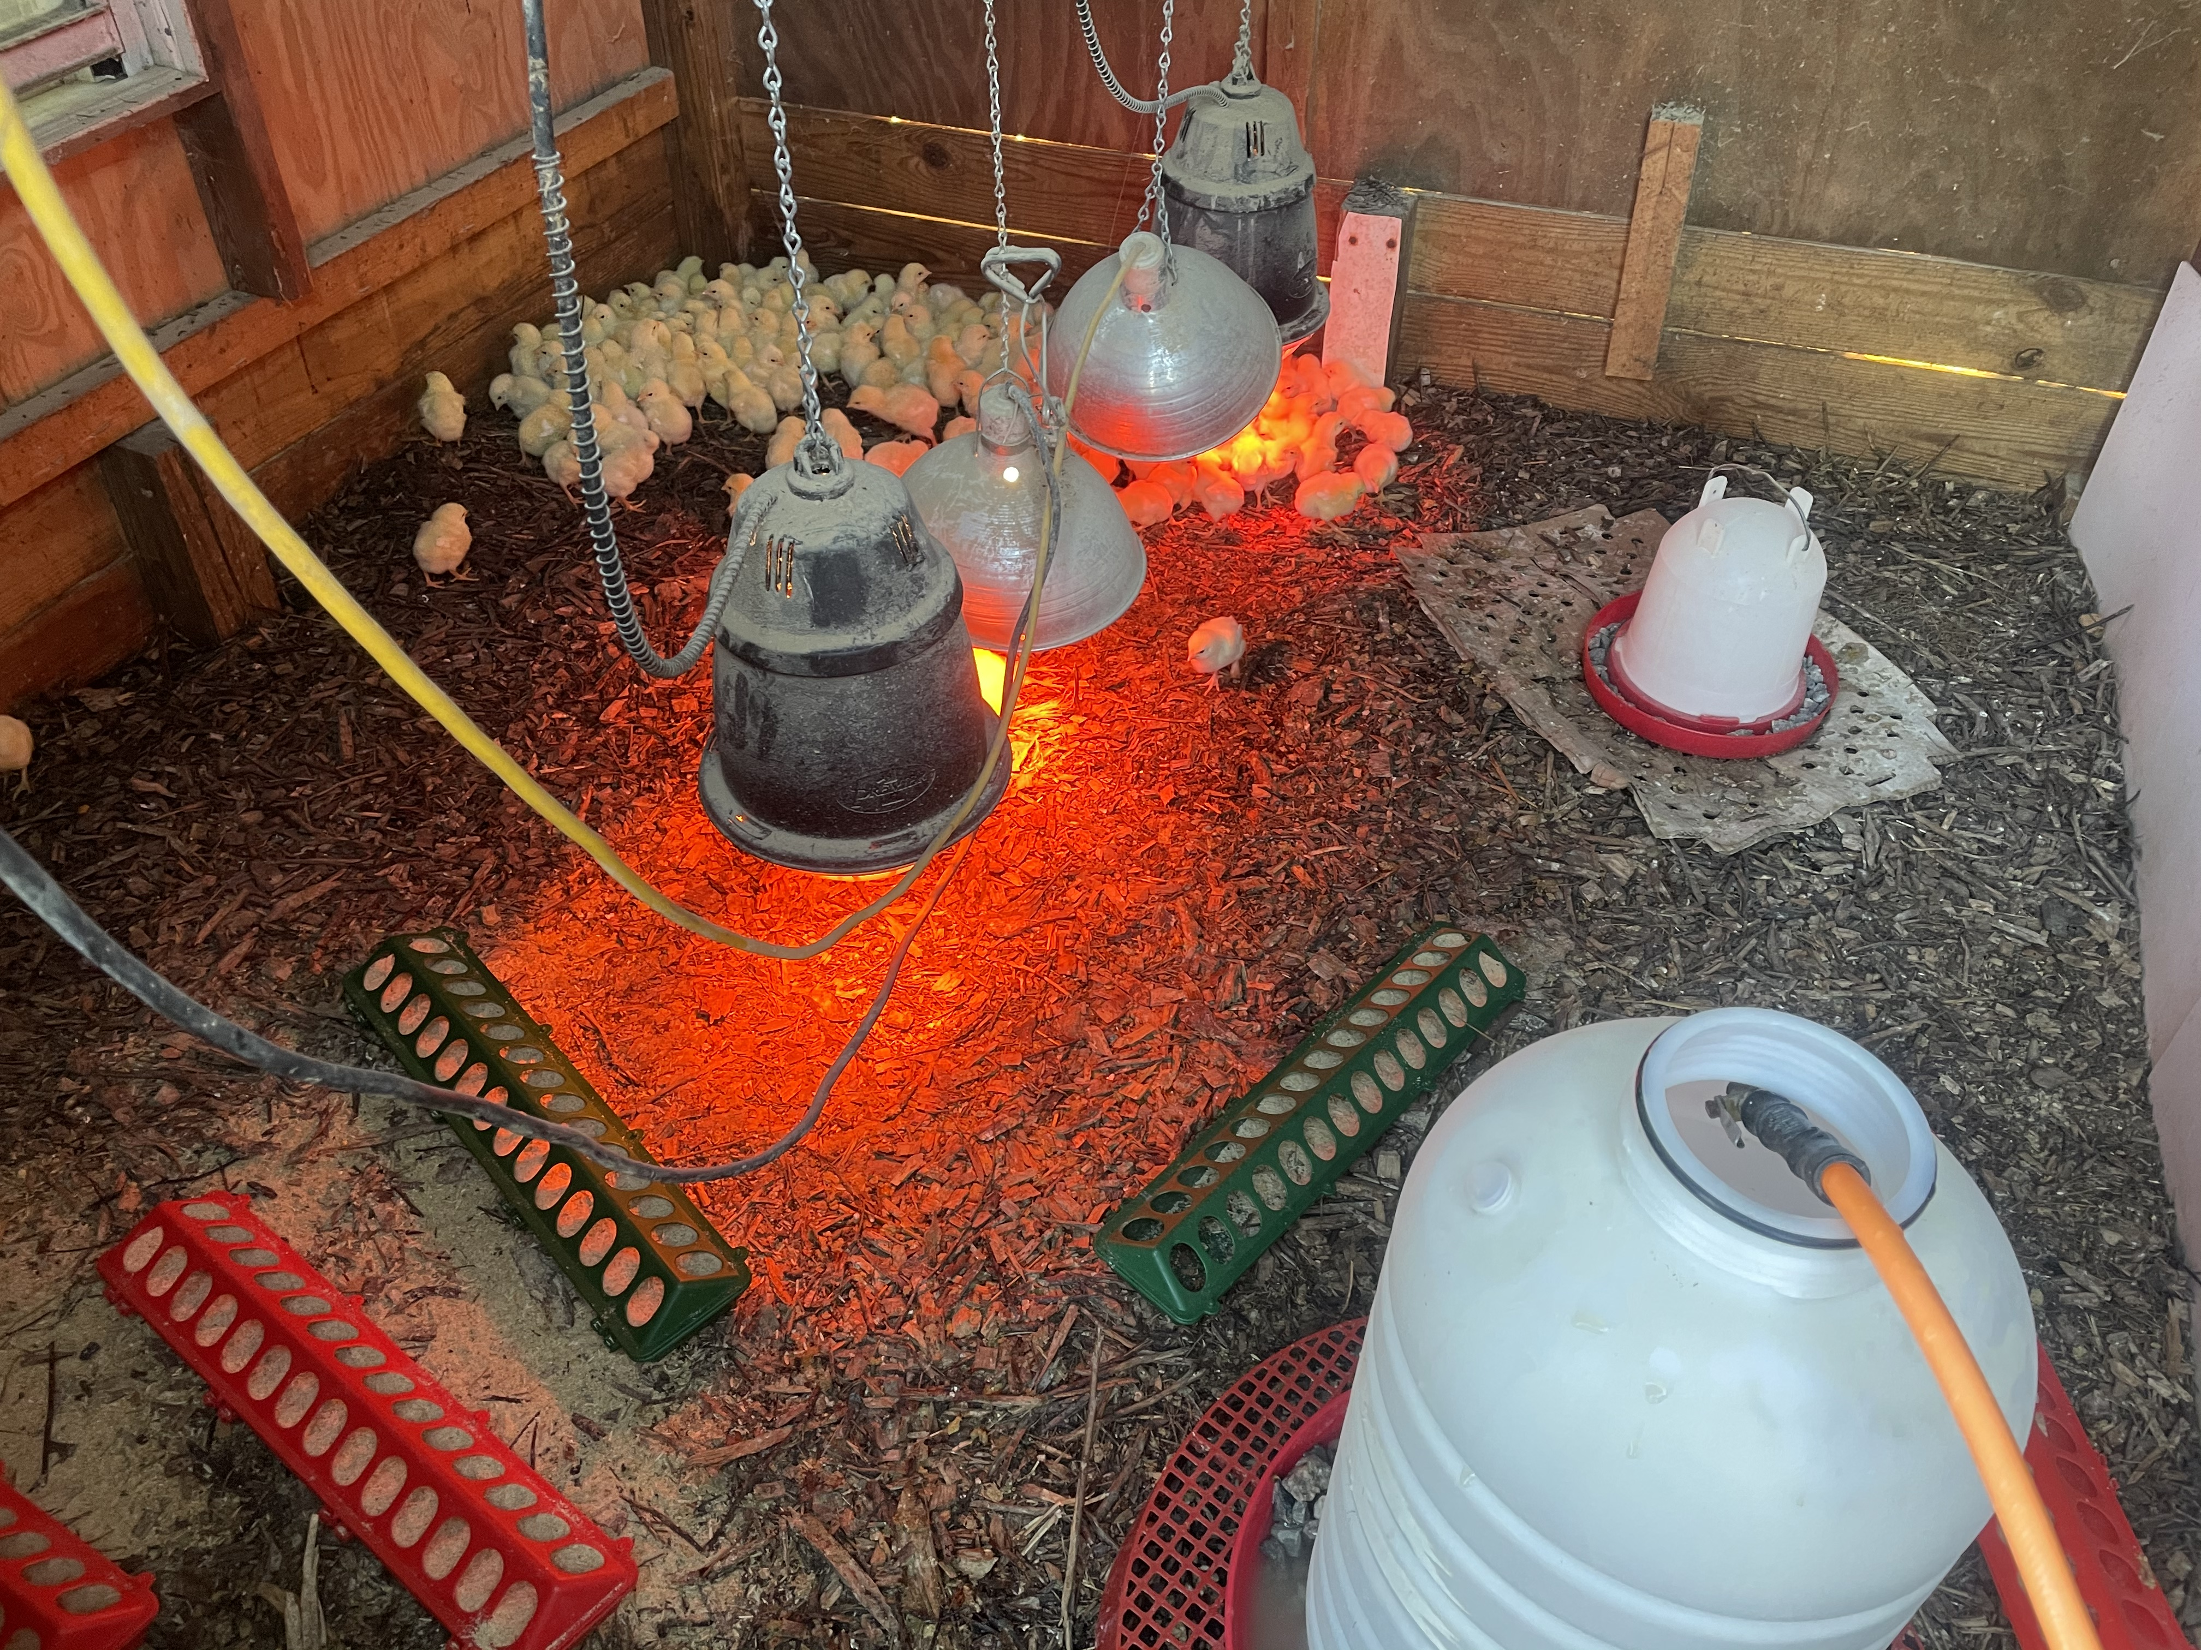

Slide 24
Care and Feeding (cont.)
98 degrees for first 3-5 days
1 degree less each day or 5 degrees less each week
80 degrees until true feathers
No drafts until fully feathered
No wet flooring, grass or bedding
Round corners to reduce piling
Free choice grit & calcium

Slide 25
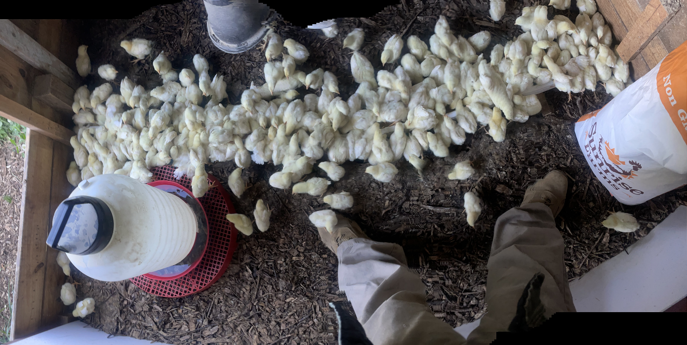

Slide 26
Breeding
You need a Rooster, or….
Buy fertilized eggs and incubate them
Incubators $50-$300
Every yolk produced by ovaries can be fertilized
21 days from fertilization until hatch

Slide 27
Health
A happy chicken is a healthy chicken
Do not participate in chicken swap meets
Mitigate pecking order
Do not mix different age birds
Reduce environmental stressors
Scout for and control pests
Free range vs caged

Slide 28
Shelter and Equipment
Security
Sanitation
Ease of Use
Train your chickens to roost
Waterers
Feeders
Pans for grit and oyster shells
Shade netting/predator bird netting
Electric poultry netting

Slide 29
”How To” Video Mobile Coop Construction
Search YouTube for “Constructing a hoop pen for pastured poultry” posted by Jaquie Jacob on December 11, 2012.
Part 1, 2, 3, 4, 5a, 5b, 6, 7 and 8.
Part 1 link: https://youtu.be/rzhGD8Kw4FA

Slide 30
Marketing
Never give away your products
Start small until you become proficient
Focus on quality
Standardize your processes
Look for ways to reduce costs
Grow your niche market
Do not get disappointed, it takes time
Your competition is Wal-mart

Slide 31
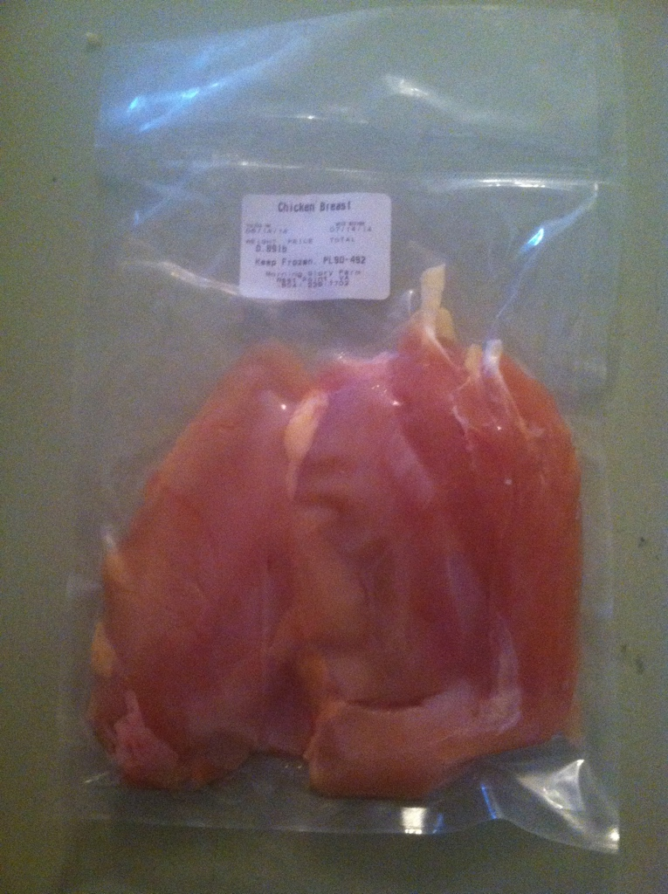
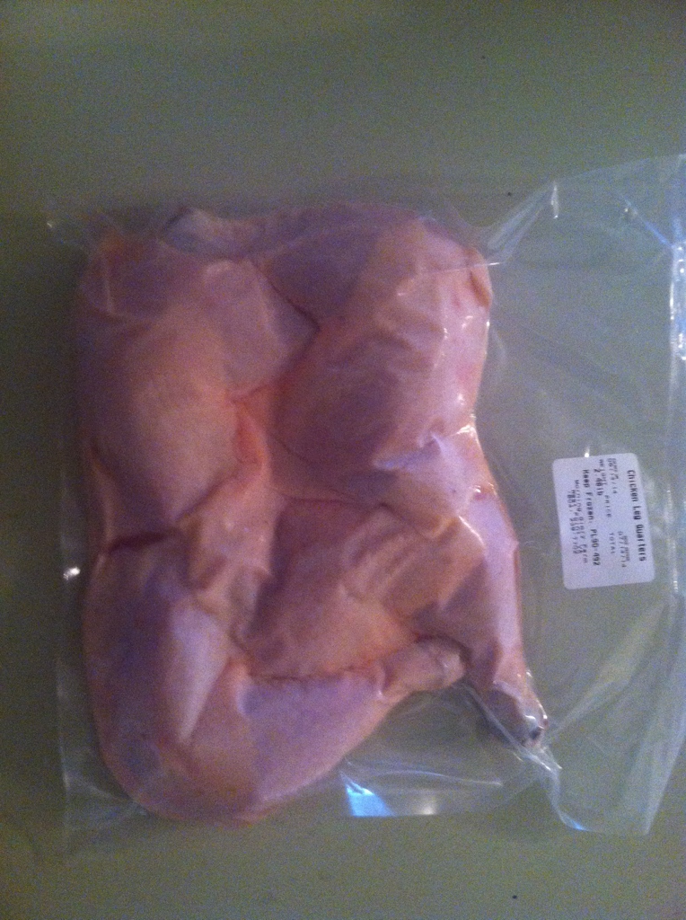
Products

Slide 32
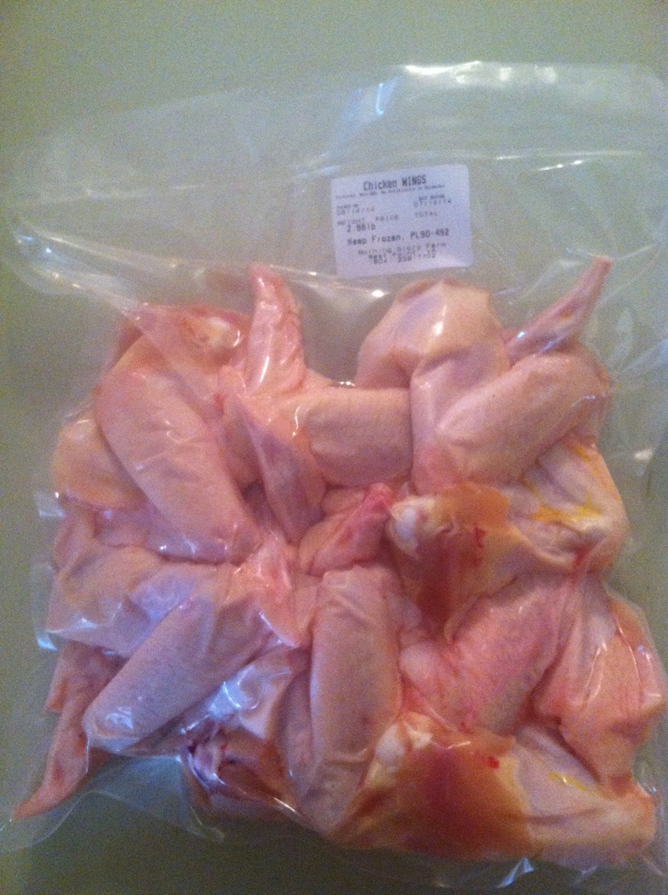
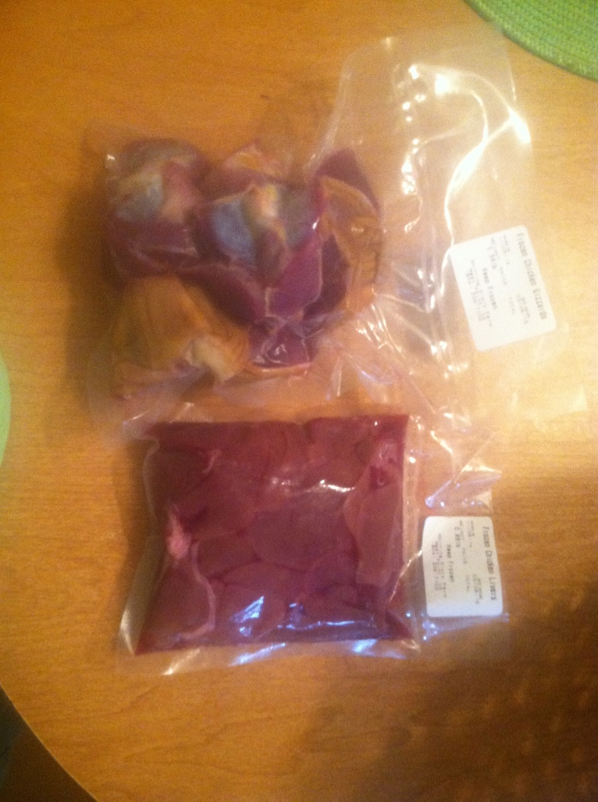
Products

Slide 33
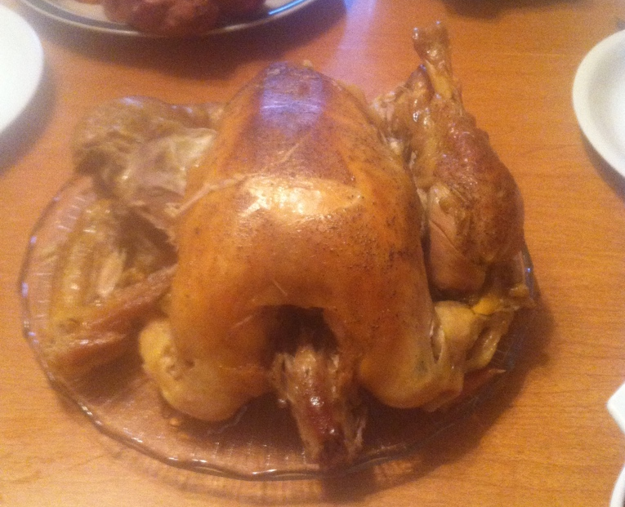
“Betty” the 10 month Broiler @ 9 lbs

Slide 34
Questions?

