Slide 1
Ursula Tankard Deitch
Regional Marketing Specialist
Office of Domestic Marketing and Promotions
Melfa, VA

Slide 2
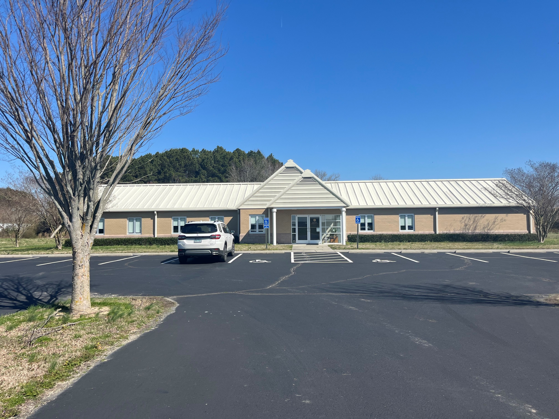
VDACS on the Eastern Shore
Who We are:
Angela Barnes
Agricultural Inspector
Office of Plant Industry Services
Nikita Higgins – (hired in 2024)
Pesticide Investigator
Office of Pesticide Services
Ursula Tankard Deitch
Marketing Specialist
Office of Marketing & Promotions
Produce Inspection Service – (only on ESVA in during growing season)
Leon White
Program Manager
Office of Fruit & Vegetable Services
18451 Garey Road, Melfa, VA 23410

Slide 3
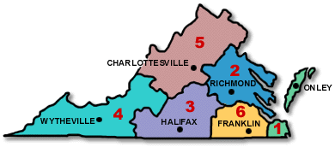
VDACS Division of Marketing & Development
Domestic Marketing & Promotions
Domestic Marketing Staff located in each of the six regions
Assists Virginia's producers and processors market their products throughout the United States and Eastern Canada.
Work with both larger farmers and small farmers throughout the state to mitigate issues and monitor crop progress throughout the growing season
Manage state commodity boards
Lindsey Anderson
(Livestock - VA Wine Board)
Vacant
Wheat, Corn & Soybeans
(VA Corn Board & VA Soybean Checkoff Board)
Ursula Deitch
(Vegetables, Aquaculture, & Nursery Crops – VA Potato Board)
Jim Atwell
(Apples, Christmas Trees, Nursery Crops – VA Apple Board)
Jennifer Atkins
(Tobacco & Hemp – VA Distilled Spirits Board & VA Tobacco Board)
Gail Milteer
(Cotton, Peanuts, & Strawberries – VA Cotton Board)
https://www.vdacs.virginia.gov/marketing-sales-and-market-development.shtml

Slide 4
VDACS Division of Marketing & Development
Programs & Promotions
Administered by Richmond staff: Marshall Payne, Alexa Pinzo, and Garrett Petro

Slide 5
Virginia Grown
Products Covered Under the Virginia Grown Label:
Virginia Grown program is a VDACS marketing tool promoting fresh, local products to consumers
www.virginiagrown.com
(website under construction and to be updated in 2024)
Fresh Fruit | Lumber
Fresh Vegetables | Aquaculture
Dairy, Meats and Eggs | CSA’s (Community Supported Agriculture)
Nursery Products | Farmers’ Markets
Christmas Trees and Seasonal Greenery | Farm Stands

Slide 6
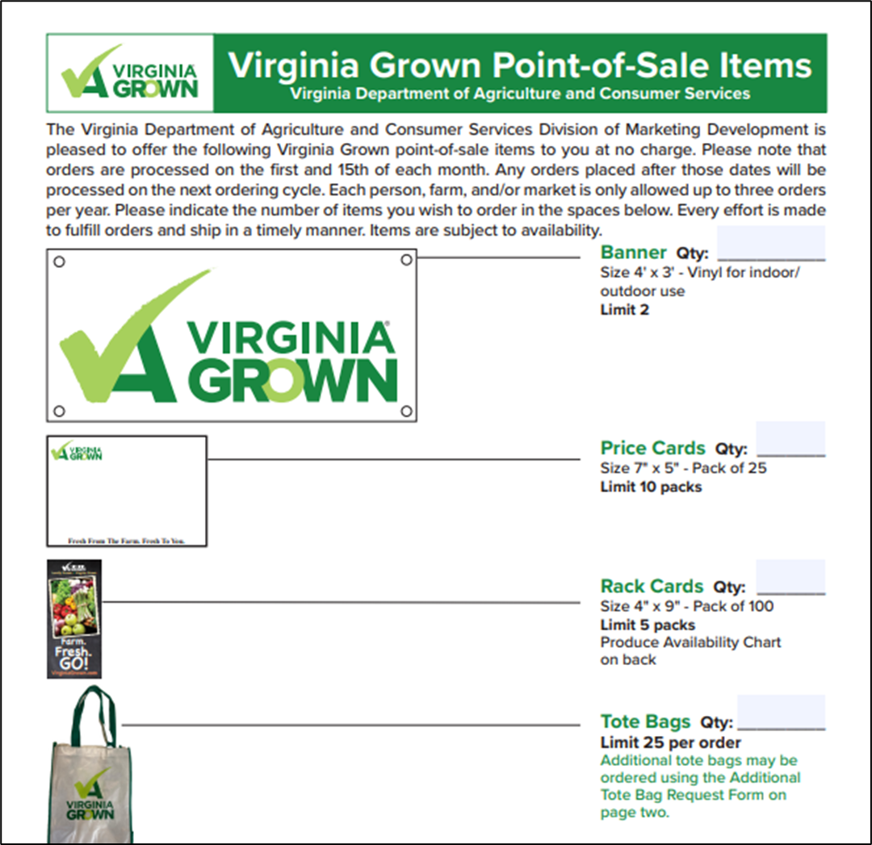
Virginia Grown
Provide marketing materials for farmers to promote the sale of their produce
Fresh Fruit | Lumber
Fresh Vegetables | Aquaculture
Dairy, Meats and Eggs | CSA’s (Community Supported Agriculture)
Nursery Products | Farmers’ Markets
Christmas Trees and Seasonal Greenery | Farm Stands

Slide 7
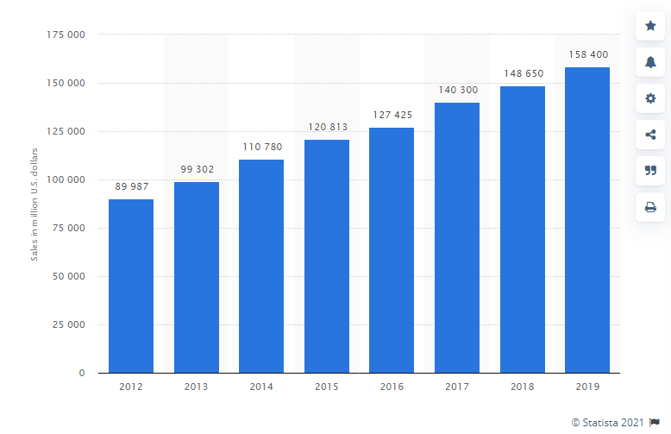
Virginia Finest Promoting Specialty & Farm Processed Foods
Virginia’s Finest -Since 1989.
Today, Virginia’s Finest helps contribute to total U.S. specialty food sales of $158.4-billion dollars, a record high according to the national specialty food trade association.
There are over 800 companies currently participating in the Virginia’s Finest program.
www.vafinest.com

Slide 8
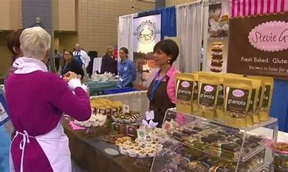
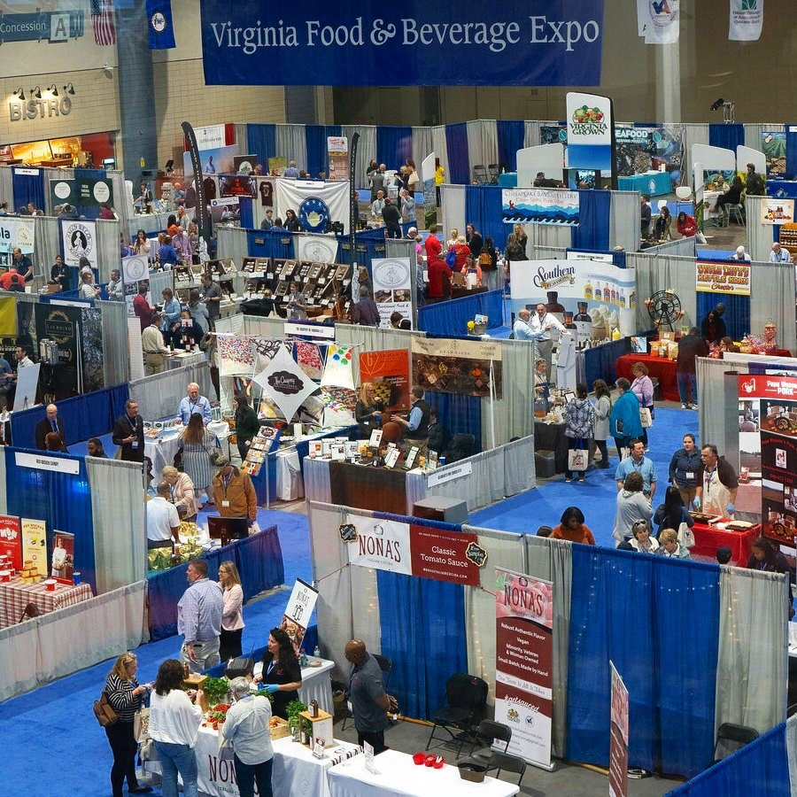
Virginia Finest Promoting Specialty & Farm Processed Foods
The VDACS Division of Marketing and Development helps market and promote Virginia’s Finest throughout the Commonwealth and around the world.
-HOW? Once a Virginia specialty crafted food or beverage company earns the Virginia’s Finest trademark, they can participate in a host of trade shows and special events throughout the year with our marketing and promotions team. Events such as…

Slide 9
2024 Virginia Food & Beverage Expo
March 27, 2024 – Richmond, VA
Greater Richmond Convention Center | 403 N 3rd St, Richmond, VA
The Expo showcases the specialty food and beverage industry in Virginia - those who make amazing products and those who want to help sell them in a retail setting.
You can either exhibit to get your product out there or attend to find Virginia made products to sell in your farm store.
www.vafoodbeverageexpo.com
**Now Featuring a Virginia Grown Pavilion**

Slide 10
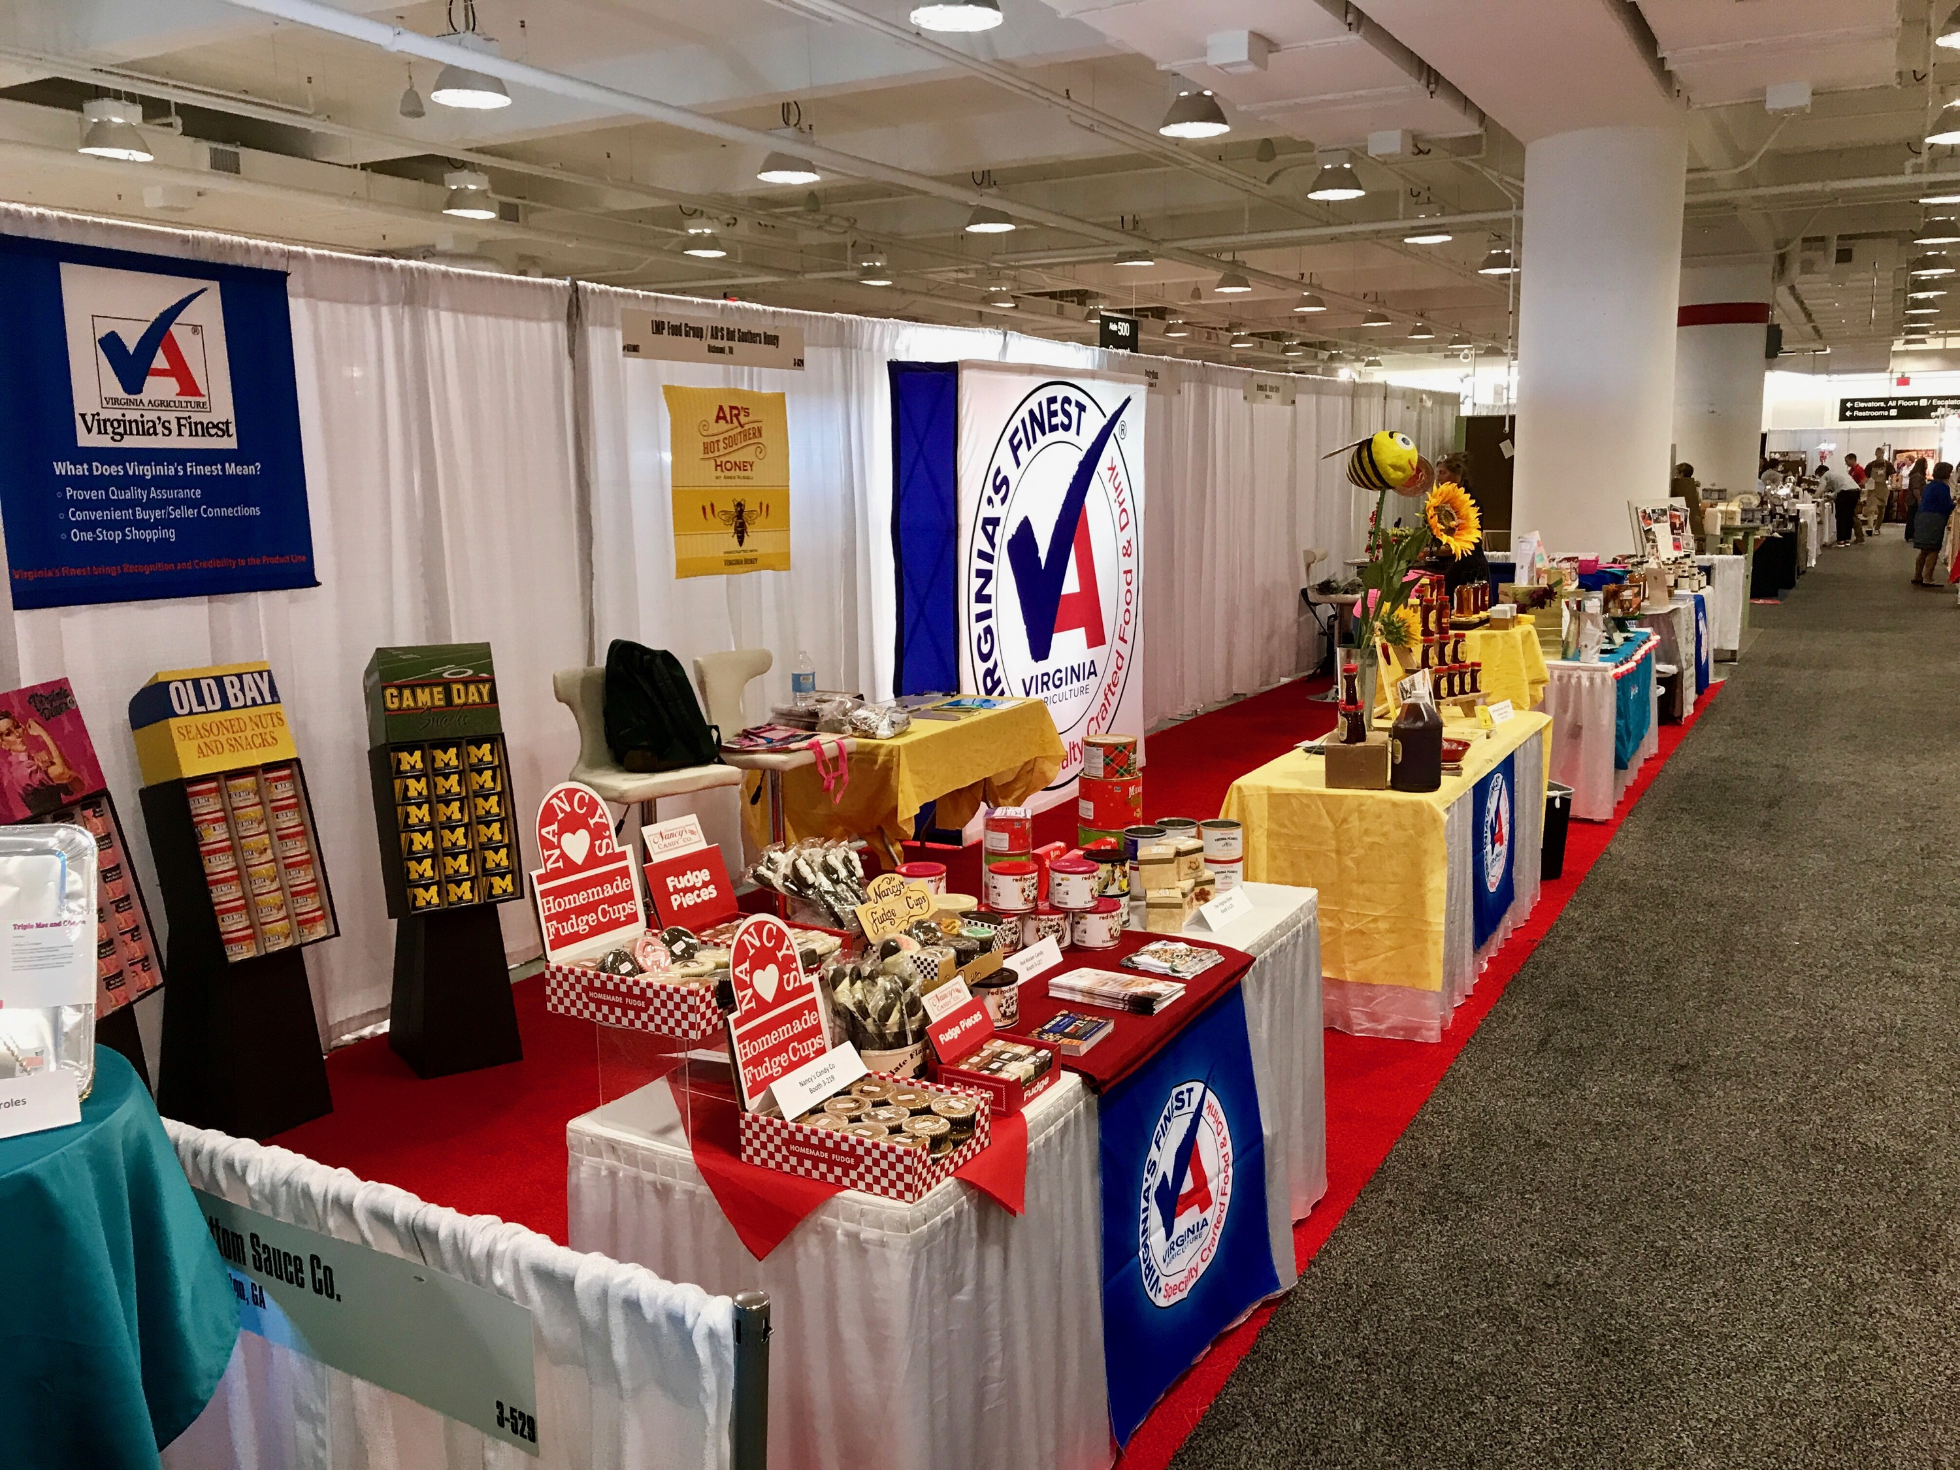
Virginia Finest Promoting Specialty & Farm Processed Foods
OTHER NOTABLE ANNUAL ACTIVITIES FOR VIRGINIA’S FINEST
* State Fair of Virginia * Virginia Wineries Association * Taste of Richmond Holiday with Richmond Times-Dispatch * * Virginia Farm Bureau Convention * Virginia Living & Distinction Holiday Magazines * Virginia Retail Merchants Association * * Virginia Agribusiness Council Reception * Southern Women’s Show * Fire, Flour & Fork * * Virginia’s Finest Educational Conference * Various Special & Trade Events *

Slide 11
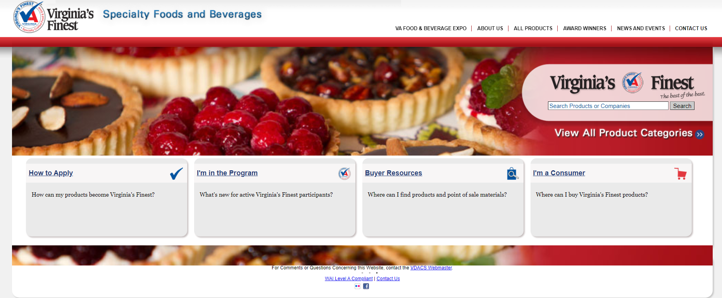
How to Become Virginia’s Finest
Complete Application
Provide Product Labels
Get inspected by VDACS Food Safety
May have to provide formulations *

Slide 12
Virginia’s Senior Farmers Market Nutrition Program (SFMNP), also known as Farm Market Fresh.
Administered through The Division for Aging and Rehabilitative Services (DARS)
VDACS supports the program with field and market visits.
Terms -
One-time benefit of $50 in checks to approved participants over the age of 60.
Checks can be spent at participating farmers markets to purchase fresh fruits, vegetables, and cut herbs from June 1 through November 18, 2024.
All Produce must be grown on approved farm – not purchased and re-sold!!!
New for 2024!! Direct Deposit…..no more coupons….well, they are phasing them out

Slide 13
Approved Farmer’s Markets on the Eastern Shore & Virginia Beach:
City of Virginia Beach Farmers Market
Old Beach Farmers Market
Chincoteague Farmers Market
Onancock Farmers Market
Parksley Farmers Market (Taste of Eden Produce)
Approved Roadside Stands on the Eastern Shore & Virginia Beach:
Pickett’s Harbor Farms (Capeville)
Painter Farm Market (Painter Light)
Hopeland Gardens (Modest Town)
Copper Cricket Farm (Machipongo)
Baines Farm Market (Machipongo)

Slide 14
Homegrown by Heroes
*Launched in 2017 *Partnership between VDACS, Virginia Grown and the Farmer Veteran Coalition *Support Virginia veteran farmers *Allows veterans to market their local agricultural products as veteran produced

Slide 15
Homegrown by Heroes
To be a member of the Homegrown by Heroes Virginia Grown program:
Register for Virginia Grown
Register for membership with the Farmers Veteran Coalition
https://farmvetco.org/membership/
Membership is Free
Certify your products through the Homegrown by Heroes program
http://www.farmvetco.org/homegrown-by-heroes/
Provide the certificate information to the Virginia Grown program to receive the Homegrown by Heroes Virginia Grown designation

Slide 16
The Association of Eastern Virginia Agricultural Producers, Inc.
Formerly The Association of Virginia Potato & Vegetable Producers
Goals:
Provide monetary and grant letter support for research on vegetable crops at the Eastern Shore AREC
Financially support educational programming aimed at small farmers and traditional farms
Advocate for a diversity of crops on a local and state level
Does this effect me as a small farmer??? - YES!!
Issues such as zoning, food safety concerns, equipment/land tax, etc. have all been advocated for by The Association
Having a voice as a group is largely beneficial for state level politicians to take notice
Create community awareness of agricultural practices and businesses that are members of The Association
Please join today – It’s only $50 annually....application in workshop packet

Slide 17
The Association of Eastern Virginia Agricultural Producers, Inc.
Formerly The Association of Virginia Potato & Vegetable Producers
2024 Projects:
Create Aquaculture Buying Guide for Local Chefs
Re-print the Eastern Shore Sweet Potato Cookbook for sale at farm stands and local stores (small farm oriented)
Videography for social media promotion of local produce
Establish/Build Association Website
Establish an online payment system for dues collection
Please join today – It’s only $50 annually....application in workshop packet

Slide 18
Moving into 2024……
ODMP Staff Goals:
ODMP staff will return to tradeshows SEPC and IFPA with Virginia companies
Working on developing the new Virginia Grown tiered program that will recognize various levels of GAP certification and environmental and sustainability practices.
Revamping of the Virginia Grown website and database (first half of 2024)
Expanding the Virginia Grown pavilion at the Virginia Specialty Food and Beverage Expo in March of 2024
Approximately 2,000 buyers to connect VA Grown Producers
Eastern Shore & VA Beach ODMP Staff Goals:
Work with growers to achieve GAP and FSMA certifications
Manage the Virginia Potato Board Projects
Manage The Association Projects
Work with both larger farmers and small farmers throughout the state to mitigate issues and monitor crop progress throughout the growing season
Monitor SFMNP participants
Attend SEPC and IFPA with Virginia Companies

Slide 19
Thank You!!
Ursula Tankard Deitch
Marketing Specialist – Office of Domestic Marketing & Promotions
Cell: 757-387-7670
Ursula.deitch@vdacs.virginia.gov

